Slide 1
Joint Organisational Learning Workshop with JOL Online
Introduction and showcase for the new lessons and notable practice sharing application

Slide 2
Who we are
Teresa Railton – Zeal Solutions
Brian Welsh – JESIP
Ben Platt – Cabinet Office
Notes:
Teresa Railton is the project Manager from Zeal Solutions. Feedback from the workshops is collated and discussed with the developers to ensure that appropriate changes are made.
Brian Welsh is the JESIP senior user on behalf of the Fire Service and is the JESIP lead for Joint Organisational Learning
Ben Platt is the Cabinet Office and cross Government lead for organisational learning across all resilience partners under the Civil Contingencies Act.

Slide 3
Agenda
Background – how we got here
We asked, you said, we did
JOL and LD Transition
Key changes to JOL Guidance
New JOL Online platform (Merging two systems in to one)
Phase 1
Phase 2
Secretariat and its responsibilities
Debriefs
Feedback
Notes:
The topics covered in this presentation are laid out in brief in the agenda.
Background – the concept behind JESIP, the Government requirement for joint organisational learning and the broadening of interoperability to include all resilience partners under the Civil Contingencies Act
We asked you said, we did - An overview of the feedback received from the use of the previous two systems (JOL and LD) and how we have implemented solutions to the new system.
JOL and LD Transition – the actions and working groups that have been set up to effectively transition between the old system and governance to the new, enhanced version. This includes the bringing together of JOL and LD in to a single system, the governance that ensure that all lessons, where appropriate are captured and reflected from single agency lessons systems (NPoCC, LID, NOG) on to JOL Online and vice versa.
Key Changes to JOL Guidance – An overview of the changes to the governance and digital systems.
New JOL online platform – The release of JOL Online has deliberately rolled out in two phases. In short this allows the users to see the new system with enhanced functionality as well as allowing feedback from the workshops to be incorporated in phase 2.
Secretariat and its responsibilities – In addition to the JOL Online digital platform there is a well established governance structure that serves to impact assess all lessons submitted on to the system. Through impact assessment, if the secretariat, made up of representatives from your organisations, deem the lesson to be of a significant impact or frequency it will be escalated to the Interoperability board who will ensure that the lesson action is taken by the relevant organisation. (e.g. Lead government departments for capabilities, LGA/DCLG, risk owners, emergency service representatives etc)
Debriefs – detail on templates that have been created to enable users to capture interoperability/single agency lessons and notable practice from debriefs.
Feedback – an opportunity to provide feedback on all elemets of the JOL Online system and structures.

Slide 4
Why Joint Organisational Learning
The Civil Contingencies Act 2004 places requirements, through Local Resilience Forums that Category 1 responders must collectively:
Learn and implement lessons from exercises
Share lessons learned from emergencies and exercises in other parts of the UK
Make sure that those lessons are acted on to improve local arrangements
The key message to responder agencies is that JOL is not about “who” but about “what” and “why”.
Notes:
Why Joint Organisational Learning
This slide provides a useful over view of the obligations under the Civil Contingencies Act (2004) for responder agencies to not only learn and implement their own lessons but to share these lessons appropriately in order for others to learn.
Emphasis is made on lessons shared that they should focus on the “what” and the “why” rather than “who”. All lessons submitted on JOL Online should focus on the route cause of the lesson rather than who was potentially at fault.

Slide 5
Background – How we got here
JESIP so far
JOL Launched July 2015
LessonDirect (LD) launched August 2015
JOL overview
237 lessons identified and analysed by the JESIP team
64 notable practice submissions published
LD Over view
40 lessons identified and analysed by Cabinet Office and DCLG
15 notable practice submissions published
Notes:
Background – How we got here.
The Joint Emergency Services Interoperability Programme (JESIP) was set up in order to enhance the way that emergency services trained, exercised and responded to major emergencies.
The “Programme” was changed to “principles” in order for interoperability to continue to be embedded within the emergency services whilst enabling all resilience practitioners to adopt the principles to bring consistency and cross sector understanding to multiagency working.
As part of JESIP working the Home Office commissioned an HMIC tri-service review to understand how embedded JESIP was within all emergency services across the country. One of the key areas for further work was the ability for sharing and learning from lessons identified. The recommendations from HMIC formed part of the drive to enable all resilience practitioners to effectively capture and share lessons from all elements of resilience working.
This along with scope already built in to JESIP and Cabinet Office objectives for interoperability informed policy of JOL Online.
Since its launch in July 2015 JOL had 237 lessons and 64 notable practices
Since its launch in August 2015 Lessons Direct captured 40 lessons and 15 notable practices

Slide 6
Cross Sector buy-in
Lead Government Department - Capability Risk owners
Local Resilience Forum – Constituent organisations
Organisation responsibilities – Home Office, Department of Health
Military
Utilities Companies – Only relevant information is shared with Utilities.
Voluntary sector organisations
Academic institutions
Notes:
Cross Sector buy-in
Appetite for learning has increased partly due to frequency of recent events but mainly due to Government and resilience partners seeing the real value in learning from each other and capturing lessons from a national experience base.
As JOL Online ensures that all capability and risk owners will have sight of lessons associated with their work streams policy, training and thinking is being influenced by resilience practitioners across the country.
The new system has been designed that all Category 1 and 2 responders, the voluntary sector and the military will have sight of lessons and notable practice which is pertinent. This has been developed to ensure that only recognised bodies have full access to the information being shared whilst having fuctionaoity so that lessons from other organisations can be shared where appropriate.

Slide 7
We asked, you said, we did
You Said | We Did | Status
Broaden categories – the categories listed are too specific and don’t allow for subtleties of org arrangements. | Broader categories added to allow for organisational differences. | Complete.
Stipulate which org, if known, the LI or NP applies. | Function added | Complete
Allow more than one capability to be associated with the LI/NP | Function changed | Complete
Date clarification – specific request that the date entered applies to the first of the event. | Clarity provided | Complete
More detailed definition of LI/NP. | Clarity provided | Complete
Documentation - consent to publish. | In development | In progress
Synopsis of LI/NP on published responses page. | In development | In progress
Complete
Notes:
We asked, you said, we did.
This slide provides and over view of the feedback that we received from users on the previous systems and how solutions have been applied to JOL Online.

Slide 8
We asked, you said, we did
You Said | We Did | Status
Change the format of the published results to enhance information retrieval. | The current system does not allow changes to be made to this section. | Currently Impossible
Multiple LI/NP be submitted in the same session. | The current system does not allow this through skip logic. | Currently Impossible
Add a link in the consultation that takes you back to RD. | Due to the positioning of the consultation this is not possible. A solution has been identified through new tabs. | Currently Impossible
Complete
Notes:
We asked, you said, we did.
This slide provides and over view of the feedback that we received from users on the previous systems and how solutions have been applied to JOL Online.

Slide 9
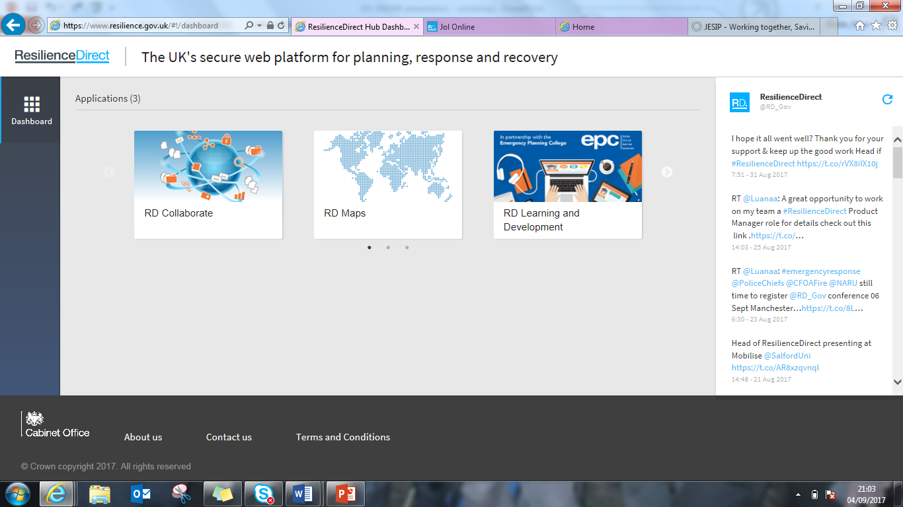
Single Sign on
Notes:
Single Sign on
An emphasis on the bringing together of JOL and LD in to one, easy to use, single sign on system JOL Online.

Slide 10
JOL and LD Transition
JOL Transition workshop objectives
Continue to develop JOL Online with key stakeholders
Support current sector lessons systems and integration with JOL Online
NOL
LID
NPoCC
EPC
Strategic JOL seminars
Provide JOL options paper to the Interoperability Board (December 2017)
Approve JOL secretariat role and responsibilities (November 2017)
Appoint JOL Secretariat (January 2018)
HMIC FRS CQC review 2018 (JESIP and JOL)
Notes:
JOL transition – working group
This slide gives an overview of the strands of the JOL transition and the groups established to ensure that all relevant organisational bodies (NOL, LID, NPoCC, EPC, LGA and lead government departments) are fully involved in the ensuring that all lessons process are capture in the new governance process and digital platform. This will, where possible, avoid duplication and also share more widely with relevant partners.
Here are some of the people involved .
JESIP team
Carl Daniels
Brian Welsh
Chief Fire Officers Association (CFOA/NFCC)
DCFO Martin Blunden
AM Stewart Nicholson
National Police Chiefs Council (NPCC)
ACC Chris Shead
DI Frankie Westoby
Association of Ambulance Chief Executives (AACE)
Director/Ass Chief Keith Prior
National Coordinator Mark Norbury
Cabinet Office - Civil Contingencies Secretariat (CCS)
Ben Platt

Slide 11
Lessons capture and submission - previously
Emergency Service and Wider Responder Lessons
Interoperability Board
Decisions
Single sector/LRF lessons
Decisions
JOL
JOL
Secretariat
Secretariat
JOL input
Single sector/LRF lessons input
Notes:
Lessons capture and submission – previously
This slide shows the two processes for capturing lessons through single agency and through JOL.
The emphasis being that previously there was no standard, universally adopted mechanism for capturing interoperability (joint working).
This was the main driver for establishing organisational representatives in both systems to reflect lessons in both structures.

Slide 12
Lessons Capture and Submission - now
OPOC’s
Interoperability Board
JOL Action Note.
FRS
NOLUG
JOL
OPOC’s
Emergency Service and Responder Agencies Lessons
Police
NPoCC
Decisions
JOL
Ambulance
LID
Secretariat -
Coordinated by NARU
JOL
JOL
LRF
JOL
JOL ONLINE input
Notes:
Lessons capture and submission – now
This slide demonstrates where there is representation in both systems.
The points of contact who make organisational decisions in the single agency processes (NOLUG, NPoCC, LID, LRF constituent organisations) are the same people who make the joint organisational decisions in JOL Online.

Slide 13
Information Flow Generic (all) RD users JOL SPOCS
Lead Government departments
Closed Group
Moderation Panel
Other organisations
JOL SPOC
RD Generic User
RD Generic User
RD Generic User
Publish to all
Publish to Closes Group
Notes:
Information flow, Generic (all) RD users and JOL Spocs
This slide shows the information flow from both JOL Single Points of Contact as well as all other RD users.
Point of note. This system allows all RD account holders share lessons and notable practice. All Category 1 and 2 responders, the military and the voluntary sector. This message should be pushed out through LRF’s
The flow of information from users goes to the moderation secretariat. All lessons are moderated and impact assessed. If a lesson is deemed, through cross sector discussion, to be of a high impact or experienced frequently it will be escalated to the Interoperability board. (for further information on the interoperability board and its representatives visit the JESIP website)
Other lessons, not escalated and is of value to other organisations will be moderated to ensure that the lesson or notable practice is clear and then published on to Resilience Direct.

Slide 14
Key Changes to JOL Guidance
Lessons Identified:
The lesson identified may have an impact on responder agencies interoperability measured against JESIP principles;
The lesson identified may have a national impact;
The lesson identified may impact on your organisations national standards;
The lesson identified may impact on effectiveness of your sectors current national operational guidance, approved professional practice or doctrine;
The lesson identified may impact on effectiveness of current national resilience capabilities;
You want to share your lessons identified with other emergency responder agencies to promote learning;
The lesson identified is low impact but high frequency (trend).
This is not a definitive list and if organisations feel that a lesson should be recorded on JOL, they should do so.
Notable Practice
Activities that you have identified that may positively improve responders interoperability, measured against JESIP principles;
Activities that you have identified that may positively improve national resilience capabilities; Activities that have a positive impact on the normal activities of responder agencies
Responder agencies must embed within their local debrief processes the facility to capture lessons relating to interoperability between any organisations, the application of JESIP principles and national resilience capabilities.
Emphasis on debriefing
Scope
Governance
Secretariat
Impact assessment matrix
Glossary
Notes:
Key Changes to JOL Guidance
This slide has multiple layers and outlines key changes to debriefing tools and the embedding of interoperability in to all debriefs.
Reflections on scope changes are outlined.
Changes to the Governance structure that sits behind JOL Online.
The impact assessment which is used to process all lessons is available on the JOL Online guidance document.
Highlights from the new glossary have been pulled out. Definitions of Lessons Identifies and Notable Practice.

Slide 15
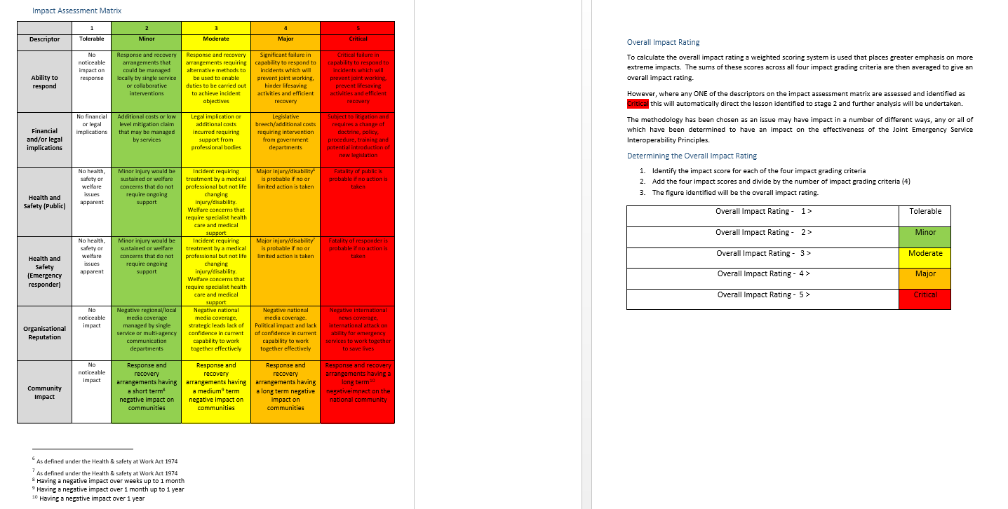
Impact Assessment Overview
Notes:
Impact Assessment
For full access to the impact assessment refer to the JOL Guidance.

Slide 16
Demonstration and walk through
Notes:
Demonstration and walkthrough.
The next few slides show screen shots of the steps to get access to JOL Online.
Talk to the slide about the system allowing users to create their own profile and tailor their interests (national risks, national capabilities and JESIP principles) which will allow them to receive alerts when any corresponding lesson or notable practice gets published on the system.
The route to JOL Online is RD login – click on the RD learning and development tile – click on JOL Online tile – click on the JOL Online link, this will take you to your system.
First time log in for users will ask them to personalise their accoungt to reflect their interests and outline their organisations details.

Slide 17
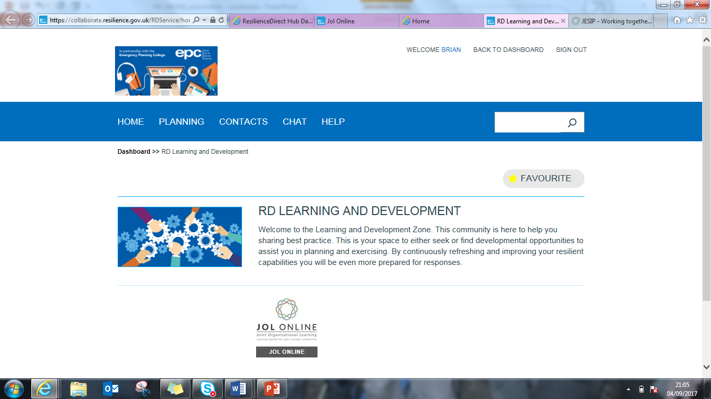
Demonstration and walk through

Slide 18
Demonstration and walk through

Slide 19
Demonstration and walk through
Ben
Platt
Ben.platt@cabinet-office.x.gsi.gov.uk
Cabinet Office
If you are a JOL Spoc check this box
This allows the secretariat to appropriately analyse user submissions
Notes:
This page will take the latest details for you from users ResilienceDirect Account. Check that these are correct and enter all of the risks that you are interested in, or are pertinent to your organisations risk profile. This will mean that whenever a lesson or a piece of notable practice is published that you will be alerted to it.

Slide 20
Demonstration and walk through
Notes:
This slide precedes the full, live system walk through and demonstration.

Slide 21
JOL Online Delivery Programme
Phase 1 -New JOL Online system
New look and feel
Personalised Dashboard for users to track their submissions
One system where all responders are able to share multi-agency and single agency lessons and notable practices.
Simple filtering process to search share Lessons and notable practices.
Phase 2 – New JOL Online System
Apply changes as a result of the Phase 1 Pilot
Free text search
Improved Analytics, reporting
SPoCs to have the ability to perform impact analysis within the system, escalate and allocation actions
User Profile – the ability to build their profile to receive chosen, preferred categories of Lessons and notable practices shared.
Heat map to demonstrate patterns/trends of lessons and notable practices share geographically
Notes:
JOL Online delivery programme
This slide gives an overview of functionality of phase one and the functionality due to be released as part of phase 2. (Dates for phase two are to be confirmed).

Slide 22
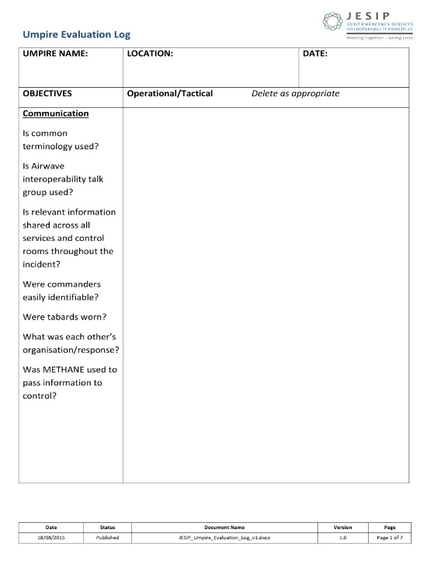
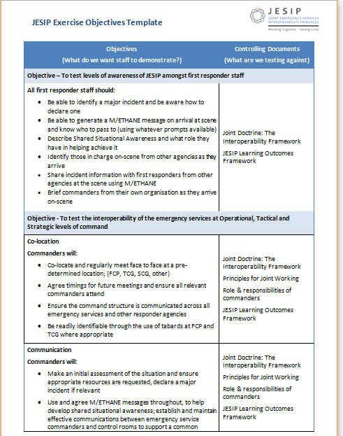
Capturing Lessons – Support tools
JESIP objectives should be at the core of EVERY multi-agency exercise
JOL templates aid capturing interoperability lessons
Debriefs must capture any interoperability lessons
Notes:
Capturing Lessons – Support tools.
This slide shows templates and tools created by JESIP to facilitate not only appropriate interoperability and single agency lessons but objectives that should be inserted in to development of training, exercising and debriefing.

Slide 23
The future of JOL Online
In the near future?
Experience = Value
Your experiences are invaluable for development
Welcome comments, suggestions and feedback
And beyond….
Experience = Value
The information gathered and shared relies on the quality of your experiences
Notes:
The future of JOL Online
The real value on this system relies on users experiences. User experience is at the heart of all lessons learning processes and JOL Online is no different.

Slide 24
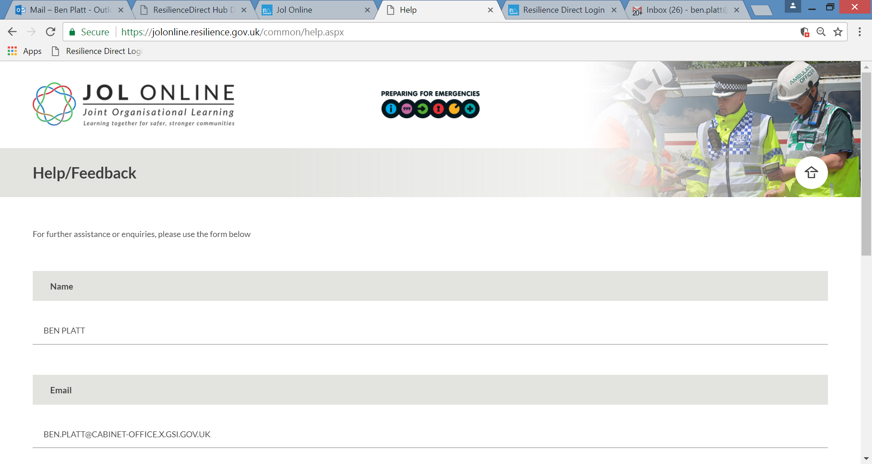
Feedback capture
Notes:
Feedback Capture
If you or attendees have comments, suggestions, questions or general feedback please submit this through the feedback form at the bottom of the JOL Online page.

Slide 25
Suggested Enhancements from Workshops
Printable/email drafts for authorisation
Primary risk descriptor
Ability to add information/solution to previous submission
Add links to professional bodies on the useful links page
Separate the published responses from the main dashboard
Other users to input possible solutions to your issue.
Triggers questions as to why you put this on JOL Online.
Centrally approved comms/letter to provide cross sector reassurance to use the system.
Notes:
A snap shot of recommendations that have come out of the workshop process.

Slide 26
Thank You
Any Questions?
contact@jesip.org.uk
ben.platt@cabinet-office.x.gsi.gov.uk

