Slide 1
Presenter Instructions Hide this slide before presenting
The following slides are provided for presenters from Category 1 & 2 responder organisations and partner agencies who may use them to update groups of staff or other interested parties.
The slides are mainly self-explanatory and carry core messages developed by the JESIP team. In addition some speaker notes are also provided on specific slides to give supplementary information.
We appreciate some presenters may wish to add additional slides to provide context for their audiences, but we request that the slides provided are not amended without consulting the JESIP team in advance.
Slides can be hidden from the presentation which means they will not display during a slide show. To hide or unhide slides, use the [Hide Slide] option on the Slide Show menu (MS PowerPoint 2010) or when viewing the presentation in slide sorter view, right mouse click on the slide you wish to hide and choose [Hide Slide] from the menu that appears.
Specifically, the presentation is designed so that slides 17-21 and 23-27 can be hidden to produce a shorter, higher level briefing, excluding the more detailed slides on the core principles and the decision making model. The presentation is designed to take approx. 30 minutes in full, or 20 minutes with these 10 slides excluded.
The slides have animation effects so that information appears in a way that helps the audience read the slide before the presenter moves to the next point. Please allow time for the animation effects to run to ensure the audience get the maximum benefit from the information provided.
A version of this presentation is available in an older format of MS PowerPoint if required and will be available from the JESIP website.
For any queries about the presentation, please contact the JESIP team on jesip@homeoffice.x.gsi.gov.uk or the Civil Contingencies Secretariat via toby.gould@cabinet-office.x.gsi.gov.uk.

Slide 2
JESIP Awareness Package
To provide awareness of the Joint Emergency Services Interoperability Programme for Category 1 and 2 responders and appropriate partner organisations
Notes:
This presentation is aimed at those working in Category 1 & 2 responder organisations and who may be involved in response to major incidents alongside the emergency services.

Slide 3
Contents
Introduction
Aim of this session
JESIP in context
JESIP overview
Hierarchy of guidance
Joint Decision Model
Implications for other responders
On-scene response
Wider response
Principles for interoperability
JESIP doctrine
Aim and purpose
Background and rationale
Programme outputs and benefits
Available training products
Notes:
Here is what we will cover.

Slide 4
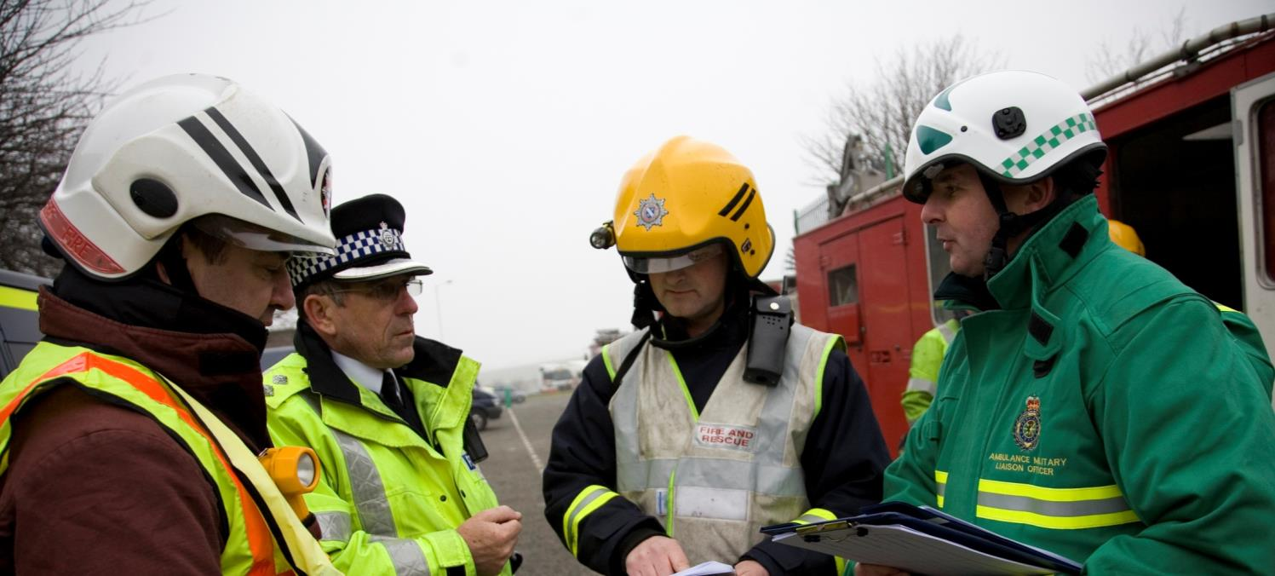
Introduction
Notes:
Introduction.

Slide 5
Aim of this session
To raise awareness of the Joint Doctrine, other JESIP outputs, and the implications for category 1 and 2 responders and their partner organisations
JESIP is focussed on the interoperability of the police, fire and ambulance services in the early stages of a major or complex incident.
However, the principles described in the Joint Doctrine are also applicable to the full range of emergency responders and can be applied to smaller scale incidents, wide-area emergencies, and pre-planned operations.
This package is designed to explain what JESIP means for wider responders working in partnership with emergency services.
Notes:
Here are the aims of this session.

Slide 6
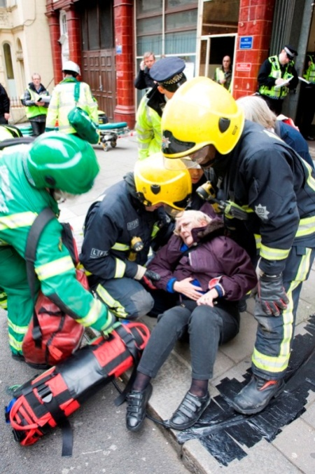
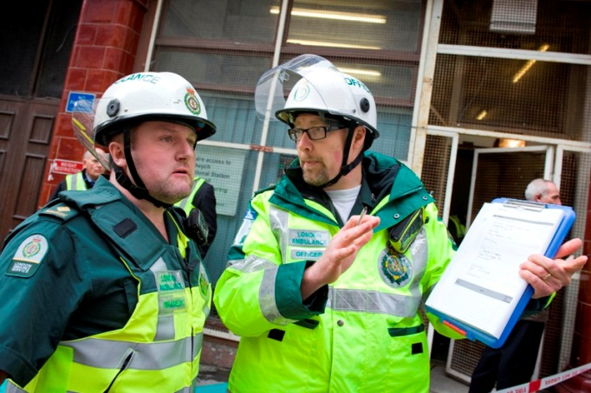
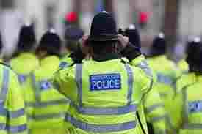
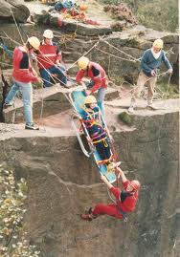
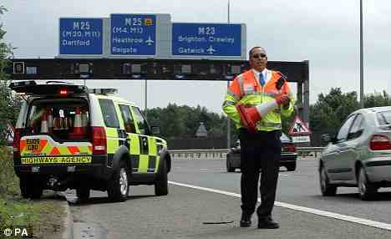
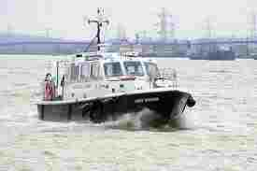
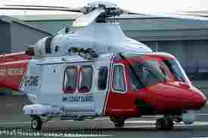
JESIP in context: emergency services & partners
Notes:
The Civil Contingencies Act establishes clear roles and responsibilities for those involved in emergency preparation and response.
The Act divides local responders into 2 categories.
Category 1 organisations – those at the core of the response to most emergencies – include the emergency services, local authorities, NHS bodies, Public Health England, the Environment Agency and the Maritime & Coastguard Agency.
Category 2 organisations – those that will be heavily involved in incidents that affect their own sector – include transport and utility companies and the Health & Safety Executive. The combined response effort of these organisations is often supported by the voluntary and private sectors, the Armed Forces and the community.
Emergency response is a multi-agency activity and the resolution of an emergency will usually involve collaboration between the emergency services and other Category 1 and 2 responders. JESIP does not aim to redefine multi-agency interoperability as only applicable to the blue light services. JESIP simply aims to improve how the police, fire and ambulance service work together at the scene of a major or complex incident as one part of the wider multi agency response effort.
The greater clarity that JESIP aims to bring to emergency services commanders at the scene will deliver a more coordinated and efficient command structure, and will make integration of the activities of wider responders easier and more beneficial for all.

Slide 7
JESIP training products
Police, fire and ambulance – commanders
Police, fire and ambulance – control rooms
Police, fire and ambulance – all front line staff
All category 1 and 2 responders and partner organisations
Pre-Course e-learning package
Operational command course 1 day
Tactical command course 1 day
Introduction to JESIP presentation
Control Room Supervisor package
Introduction to JESIP presentation
Operational staff e-learning package
Awareness package
Operational staff e-learning package (where relevant to role)
Notes:
The first three boxes show the JESIP products that have been developed for the emergency services. The final box in green shows the products available to Category 1 & 2 responders and partner organisations.
The JESIP Joint Doctrine forms the platform on which the JESIP training products are built. Training is a key part of ensuring the doctrine is understood by staff in police, fire and ambulance services as well as other partner organisations. JESIP has developed a range of training and awareness products for a variety of audiences. This awareness package being one.
At the heart of JESIP implementation is a series of one day classroom based training courses for emergency services operational and tactical commanders and for control room supervisors. To support the emergency services training, JESIP has established a network of approximately 350 licensed JESIP trainers. Only through joint training can the key element of interoperability be understood – the role, responsibilities and capabilities of others. The courses will therefore be run jointly in a tri-service training environment, i.e. trainers and students representing all three services on every training course.
The one day courses have been designed for an emergency services audience, however, other partners staff can be included in these courses where it is relevant to their role in relation to incident response. Observing or taking part in the emergency services courses should be discussed and arranged between other responders and emergency services on a local basis.
This is the most ambitious training initiative for the emergency response sector. In the region of 12,000 priority commanders and 1,500 control room supervisors will be trained by September 2014. It is estimated that overall, during 2014 to 2015, JESIP products will reach thousands of people who work to save people’s lives.

Slide 8
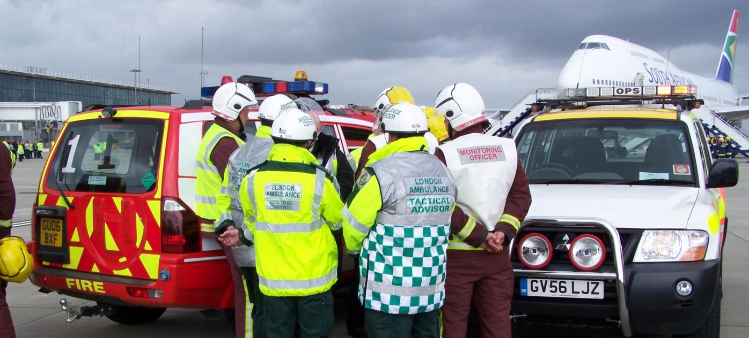
JESIP Overview
Notes:
Next is an overview of JESIP, why it was started and what it plans to do.

Slide 9
JESIP aim and purpose
Aim To ensure that the blue light services are trained and exercised to work together as effectively as possible at all levels of command in response to major or complex incidents so that as many lives as possible can be saved.
Purpose When the emergency services and partner organisations respond to major incidents, each organisation brings their own expertise to that situation.
JESIP aims to improve how police, fire and ambulance services work together at the incident scene by enhancing their understanding of each other’s expertise and ways of working.
Notes:
This is the aim and purpose for JESIP.

Slide 10
JESIP background & rationale
JESIP was set up in September 2012 at the request of the Home Secretary following a number of public enquiries which said better joint working between the three emergency services would enhance the collective ability to save lives and reduce harm.
JESIP is a two year national programme, staffed by representatives from the blue light services, which has the full support of Chief Officers and Government Departments; the Home Office, Cabinet Office, Department for Communities & Local Government and the Department of Health.
‘Although considerable progress has been made over the last six years, each organisation has accepted that there are lessons to be learnt from 7/7 and improvements to be made... However, despite substantial progress, there remains more that could and should be done.’
The Rt. Hon Lady Justice Hallett, Coroner’s Inquests into the London Bombings of 7 July 2005
Notes:
[After reading the text on slide add:]
The UK’s emergency services are admired and respected all around the world for the excellent service they provide. They each provide a different and distinct service, but collectively they work to protect the public and to keep our country safe and secure.
Whilst it is recognised our emergency services do an excellent job, some areas have been identified as needing improvement. JESIP was established to address the recommendations and findings from a number of reviews of major incidents and emergencies. Those reviews made it clear the emergency services carry out their roles efficiently and professionally, however, some common themes emerged providing clear reasons for improved joint working.

Slide 11
JESIP background & rationale
1987
King’s Cross Fire
Difficulties of understanding the risks posed by the incident, particularly to the public, and the complexity of the environment.
2005
7/7 Bombings
Difficulties in identifying scene locations, hazard assessment and location of rendezvous points and command posts
2007
Floods
Difficulties in understanding the infrastructure under threat and the scale and combination of resources deployed
2010
Cumbria Shootings
Communications failings between the police and ambulance caused priorities to be misunderstood.
Notes:
The findings from the King’s Cross Fire, 2005 bombings, 2007 floods and 2010 Cumbria shootings demonstrate a broad range of specific difficulties and failings.
JESIP has identified some common findings and areas where the emergency services need to improve. These findings have helped shape the programme and are strongly supported by the Pollock review of persistent lessons identified relating to interoperability from emergencies and major incidents since 1986 which considered the results of 32 separate inquiries spanning a wide range of incidents.
Some common key findings:
Challenges with initial command, control and coordination on arrival at scene.
A requirement for common joint operational and command procedures.
Role of others, especially specialist resources and the reasons for their deployment, not well understood between services.
Barriers and misunderstandings when sharing incident information.
Differing risk thresholds not understood.
Difficulties with communication between control rooms and the incident scene.
Issues with the use of radio communications.
Acronyms, jargon and differing call signs hampering communications.

Slide 12
JESIP will provide
Interoperability joint doctrine
Training
Testing & exercising
A core framework to enable effective interoperability - extensively embedded and consistently applied
Supplementary
JESIP legacy
Operational and tactical command training
Continuation training for all front line staff and wider responders (e-learning and classroom)
Control room training
JESIP training validation exercises
National interoperability governance arrangements
Police on-scene commander tabards
Organisational learning arrangements with robust oversight to ensure lessons from exercises and emergencies are fully implemented
Tri-service mobilisation procedures between national coordination centres
A regular standard Airwave test regime for operational commanders
Notes:
Here is what JESIP has produced as part of meeting its aim.
[Read from the slide]

Slide 13
JESIP key benefits
JESIP will provide the framework for an effective and consistent joint response to incidents, wherever they may take place.
Declaration of major or complex incidents, sharing of information and mobilisation will be more efficient, supported by a common language, terminology and approach.
Emergency services personnel will better understand the capabilities of their peers and will be competent in jointly establishing situational awareness, understanding of risk and the use of command decision models.
Effective governance structure & organisational learning for interoperability
Consistent application of doctrine to support joint working
Enhanced understanding of guidance, roles, responsibilities & capabilities
Better coordinated deployment of resources at major incidents
Interoperability
Improved use of mobile communications
Joint situational awareness, understanding of risk & decision making
Notes:
JESIP will deliver a number of benefits in its mission to ensure more lives are saved by emergency services and wider responders working together.
[Read text on slide]
For the first time, JESIP will have established a national standard in the way the emergency services manage major incident response.

Slide 14
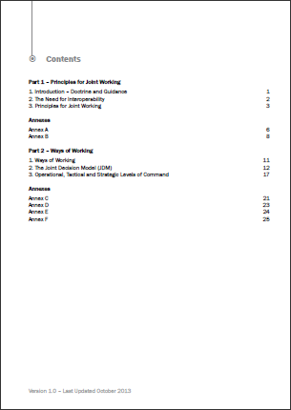
JESIP Doctrine
Contents
Part 1: Principles for joint working
Part 2: Ways of working
The Joint Decision Model
Annexes:
Common terminology and map symbology
Operational, Tactical and Strategic Commander roles and responsibilities
Notes:
Joint doctrine: the interoperability framework provides specific guidance to police, fire and ambulance commanders on the principles for effective joint working at major or complex incidents. It also provides other responder organisations an understanding of joint police, fire and ambulance operations.
The joint doctrine sets out what front line staff should do and how they should do it in a multi-agency working environment, in order to achieve the degree of interoperability that is essential to joint response. It provides commanders, at the scene and elsewhere, with generic guidance on what actions they should undertake when responding to major and complex incidents, and the principles are equally relevant to day-to-day joint operations.
It does not constitute a set of rules to be applied without thought, but rather seeks to guide, explain and inform.

Slide 15
Hierarchy of guidance
Civil Contingencies Act
Emergency Preparedness and
Emergency Response & Recovery
Joint Doctrine: the interoperability framework
Specialist e.g. CBRNe
Single service materials
Joint SOPs and aide memoires
LAW
GUIDANCE
JESIP
SUBSIDIARY
Notes:
The joint doctrine has been introduced as an essential element in the hierarchy of guidance shown above. It is subordinate to the Civil Contingencies Act and supporting guidance – in particular ‘Emergency Response & Recovery, chapter 4: Responding to Emergencies’ which describes the framework to manage the local multi-agency response to emergencies.
The joint doctrine should be reflected consistently within individual organisation’s guidance, instructions to their personnel and in training.
Separate publications set out specialist ways of working that will apply in specific circumstances such as Chemical, Biological, Radiological and Nuclear (CBRN) incidents or Marauding Terrorist Firearms Attacks (MTFA). Where necessary, these specialist response documents will also reflect the generic guidance contained within the joint doctrine.

Slide 16
Principles for interoperability
Five key principles
The Joint Doctrine sets out five principles which must be applied by responders when they are determining an appropriate course of action in the response to and co-ordination of an emergency.
Co-location
Co-ordination
Joint understanding of risk
Communication
Shared situational awareness
At the scene, the expected sequence of actions to follow these principles would comprise the first meeting of police, fire and ambulance commanders (co-location); a joint assessment of the situation and prevailing risks (communication, joint understanding of risk and shared situational awareness); and a co-ordinated plan for action.
Notes:
The public expects that the emergency services will work together, in order to preserve life and reduce harm at any emergency. The purpose of clear, simple principles is to help commanders to take action under pressure that will enable the achievement of successful outcomes.
This simplicity is of paramount importance in the early stages of an incident or emergency, when clear, robust decisions and actions need to be taken with minimum delay in an often rapidly changing environment.
The principles should be reflected in all joint or standard operating procedures for joint working in the response to and co-ordination of an emergency.

Slide 17
Principles for interoperability
Co-location
Co-location of operational commanders is essential and allows those commanders to perform the functions of command, control and co-ordination, face to face, at a single and easily identified location. This is known as the Forward Command Post (FCP), which is a location near to the scene, where the response is managed.
Co-location is also usually desirable for tactical and strategic levels of command. The decision to co-locate tactical or strategic levels of command will depend on where commanders can best maintain effective command of the incident. This includes consideration of effective joint working with other services and other factors such as access to their own organisations command and communications systems.
Co-location
Communication
Co-ordination
Joint understanding of risk
Shared situational awareness
Notes:
[Read information from slide]

Slide 18
Principles for interoperability
Communication
Communication is the passage of clear, unambiguous and timely information relevant to an emergency situation. Meaningful and effective communication underpins effective joint working.
The sharing of information, free of acronyms, across service boundaries is essential to operational success. This starts through pre-planning and between Control Rooms prior to deployment of resources.
The understanding of any information shared ensures the achievement of shared situational awareness which underpins the best possible outcomes of an incident.
Co-location
Co-ordination
Joint understanding of risk
Communication
Shared situational awareness
Notes:
The JESIP doctrine does not provide guidance on the technical solutions that are available to the emergency services. A technical solution already exists – Airwave – and is in widespread use by the emergency services and other responders. The replacement of Airwave is subject to a separate, cross-governmental and emergency service programme.

Slide 19
Principles for interoperability
Co-ordination
Co-ordination is defined as: The integration of multi-agency efforts and available capabilities, which may be interdependent, in order to achieve defined objectives.
Co-ordination involves the integration of the priorities, resources, decision making and response activities of each emergency service in order to avoid potential conflicts, prevent duplication of effort, minimise risk and promote successful outcomes.
Effective co-ordination generally requires one service to act in a lead capacity, this will frequently be the Police. In certain circumstances other agencies may be more appropriate, depending upon the nature of the emergency, the phase of the response and the capabilities required.
Co-location
Co-ordination
Joint understanding of risk
Communication
Shared situational awareness
Notes:
[Read information from slide]

Slide 20
Principles for interoperability
Joint understanding of risk
Risk arises from threats (malicious attacks) and/or hazards (accidents or natural events) which will be seen, understood and treated differently by each emergency service.
The joint understanding of risk is the process by which commanders work towards a common understanding of threats, hazards and the likelihood of them being realised, in order to inform decisions on deployments and risk control measures that are required.
This will include ensuring the safety of responders and mitigating the impact of risks to members of the public, infrastructure and the environment.
Co-location
Co-ordination
Joint understanding of risk
Communication
Shared situational awareness
Notes:
[Read information from slide]

Slide 21
Principles for interoperability
Shared situational awareness
Shared situational awareness is a common understanding of the circumstances and immediate consequences of the emergency, together with an appreciation of the available capabilities and emergency services’ priorities.
Achieving shared situational awareness is essential for effective interoperability in the emergency response and can be achieved by using the Joint Decision Model described later in this session.
Shared situational awareness relates not only to a common understanding between incident commanders, but also between control rooms and all tiers of the command structure.
Co-location
Co-ordination
Joint understanding of risk
Communication
Shared situational awareness
Notes:
[Read information from slide]

Slide 22
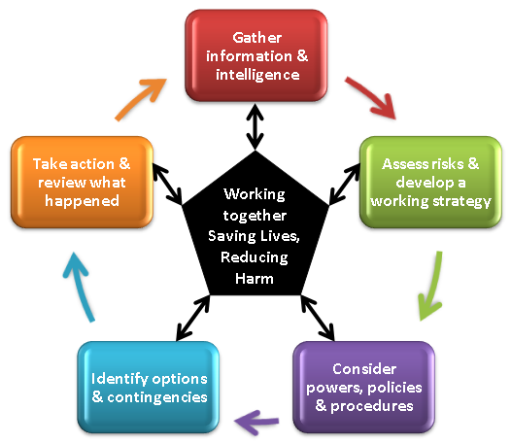
The Joint Decision Model (JDM)
The use of the JDM which includes the approach to establishing shared situational awareness and undertaking a joint assessment of risk, will enable efficient and effective joint working amongst responders and help determine their priorities for action.
Joint decisions must be made with reference to the primary aim of any emergency response: to save lives and reduce harm.
Notes:
One of the difficulties facing commanders from different organisations in a joint emergency response is how to bring together the available information, reconcile objectives and then make effective joint decisions. The JDM has been developed to enable this to happen.
In common with most decision models, the JDM is organised around three primary considerations:
Situation: what is happening, what are the impacts, what are the risks, what might happen and what is being done about it? Situational awareness is having an appropriate knowledge of these factors.
Direction: what end state is desired, what are the aims and objectives of the emergency response and what overarching values and priorities will inform and guide this?
Action: what needs to be decided and what needs to be done to resolve the situation and achieve the desired end state?
The JDM develops these considerations and sets out the various stages of how joint decisions should be reached.
One of the guiding principles of the JDM is that decision makers will use their judgement and experience in deciding what additional questions to ask and considerations to take into account, to reach a jointly agreed decision. They are therefore free to interpret the JDM for themselves, reasonably and according to the circumstances facing them at any given time. Strict adherence to the stepped process outlined in the JDM should always be secondary to achieving desired outcomes, particularly in time sensitive situations.

Slide 23
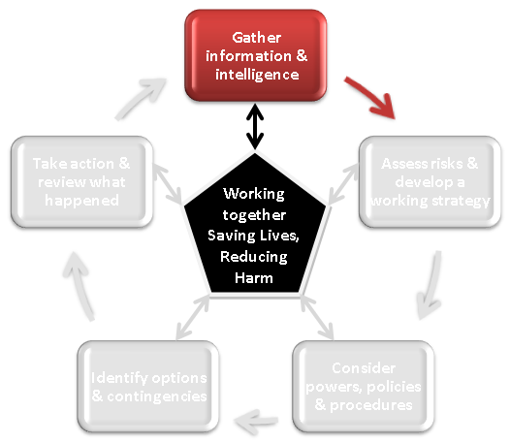
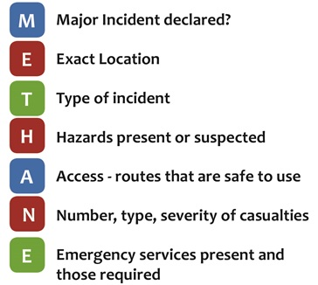
The Joint Decision Model (JDM)
No one service can appreciate all dimensions of a major or complex incident. Wider understanding requires communication between organisations.
METHANE should be used to pass information, to establish initial shared situational awareness:
Notes:
Meaningful communication between the emergency services and other emergency responders should be built upon agreed procedures to share the required information and the use of commonly understood terminology rather than service specific terminology or jargon where this may impede understanding.
Decision making in the context of an emergency, including decisions involving the sharing of information, does not remove the statutory obligations of agencies or individuals, but it is recognised that such decisions are made against an overriding priority to save life and reduce harm. The sharing of personal data and sensitive personal data (including police intelligence) requires further consideration before sharing across agencies and the JDM can be used as a tool to guide decision making on what to release and to whom.

Slide 24
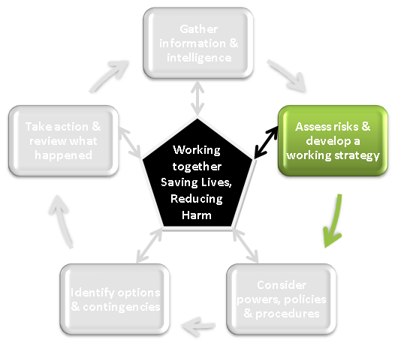
The Joint Decision Model (JDM)
Understanding risk is central to emergency response.
A key task for commanders is to build and maintain a common understanding of the full range of risks and the way that those risks may be increased, reduced or controlled by decisions made and subsequent actions taken.
In a major or complex incident the blue light services will have unique insights into risks and by sharing that knowledge, a common understanding can be established.
Notes:
The joint assessment of risk is the process by which commanders work towards a common understanding of threats, hazards and the likelihood of them being realised, in order to inform decisions on deployments and the risk control measures that are required.
Risk mitigation measures to be employed by individual services also need to be understood by the other responding organisations in order to ensure any potential for unintended consequences are identified in advance of activity commencing.
A joint assessment of the prevailing risks also limits the likelihood of any service following a course of action in which the other services are unable to participate. This, therefore, increases the operational effectiveness and efficiency of the response as well as the probability of a successful resolution of the incident.

Slide 25
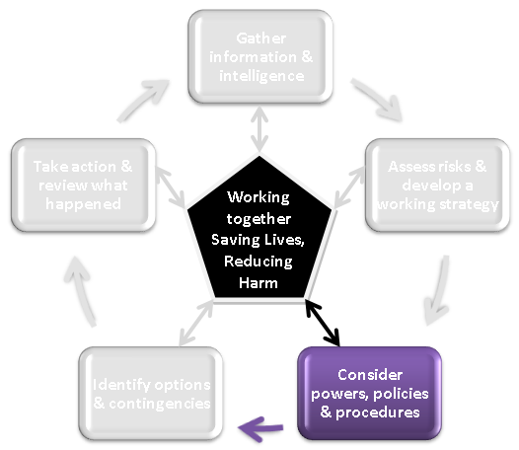
The Joint Decision Model (JDM)
Decision making in an emergency will be focussed on how to achieve the desired end state and there will always be various constraints and considerations that will shape how this is achieved.
Powers, policies and procedures relate to any relevant laws, operating procedures or policies that may impact on the desired response plan and the capabilities that are available to be deployed.
Notes:
Powers, policies and procedure may impact on how individual services will need to operate and co-operate in order to achieve the agreed aims and objectives.
In the context of a joint response, a common understanding of any relevant powers, policies, capabilities and procedures is essential in order that the activities of one service compliment and do not compromise, the approach of the other services.

Slide 26
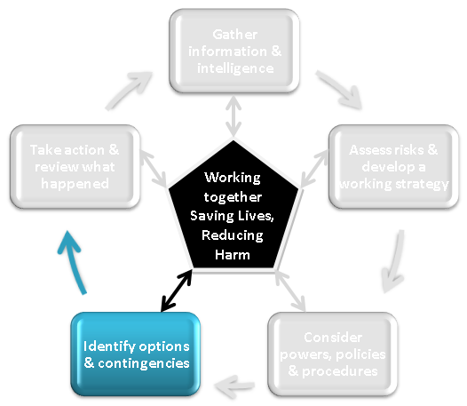
The Joint Decision Model (JDM)
There will usually be more than one option to achieve the desired end state and it is good practice that a range of options are identified and evaluated.
Any potential option or course of action should be evaluated with respect to:
Suitability – does it fit with the strategic direction?
Feasibility – in resource terms can it be done?
Acceptability – is it legal, morally defensible and justifiable?
Notes:
An option may include deploying resources, briefing the public (mainstream and social media) or developing a contingency or emergency plan. Whichever options are chosen, it is essential that commanders are clear what they are required to carry out and there should be clearly agreed procedures for communicating any decision to defer, abort or initiate a specific tactic.
Contingencies relate to events that may occur and the arrangements that are put in place to respond to them should they occur. For example, strong evidence may suggest that an emergency is being successfully managed and the impacts safely controlled, but there remains a likelihood that the situation could deteriorate with significant impacts. A contingency in this case may be to define measures to adjust the response should the situation deteriorate.

Slide 27
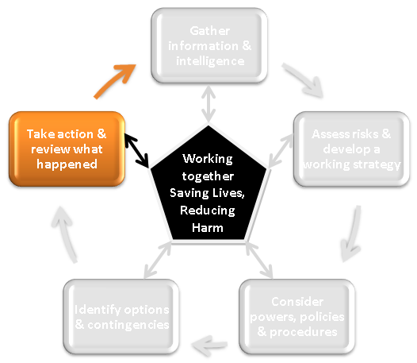
The Joint Decision Model (JDM)
Building situational awareness, setting direction and evaluating options all lead to taking the actions that are judged to be the most effective and efficient in resolving an emergency.
As the JDM is a continuous cycle, it is essential that the results of those actions are fed back into the first box – Gather and share information and intelligence.
This will, in turn, shape any revision to the direction, and the cycle continues.
Notes:
As with any learning or activity cycle, the final and important step is a review of what has happened so far and whether further action is needed.

Slide 28
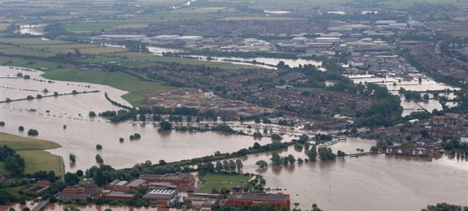
Implications for other responders
Notes:
So what does JESIP mean to other organisations who are involved in emergency response?

Slide 29
On-scene response
Essentially there will be no change to the way in which other responders interact with the emergency services at the incident scene.
The level, nature and timing of engagement with other responders will not alter.
Other responders should benefit from an improvement in how the emergency services work together at the scene. A better coordinated and more efficient command structure should make integration of the activities of wider responders easier and more beneficial for all.
Other responders attending the scene should be familiar with the principles for joint working, and aware of the Joint Decision Model so that they can engage in this process if required.
Co-location
Co-ordination
Joint understanding of risk
Communication
Shared situational awareness
Notes:
[Read from slide]

Slide 30
Wider response
JESIP is focussed on the on-scene response but also aims to improve the effectiveness of emergency service control rooms in responding to major incidents.
As with the improved on-scene response, this should make the integration of other responders activities more efficient, but the level, nature and timing of engagement with emergency service control rooms will not alter.
When communicating with control rooms, other responders should benefit from an increased level of awareness about the situation at the incident scene.
Other responders who engage with emergency services control rooms should be familiar with the use of METHANE for passing information, in the initial stages, to establish shared situational awareness.
Notes:
One of the most important aspects is that wider responders should become familiar with the method by which to share initial incident information. Use of the METHANE model will improve both the reporting and receiving of information in a consistent way.

Slide 31
What will follow JESIP?
Ensuring training continues and reaches all front line staff, and interoperability is embedded in how organisations respond to major incidents is paramount.
JESIP legacy arrangements, including a national governance structure for interoperability, will maintain momentum in four key areas:
Doctrine
Training
Testing & Exercising
Joint Organisational Learning
Continuing to embed the Joint Doctrine
Continuing to build strong foundations through training and CPD
Learning lessons from major incidents and exercises, and driving change
Systematically testing interoperability through local and national exercises
Notes:
JESIP will follow JESIP!
Whilst the two-year programme will formally end in the autumn 2014, and the JESIP team in its original form will disband, the training will continue, embedded in ‘business as usual’ for the emergency services and other responders.
The work JESIP has done so far in producing the doctrine, training and awareness products, and initiating arrangements for joint testing and exercising as well as organisational learning will live on.

Slide 32
Further Information
www.jesip.org.uk
jesip@homeoffice.x.gsi.gov.uk
Watch the JESIP film and review other programme materials
Submit your enquiries direct to the JESIP team
Local ownership & engagement
Read the latest news and see our diary of events
Talk to your local resilience partners about JESIP implementation in your area, including involvement in training and exercises
View information about the programme and meet the JESIP team
Download the Joint doctrine: the interoperability framework
Notes:
The JESIP website is regularly updated with the latest information from the programme team.
The JESIP team welcome enquiries to the team email address.

