Slide 1
Presenter Instructions Hide this slide before presenting
The following slides are provided for presenters from emergency services who may use them to update groups of staff with regard to interoperability and JESIP.
The slides are mainly self-explanatory and carry core messages developed by the JESIP team. In addition some speaker notes are also provided on specific slides to give supplementary information.
We appreciate some presenters may wish to add additional slides to provide context for their audiences, but we request that the slides provided are not amended without consulting the JESIP team in advance.
Slides can be hidden from the presentation which means they will not display during a slide show. To hide or unhide slides, use the [Hide Slide] option on the Slide Show menu (MS PowerPoint 2010) or when viewing the presentation in slide sorter view, right mouse click on the slide you wish to hide and choose [Hide Slide] from the menu that appears.
The slides have animation effects so that information appears in a way that helps the audience read the slide before the presenter moves to the next point. Please allow time for the animation effects to run to ensure the audience get the maximum benefit from the information provided.
This presentation has been generated using MS PowerPoint 2010. This may mean certain graphics or effects may not work in older versions of PowerPoint. A version of this presentation is available in an older format of MS PowerPoint if required and will be available from the JESIP website.
For any queries about the presentation, please contact the JESIP team on contact@jesip.org.uk

Slide 2
Introduction to Interoperability & JESIP
To improve understanding of interoperability and raise awareness of JESIP for staff working in emergency services
Notes:
This presentation is aimed at those working in emergency services who may be involved in response to major incidents and those staff that may support them. It aims to improve the understanding of the importance of interoperability between services and also introduce JESIP, the Joint Emergency Services Interoperability Programme.

Slide 3
Contents
Introduction
Aim of this session
What is Interoperability?
JESIP overview
What is the Joint Doctrine guidance?
Understanding the Joint Decision Model
Joint Doctrine - The Basics
JESIP doctrine
JESIP Vision & Aims
Why will it help?
Understanding major or complex incidents
Notes:
Here is what we will cover.

Slide 4
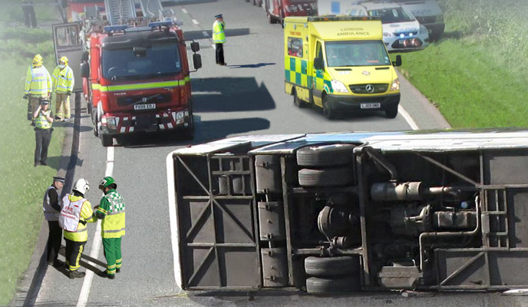
Introduction
Notes:
Introduction.

Slide 5
Aim of this session
To raise awareness of the importance of interoperability between services.
To introduce JESIP and help clarify the implications for staff working in emergency services
Notes:
The aims of this session are [read text on slide].

Slide 6
What is interoperability?
Interoperability is defined as the extent to which organisations can work together coherently as a matter of routine
Many services have local joint working arrangements in place but there is inconsistency across the country
Whilst it is recognised we have some of the best emergency services in the world, there is still room for improvement
Notes:
What is Interoperability? [read text]

Slide 7
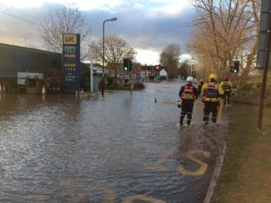
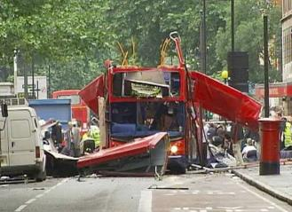
What is meant by a Major Incident?
A major incident for one service, may not be for another
Many services have their own definitions and classifications
In all cases each service needs to be informed if a major incident is declared
Overall a major incident is an emergency arising with or without warning that may cause death or injury. It is likely to cause serious disruption to a significant number of people and damage to property or the environment. It is likely to require the implementation of special arrangements.
Notes:
The presenter should explain the definition of a major incident, so they are aware of the scale of the incidents this awareness session is relating to.

Slide 8
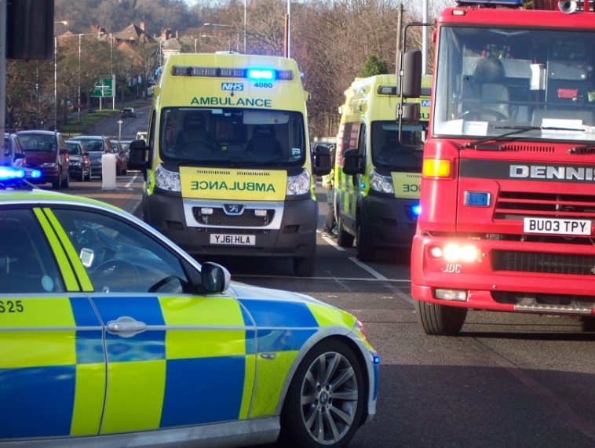
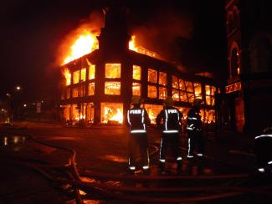
Roles of services at a major incident
Police services are responsible for upholding the law; ensuring the incident is under control as well as working to restore the situation to normal as quickly as possible.
Ambulance services are primarily concerned with the medical treatment of those involved in the incident, either at the scene or by getting them to hospital as quickly as possible.
Fire and rescue services are primarily focused on the rescue of people involved in the incident and making the area safe others including colleagues from police and ambulance to carry out their roles.
Notes:
At the scene of a major incident, the three services need to carry out their respective roles and they tend to have differing priorities. However, they need to be aware of the impact their actions have on others and of the priorities of their peers. What may be critically important to one service, may be much less important for another. It is this understanding about each other JESIP hopes to help services improve.
We need to improve they way in which we establish what is happening at the scene to ensure each service can carry out their role as quickly and effectively as possible. Each service has a different role to play but they should all complement each other and work together to provide the best response possible for the causalities involved.
The roles of each service in the context of a major incident are: [read text]

Slide 9
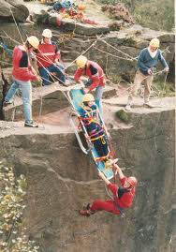
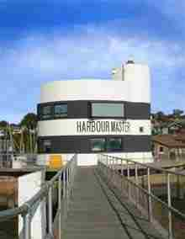
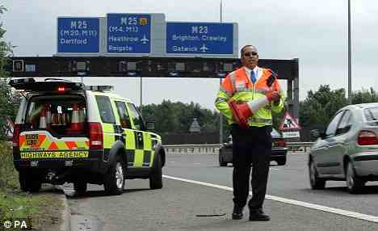
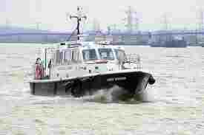
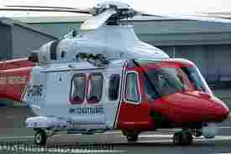
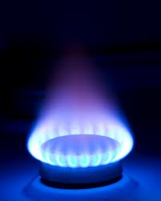
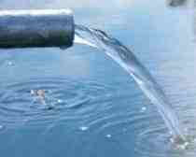
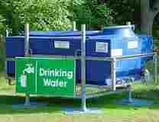
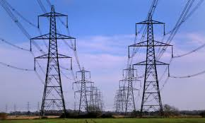
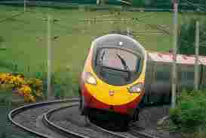
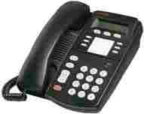
Many organisations can be involved
Depending on the nature of the incident any service may call on specialist resources such as flood response or rope rescue teams. In addition local authorities, utility and transport companies as well as private sector operators of critical infrastructure may be involved.
Whoever is involved, each organisation brings their own expertise to that situation.
All those involved all need to be included in communications about the incident as the actions of one organisation may affect another.
Notes:
Depending on the type and scale of an incident, many organisations can be involved.
Successful interoperability is when they can all work together to provide the public with the best emergency response possible.

Slide 10
The impact of social media
The increased use of social media has an impact on the response to major incidents
Pictures and videos of events can be shared rapidly by the public
This can inadvertently provide additional challenges for the Responders in charge of the incident
Notes:
[read text from slide]
Today, the public want to PLAY the role of the interactive audience and they use social networks and mobile technology, to share their thoughts, views and concerns on what they have witnessed. Social Media is immediate and allows organisations to proactively push out large volumes of useful and sometimes critical information to ever increasing numbers of people at the push of a button, ensuring there is no vacuum of official information.

Slide 11
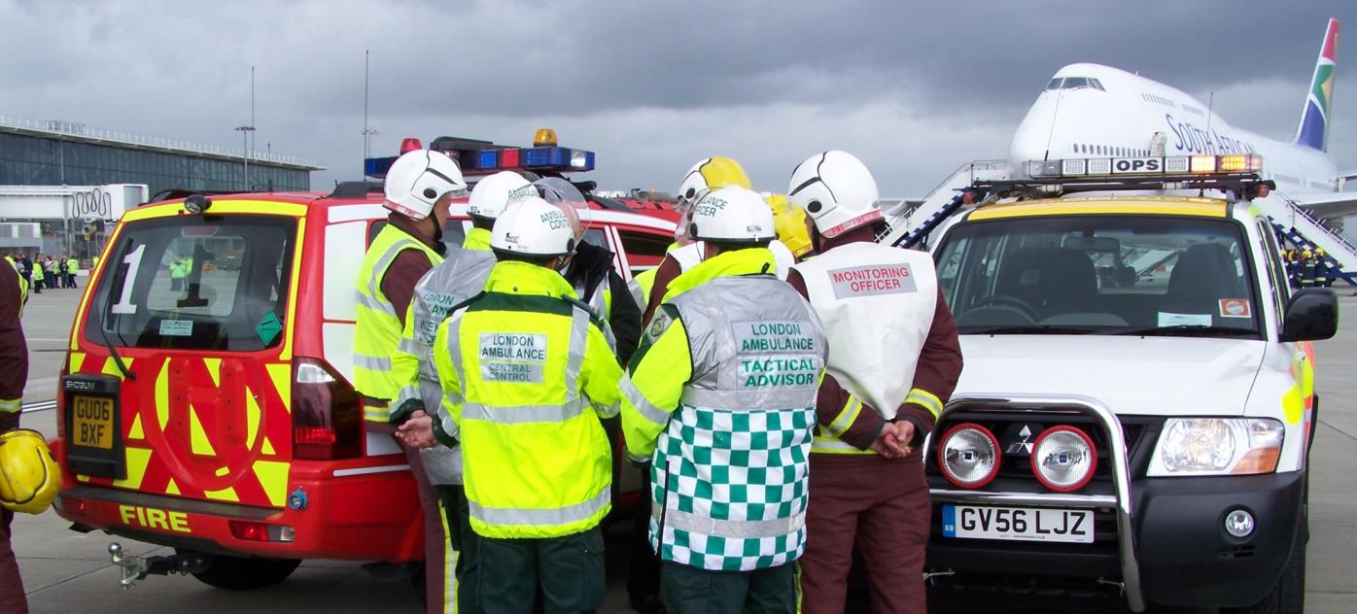
JESIP Overview
Notes:
Next is an overview of JESIP, why it was started and what it plans to do.

Slide 12
JESIP Vision
“Working Together – Saving Lives”
Aim of the Programme:
“To ensure that the blue light services are trained and exercised to work together as effectively as possible at all levels of command in response to major or complex incidents so that as many lives as possible can be saved”
Notes:
The JESIP vision and aim are [read text on slide]
This is why we are all here – to save as many lives as possible should disaster occur.

Slide 13
Why will JESIP help?
Provides a common way of working together with saving life and reducing harm at its core, underpinned by:
Generic roles and responsibilities
Key principles of interoperability
A single decision model for making joint decisions
A single model for the attainment of shared situational awareness
Notes:
The presenter should hand out the generic roles and responsibilities documents
Explain these are only for multi-agency incidents and not for when working single agency
Principles will be covered later in the presentation
The importance of having a single decision model helps responders understand the incident, the impact on each organisation and what they can jointly do about it.
METHANE provides a standard way of passing information between responders and control rooms and control room to control room.

Slide 14
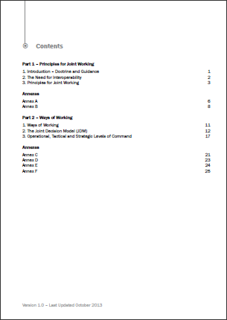
JESIP Doctrine - explained
Contents
Part 1: Principles for joint working
Part 2: Ways of working
The Joint Decision Model
Annexes:
Common terminology and map symbology
Operational, Tactical and Strategic Commander roles and responsibilities
Notes:
“Joint doctrine: the interoperability framework” is core guidance that sets the national standard. It provides specific guidance to police, fire and ambulance commanders on the principles for effective joint working at major or complex incidents. It also provides other responder organisations an understanding of joint police, fire and ambulance operations.
The joint doctrine sets out what front line staff should do and how they should do it in a multi-agency working environment, in order to achieve the degree of interoperability that is essential to joint response. It provides Responders, at the scene and elsewhere, with generic guidance on what actions they should undertake when responding to major and complex incidents, and the principles are equally relevant to day-to-day joint operations.
It does not constitute a set of rules to be applied without thought, but rather seeks to guide, explain and inform.

Slide 15
Principles for joint working
Five key principles
The Joint Doctrine sets out five principles which must be applied by responders when they are determining an appropriate course of action in the response to and co-ordination of an emergency.
Co-location
Co-ordination
Joint understanding of risk
Communication
Shared situational awareness
At the scene, the expected sequence of actions to follow these principles would comprise:
the first meeting of police, fire and ambulance responders (co-location);
a joint assessment of the situation and prevailing risks (communication, joint understanding of risk and shared situational awareness); and,
a co-ordinated plan for action.
Notes:
[Read slide text]
[text below for presenters - read before slide text]
The public expects that the emergency services will work together, in order to preserve life and reduce harm at any emergency. The purpose of clear, simple principles is to help Responders to take action under pressure that will enable the achievement of successful outcomes.
This simplicity is of paramount importance in the early stages of an incident or emergency, when clear, robust decisions and actions need to be taken with minimum delay in an often rapidly changing environment.
The principles should be reflected in all joint or standard operating procedures for joint working in the response to and co-ordination of an emergency.
Co-Location – Responders should identify who is in charge from the other services, this is made easier by the use of tabards. If you have access to a relevant tabard from your organisation then you should put this on.
Communication - The JESIP doctrine does not provide guidance on the technical solutions that are available to the emergency services. A technical solution already exists – Airwave – and is in widespread use by the emergency services and other responders. The replacement of Airwave is subject to a separate, cross-governmental and emergency service programme. The sharing of information, free of acronyms, across service boundaries is essential to operational success. The understanding of any information shared ensures the achievement of shared situational awareness which underpins the best possible outcomes of an incident.
Co-ordination - Involves joint decision making and response activities of each emergency service in order to avoid potential conflicts, prevent duplication of effort, minimise risk and promote successful outcomes.
Joint Understanding of Risk - This will include ensuring the safety of responders and mitigating the impact of risks to members of the public, infrastructure and the environment.
Shared Situational Awareness - Shared situational awareness (SSA) is a common understanding of the circumstances and immediate consequences of the emergency, together with an appreciation of the available capabilities and emergency services’ priorities. Using METHANE to pass information regarding the incident will help to ensure SSA, as will using the JDM for decision making amongst responders.
To learn more about the Five Principles please see the additional awareness package : JESIP Joint Doctrine – The Five Principles also available on the JESIP website and on YouTube.

Slide 16
Ways of Working
The five principles are part of the ways of working in the Joint Doctrine
They aim to help responders improve the initial incident response sometimes known as “the golden hour”
Notes:
The Joint Doctrine is built around the five principles which, if followed, will improve the initial incident response often called the golden hour.

Slide 17
Joint Decision Model
The Joint Decision Model (JDM)
A common model used nationally
To enable Responders to make effective decisions together
Notes:
The Joint Decision Model or JDM [read other bullets]
Again, all services train their staff in decision making techniques and have used differing models in the past. JESIP has taken the best from all models and instigated the use of a common Joint Decision Model.
All decision models perform the same or very similar functions but the fact that Responders on the scene in very rapidly changing circumstances will be using the same model, will improve how they make decisions and help plan the actions required more quickly.

Slide 18
Using the JDM
The JDM will help responders bring together available information, reconcile objectives and then make effective decisions together.
It is organised around three primary considerations:
Situation | Direction | Action
What is happening? What are the impacts? What are the risks? What might happen and what is being done about it? | What do you want/need to achieve in the first hour? What are the aims and objectives of the emergency response? What overarching values and priorities will inform and guide this? | What do you need to do to resolve the situation and achieve your desired outcomes.

Slide 19
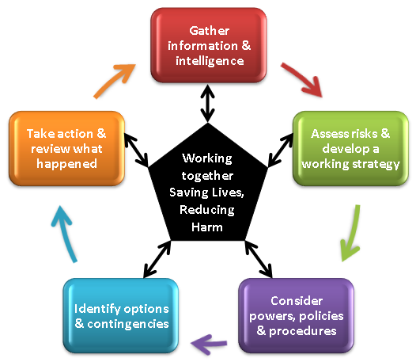
Understanding the JDM
Using the JDM will help to establish shared situational awareness and include Responders undertaking a joint assessment of risk and determine their priorities for action
The following slides explain each stage of the JDM
Notes:
One of the difficulties facing Responders from different organisations in a joint emergency response is how to bring together the available information, reconcile objectives and then make effective joint decisions. The JDM has been developed to enable this to happen.
In common with most decision models, the JDM is organised around three primary considerations:
Situation: what is happening, what are the impacts, what are the risks, what might happen and what is being done about it? Situational awareness is having an appropriate knowledge of these factors.
Direction: what end state is desired, what are the aims and objectives of the emergency response and what overarching values and priorities will inform and guide this?
Action: what needs to be decided and what needs to be done to resolve the situation and achieve the desired end state?
The JDM develops these considerations and sets out the various stages of how joint decisions should be reached.
One of the guiding principles of the JDM is that decision makers will use their judgement and experience in deciding what additional questions to ask and considerations to take into account, to reach a jointly agreed decision. They are therefore free to interpret the JDM for themselves, reasonably and according to the circumstances facing them at any given time. Strict adherence to the stepped process outlined in the JDM should always be secondary to achieving desired outcomes, particularly in time sensitive situations.

Slide 20
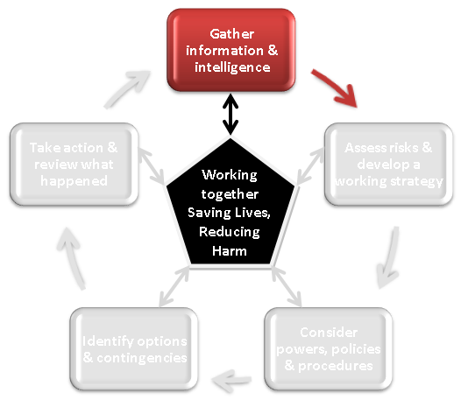
Stage One
What is happening?
What are the impacts?
What are the risks?
What might happen?
What is being done about it?
Notes:
The trainer should explain that situational awareness is having appropriate answers to the following questions: what is happening, what are the impacts, what are the risks, what might happen and what is being done about it?
In the context of the Joint Decision Model, shared situational awareness becomes critically important. Shared situational awareness is achieved by sharing information and understanding between the involved organisations to build a stronger, multi-dimensional understanding of events, their implications, associated risks and potential outcomes.
Responders cannot assume other emergency service personnel see things or say things in the same way, and a sustained effort is required to reach a common view and understanding of events, risks and their implications.

Slide 21
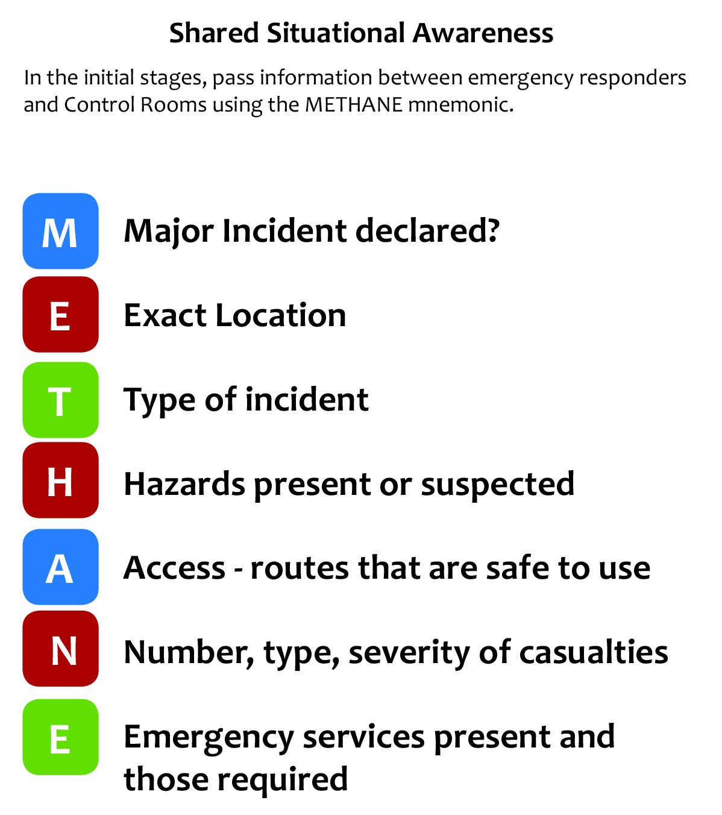
METHANE
To help with Stage One, a common method for passing incident information between services and their control rooms has been agreed
To learn more about METHANE, please access the All Staff e-learning package via the JESIP website.
Notes:
Another key component of the Joint Doctrine is a common model for passing incident information between services and their control rooms.
All services have used similar models for passing information in the past but JESIP has instigated the use of a common model which will mean information can be shared in a consistent way, quickly and easily, whoever the information is passing between.
Dependant on your role in your organisation, this is a model you may need to become familiar with. You can do this via the All Staff e-learning package available from the JESIP website.

Slide 22
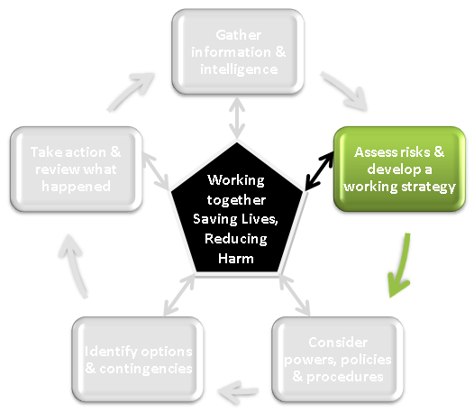
Stage Two
The different emergency services will have unique insights into the risks
By sharing that knowledge common understanding can be established
Considered in the context of the agreed priorities
Can inform a jointly agreed working strategy
Notes:
The trainer should explain that emphasis should be placed upon the importance of the first 60 minutes of response to a major incident, during which responder intervention is recognised to have the greatest impact on saving life.
Understanding risk is central to emergency response, and one of the major challenges in joint emergency response is for responders to build and maintain a common understanding of the full range of risks, and the way that those risks may be increased, or controlled by decisions made and actions taken by the emergency responders.
In a major or complex emergency the different emergency services will have unique insights into those risks, and by sharing that knowledge a common understanding of the various risks can be established, considered in the context of the agreed priorities and can inform a jointly agreed working strategy to resolve the incident.

Slide 23
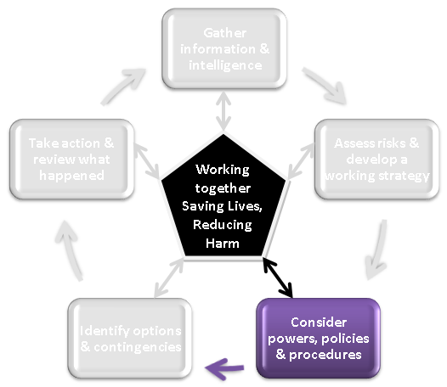
Stage Three
What relevant laws, standard operating procedures and policies apply?
How do these influence joint decisions?
How do they constrain joint decisions?
Notes:
The trainer should explain that in the context of a joint response, a common understanding of any relevant powers, policies, capabilities and procedures is essential in order that the activities of one service complement, and do not compromise, the approach of the other services.

Slide 24
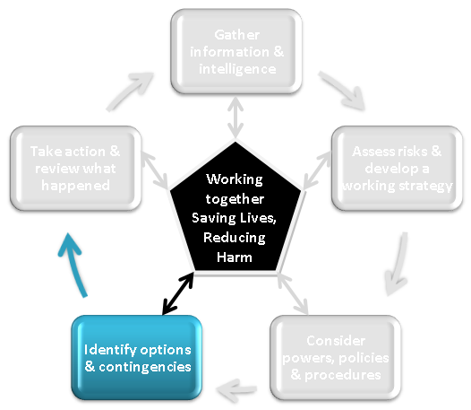
Stage Four
Any potential option or course of action should be evaluated with respect to:
Suitability
Feasibility
Acceptability
Notes:
The trainer should explain that there will almost always be more than one option to achieve the desired end state, and it is good practice that a range of options are identified and rigorously evaluated. All potential options or courses of action should be evaluated with respect to:
Suitability – Is what you are doing in line with achieving the direction required to successfully conclude the incident
Feasibility - in resource terms can it be done? Do you have sufficient resources, skills or equipment.
Acceptability - is it legal, morally defensible and justifiable?
Whichever option(s) is/are chosen at the scene, it is essential that responders are clear about what they are required to carry out and, where the option is time-critical, there should be clearly agreed procedures for communicating any decision to defer, abort or initiate a specific tactic.
Contingencies are events that may occur and the arrangements that are put in place to respond to them should they occur. For example, strong evidence may suggest that an emergency is being successfully dealt with and the impacts safely controlled, but there remains a low likelihood that the situation could deteriorate with significant impacts. Simply hoping for the best is not a defensible option, and a contingency in this case would be to define measures to adjust the response, should the situation deteriorate.

Slide 25
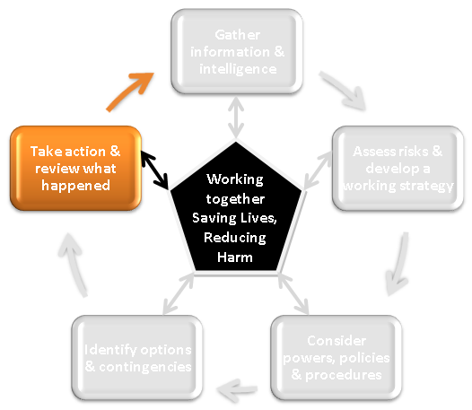
Stage Five
Building situational awareness
Setting direction
Evaluating options
Actions fed back into continuous loop of JDM – establishes shared situational awareness
Which in turn shapes the direction and risk assessment
Notes:
The trainer should explain that building situational awareness, setting direction and evaluating options all lead to taking the actions that are judged to be the most effective and efficient in resolving an emergency and returning to a new normality.
As the JDM is a continuous loop, it is essential that the results of those actions are fed back into the first box - Gather and share information and intelligence - which establishes shared situational awareness.
This will, in turn, shape any revision to the direction and risk assessment, and the cycle continues.

Slide 26
Further Information
www.jesip.org.uk or follow us on Twitter @jesip999
Watch the JESIP film and review other programme materials
Local ownership & engagement
Complete the All Staff E-Learning package
Download the Joint Doctrine: the interoperability framework
Find out more about how your service is embedding JESIP and working with local partners
Notes:
The JESIP website is regularly updated with the latest information from the programme team.
The JESIP team welcome enquiries to the team email address.

Slide 27
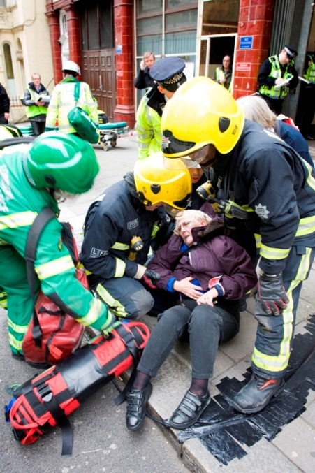
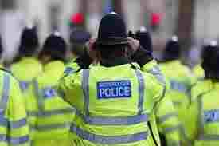
Developing mutual respect and understanding = maximum effectiveness
Notes:
By working more closely with our partners we can improve how we work together and achieve the JESIP vision of Working Together – Saving Lives.

Slide 28
Thank you and any questions?
www.jesip.org.uk
Twitter @jesip999
[insert local website / contact]

