Slide 1
Multi-Agency Interoperability Training Operational and Tactical Command
Module: Command Communications

Slide 2
Objectives
Explain the importance of using operational communications – currently Airwave between commanders and control rooms
Explore the potential issues and options when using Airwave
Explain the importance of utilising Tactical Advisors
Describe how to use Airwave Talkgroups
Describe how Airwave will be replaced by the Emergency Services Network

Slide 3
Emergency Services Network
The Emergency Services Network will replace Airwave
It will provide resilient and secure voice and data communications across England, Wales and Scotland

Slide 4
Airwave
Group messaging
Secure
Controlled network
Instantaneous
Compatibility
Via Police Control – ES interoperable talkgroup
Recordable if required
Notes:
XX Trainers should provide an explanation of mast sites, max talk groups , airwave tac advisor

Slide 5
Options
Contact an Airwave Tactical Advisor at early stage for advice
Suitable Talk groups
Coverage including Gateway Sets

Slide 6
Issues – Coverage
In certain areas there will be no Airwave coverage. This could be underground, inside buildings or in very rural areas
Radios will not connect to the network at all
There are solutions for this

Slide 7
Issues – Capacity
The Airwave network is built to support the normal number of users in a given area with some overhead
If there are many more there may be issues in terms of queuing
There are solutions for this

Slide 8
Options – Tactical Advisors
Contact an Airwave Tactical Advisor at early stage for advice
Existing “single service” tactical advisors
Since 2016 “tri-service” tactical advisors
New multi-agency “Operational Communications Advisor Course” available via the College of Policing
Notes:
XX Trainers may wish to explain that details about the new Operational Communications Advisor Course can be found on both the JESIP and CoP websites with details of how to book. Currently aligned to Airwave but future-proofed to be easily converted to ESN when required.
Existing or recently trained Tac Ads only need only attend in line with CPD requirements. XX

Slide 9
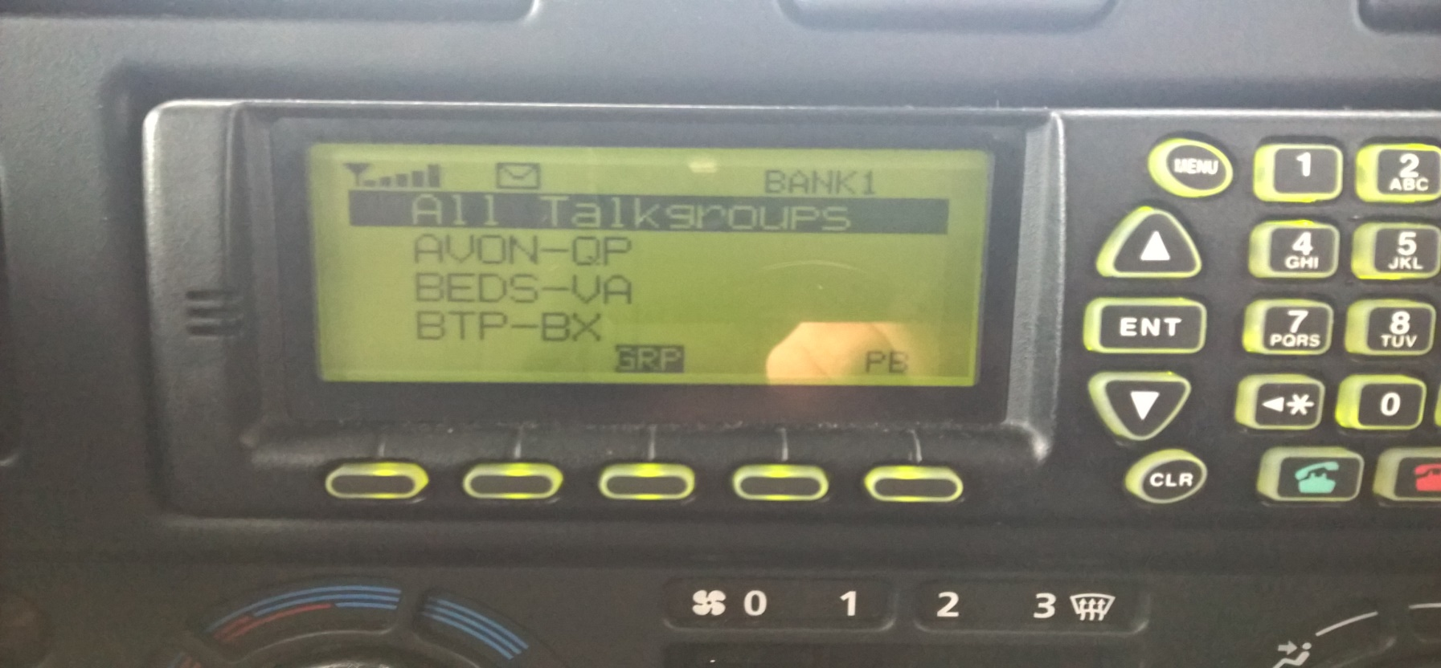
Selecting the relevant police constabulary/force area will access the Multi-Agency Talkgroups
Avon & Somerset = PAVON
Devon & Cornwall = PDVCO
Dorset = PDORS
Notes:
XX Trainers can use/insert local photographs of radios and talkgroups if they wish XX

Slide 10
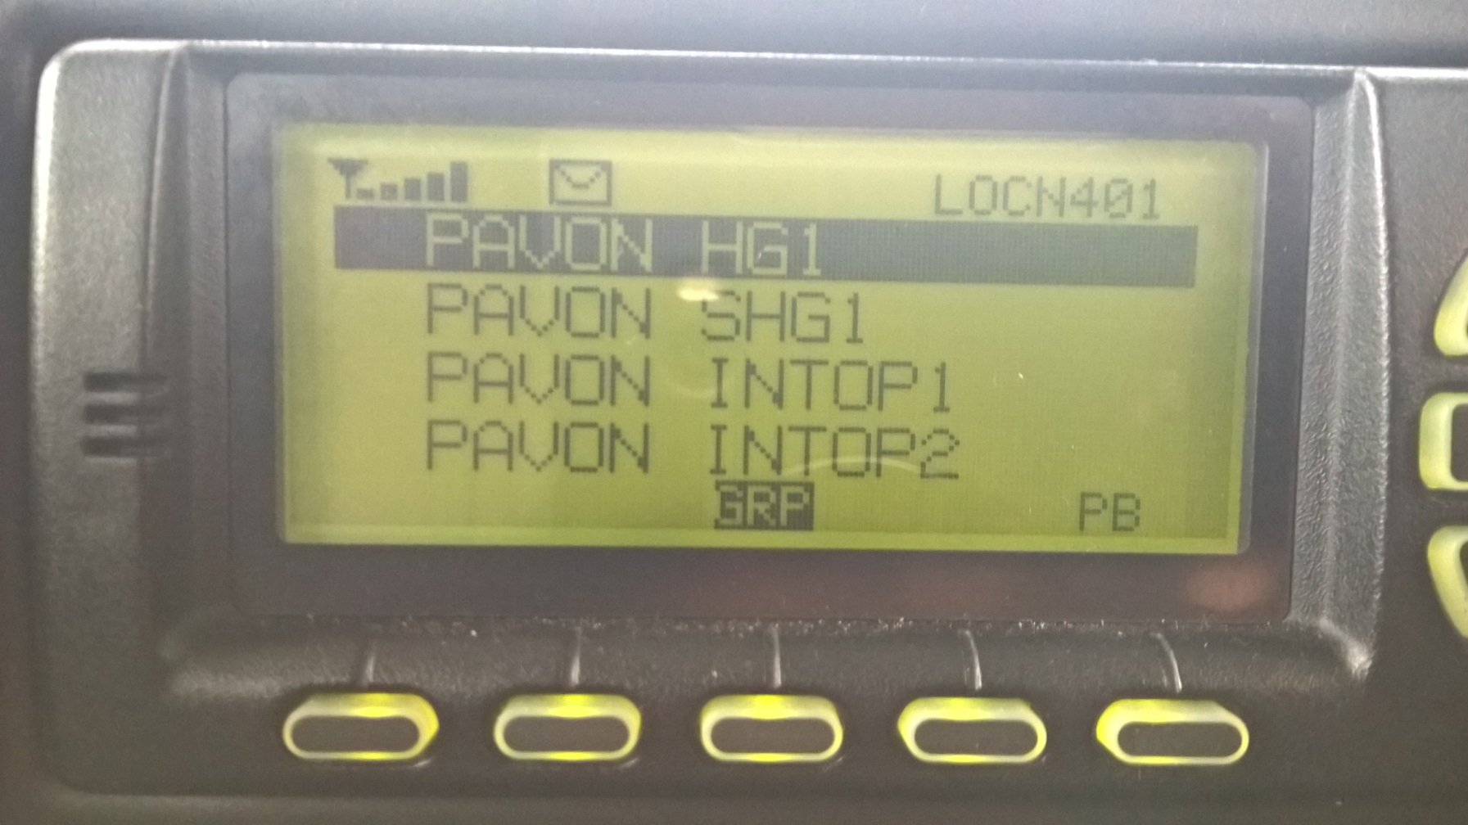
POLICE
TALKGROUP
FORCE NAME
(Avon & Somerset)
Notes:
Trainers should remind students to use alphatags – the talkgroup name- rather than a position number from the handsets.

Slide 11
What is available for Emergency Services?
The Local Police Multi-Agency Interop Talk groups
(The police hold the emergency service talkgroups)
Police Sharers Hailing | PXXXX SHG1
IC1 (Incident Command 1) | PXXXX IC1
ES 1-3 (Emergency Service 1-3) | PXXXX ES1 PXXXX ES2 PXXXX ES3 (SAR H)
IAT (Inter Agency) | PXXXX IAT1
Other Talk Groups are also available For example PMAs – seek advice from your Airwave (Operational Communications) Tactical Advisor
Notes:
Note that these are often used in the initial stages of an incident. After this other mutual aid talk groups of different types may be used. Tactical advisors will provide advice on these. There are local arrangements in place for the use of ES talkgroups trainers should share these with their students.

Slide 12
Points When Communicating
Use clear speech
Do not use TLAs (three letter abbreviations)
Brief messages over communications systems
No Call Signs, use Agency & Role Description (for example Police Commander)
Check understanding

Slide 13
Interoperability – Practice

Slide 14
Interoperability – Practice

Slide 15
Interoperability – Practice

Slide 16
Questions

