Slide 1


Multi-Agency Interoperability Training
Operational and Tactical Command
Module: Action & Review

Slide 2
Objectives
Identify how to take action and review what happens in regard to the Joint Decision Model (JDM)
Recognise the importance of a post event debrief
Explain the need for joint learning in order to sustain interoperability

Slide 3

Stage Five
Building situational awareness
Setting direction
Evaluating options
Actions fed back into continuous loop of JDM establishes shared situational awareness
Which in turn shapes the direction and risk assessment

Slide 4
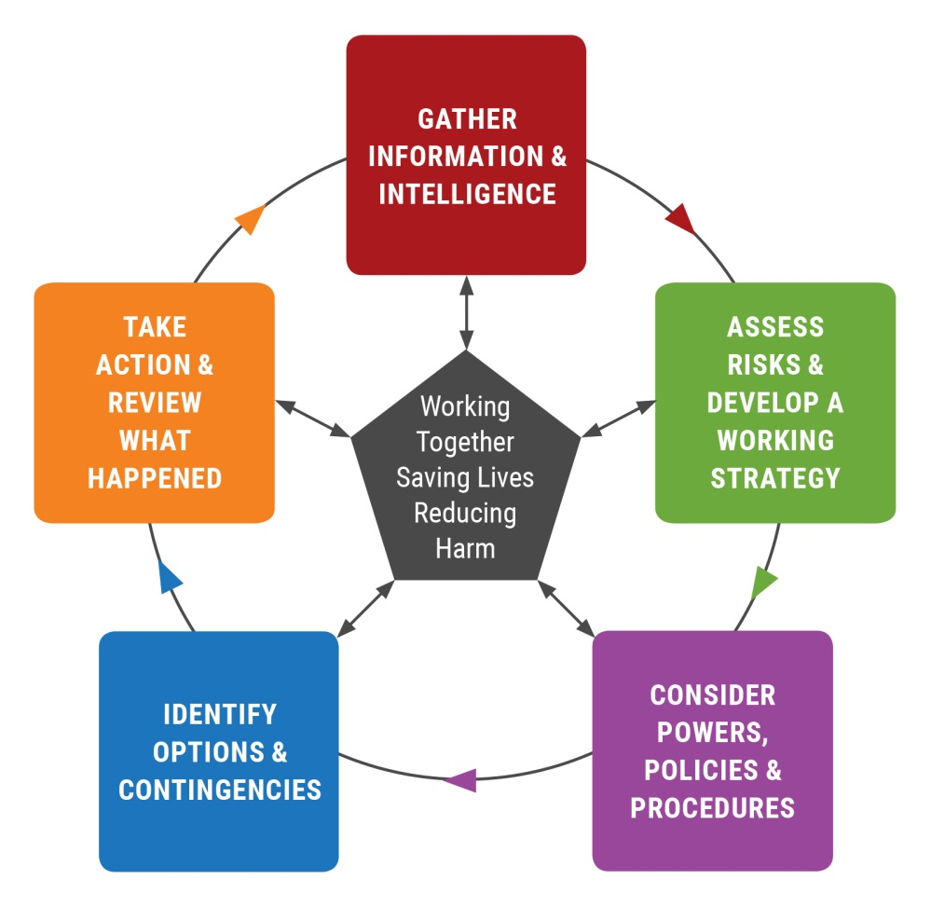
Briefing
Briefing
  For quick time briefing the JDM may be used
Notes:
XX Trainers should stress this is a suggested model in use by many services already but it is recognised that in some areas other suitable briefing models are used. XX

Slide 5
Briefing
Protracted incidents may
require a more detailed
briefing….
  Information
  Intent
  Method
  Administration
  Risk Assessment
  Communication
  Humanitarian issues

Slide 6
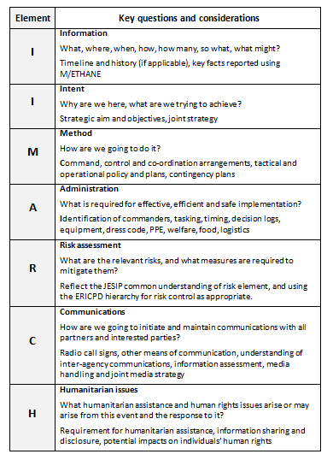
Briefing

Slide 7
Joint Learning & De-briefing
Building and sustaining interoperability requires that lessons identified are shared in order that unintended consequences are minimised, and opportunities for greater interoperability are realised
Those involved should ensure they know how to contribute to relevant de-briefing procedures

Slide 8
Capturing Lessons
Joint hot debrief (where possible)
Deal with key welfare issues and document them
Where lessons identified, feedback through single service procedures to get them addressed if possible
Multi-agency debrief
Any lessons identified that meet the criteria can be fed into national arrangements for Joint Organisational Learning
Notes:
XX Trainers should note the following guidance re what should be submitted to JOL:
Any issues raised as part of de-briefing which meet any or all of the following criteria should be submitted onto JOL:
relate to emergency response interoperability, primarily the use of M/ETHANE, the five JESIP principles for joint working and use of the Joint Decision Model;
had an impact on the effectiveness of at least two of the response organisations;
impeded successful interoperability;
are known recurring issues; and/or
if resolved could benefit other organisations therefore may have national impact.

Slide 9
Joint Organisational Learning (JOL)
National arrangements to collate and review lessons from across the country are now in place
Joint Organisational Learning is part of the JESIP Joint Doctrine and should become the standard for multi-agency learning
All services & Local Resilience Forums can submit mutually agreed lessons identified via the system hosted on ResilienceDirect

Slide 10
To conclude on a positive……it works!
“….the fantastic effect of JESIP on the ground”
Steve Voice Sussex Police talking about the multi-agency response to the Shoreham Air Crash - August 2015
Notes:
XX Trainers may wish to explain that whilst a number of key lessons have been identified in the de-briefing of the Shoreham Air crash, those involved with the response (especially operational) talked about how effective using JESIP was and how glad they were to have completed JESIP training. XX

Slide 11

Questions

