Slide 1


Multi-Agency Interoperability Training
Operational and Tactical Command
Module: Assess Threat & Risk

Slide 2
Objectives
Identify how to jointly assess risk and develop a working strategy in regard to the Joint Decision Model
Explain the key steps to delivering an effective integrated emergency response
Explain and demonstrate the application of the joint assessment of risk within a given scenario

Slide 3
ICL Factory Explosion Inquiry Report 2004
“...there were weaknesses in the awareness and mitigation of risks; physical surroundings changed without any consideration being given to the implications for safety;”
“…lack of effective communication to users of the risks; a lack of effective sharing of knowledge of risks between users and suppliers; and a lack of prompt and effective notification of incidents; and the lessons to be learned from them, to other interested parties”
Notes:
XXX Trainers may wish to use a local example here in support of the ICL report if they feel it would add value to students XXX

Slide 4
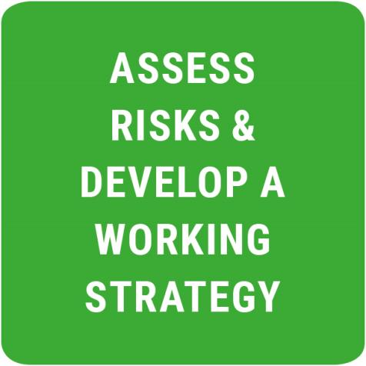
Stage Two
The different emergency services will have unique insights into the risks
By sharing that knowledge common understanding can be established
Considered in the context of the agreed priorities
Can inform a jointly agreed working strategy

Slide 5
Develop a Working Strategy
What are the aims and objectives to be achieved?
Who by – police, fire, ambulance and partner organisations?
When – timescales, deadlines and milestones
Where – what locations?
Why – what is the rationale?
  Is this consistent with the overall strategic aims and objectives?
How are these tasks going to be achieved?

Slide 6
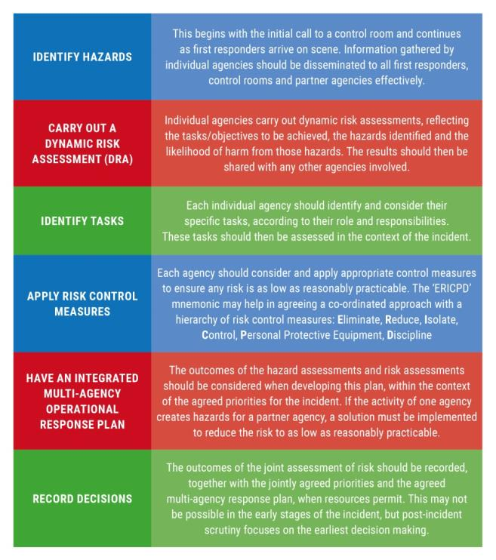
Key Steps
For an effective integrated multi-agency operational response plan, objectives and priorities must be agreed jointly
Each agency will then prioritise their plans and activity
The steps shown here should be undertaken

Slide 7
Group Task
For all modules add the title of the group task and a description of the task to a final slide.
Notes:
Mandated or local task

Slide 8

Questions

