Slide 1


Multi-Agency Interoperability Training
Operational and Tactical Command
Module: Information & Intelligence

Slide 2
Objectives
To emphasise the importance of the responding agencies working together and sharing intelligence
Describe the structure of the Joint Decision Model
Explain the overarching or primary aim and the five stages of the Joint Decision Model
Define M/ETHANE and recognise the importance of it for passing information
Identify the need to provide timely and accurate information to warn and inform
Recognise the importance, impact and considerations of social media in response to a major incident

Slide 3

Said ………………….
“We must be willing to work together and share information”

Slide 4
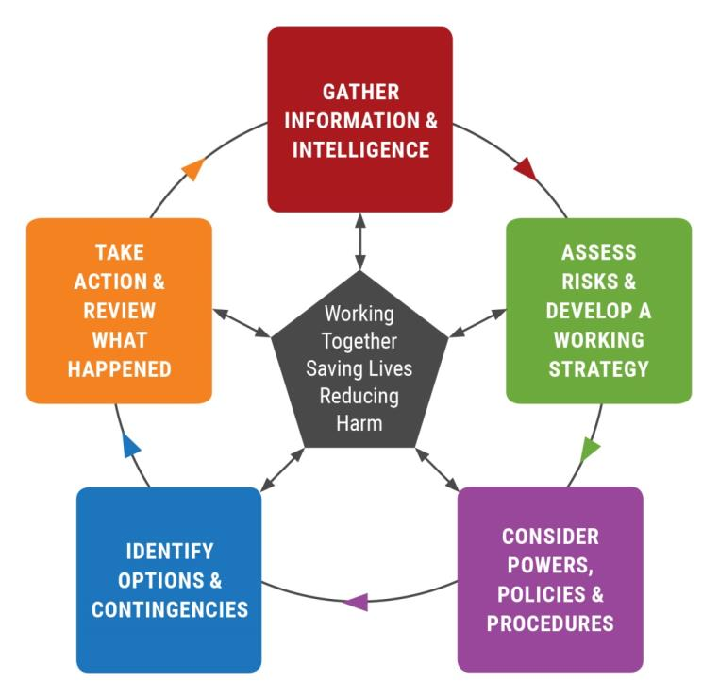
Joint Decision Model

Slide 5
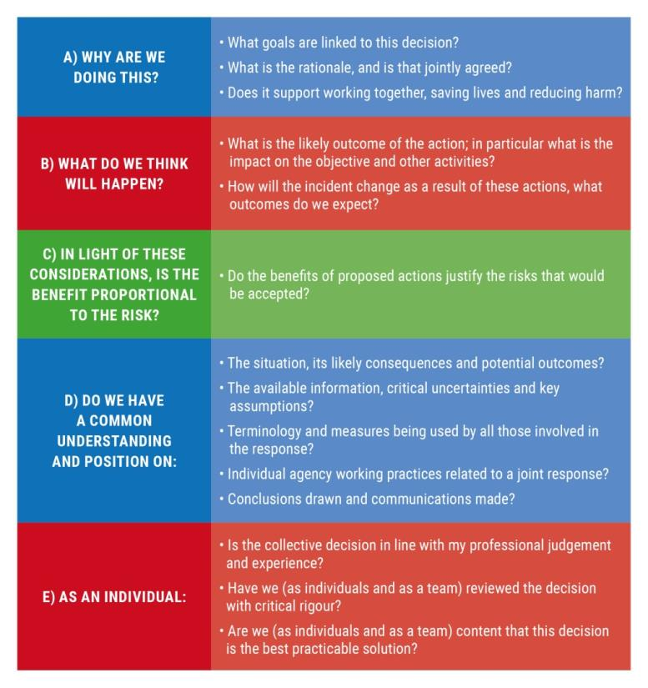
Decision Controls
Notes:
XX Trainers should speak briefly about decision controls – ref P21 of JESIP Joint Doctrine XXX

Slide 6

Overarching or Primary Aim
To save lives and reduce harm
Achieved through a coordinated multi-agency response
Enables the establishment of shared situational awareness

Slide 7

Stage One
What is happening?
What are the impacts?
What are the risks?
What might happen?
What is being done about it?
Notes:
XX Trainers should facilitate a discussion and ensure delegates understand the difference between information and intelligence. Also refer to the additions in Joint Doctrine Edition Two regarding Information Assessment ref P23 – 24) XX

Slide 8
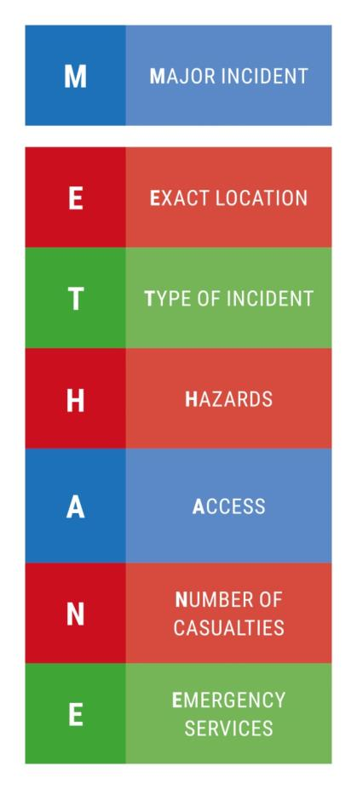
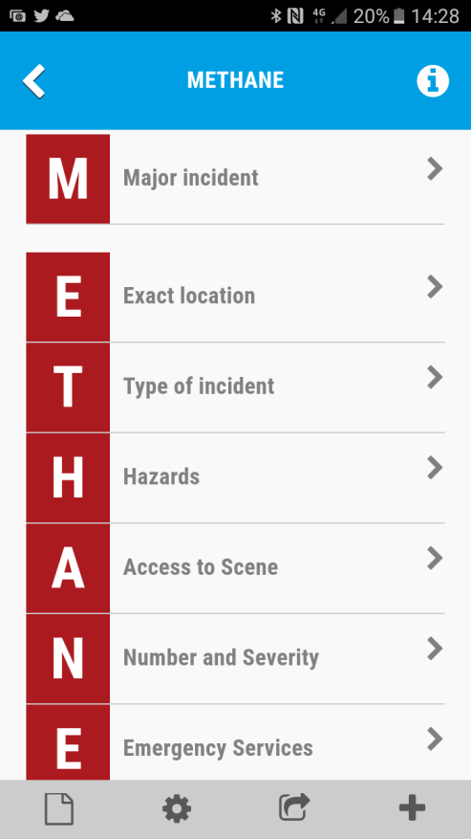
JESIP App provides prompt for generating a M/ETHANE message
Notes:
XXX trainer note – if answers to “M” is no (not a major incident) staff should continue with ETHANE message and regularly review situation in case of escalation to major incident. JESIP App and Aide Memoire provide reminder of M/ETHANE)

Slide 9
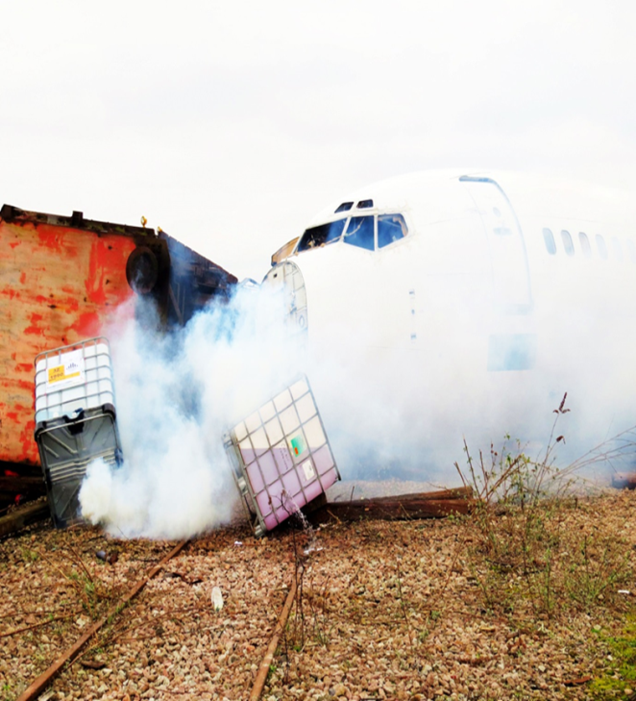
M/ETHANE
A plane has overshot a runway at Chesterton Airport, colliding with a goods train in the yard opposite.
This has caused a derailment of the train and some chemical containers have fallen from the carriage on to the track and split open.
237 passengers and 9 crew were on the plane. The yard is a goods yard and there are 3 workmen unaccounted for.
The chemicals are currently unknown.
Notes:
XX Trainers may develop their own local incident slides to drive METHANE and do not necessarily need to use this one XX

Slide 10
Terminology
Misunderstood concepts and terminology are frequent stumbling blocks:
  Language and terminology
  The use of probabilistic language (e.g. likely, possible, and probable) should be commonly understood
  Acronyms and abbreviations
  What other sources of ambiguity, miscommunication and confusion exist?

Slide 11
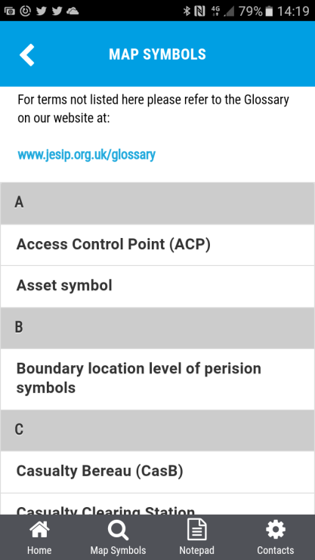
Tools to help
The UK Civil Protection Lexicon
Common Mapping Tools
JESIP website Glossary
JESIP app – map symbols

Slide 12
Social Media
It’s not just your emergency anymore
Disaster information is one of the most highly forwarded or retweeted information on social media
Social media can help monitor and address major incident issues
Its immediacy makes it invaluable in the live monitoring of situations
The era of organisations simply pushing information out is over…………………
To be relevant you need to listen and gather the information that’s out there
Notes:
XX Trainer Note - this slides refers to the use of social media as a source of information for commanders XX

Slide 13
Social Media in Response
Empowerment | Organisations’ IT infrastructures
Shared situational awareness for emergency responders | Human contact is one of the best ways of helping someone
Immediate information from the public at the scene | Contamination of incident information by responders
Notes:
Commanders should consider establishing a “multi-agency information cell” to bring together intelligence and information from all agencies into one place and to aid information collation, review and assessment. See P 28 of the JESIP Joint Doctrine Edition Two.

Slide 14
Social Media Tactical Plan Considerations
Coordination of lead person from all organisations daily
Create media centre on your website to …
One designated social media lead person per agency
Agree & designate time and frequency of distribution

Slide 15
Group Task
For all modules add the title of the group task and a description of the task to a final slide

Slide 16

Questions

