Slide 1
JESIP Awareness
1. Getting Together
Notes:
Lesson Management;
This is the first of four JESIP Awareness modules. Presenters should deliver the material in an appropriate learning style and allow time for group discussion.

Slide 2

Getting Together
Does emergency and crisis management require special skills and/or attributes?
Emergency management involves team, organisational
and multi-agency working: how well do we work across
boundaries and what problems might emerge?
How can we develop ourselves and our colleagues for this?
Notes:
Lesson Management:
The aim of this slide is to get your group to think of some of the general obstructions and enablers to multi-agency working. Ask group members to share examples of where things did go well in a multi-agency environment and where things didn’t go so well. Why did this happen?
Use this short opening discussion to establish an interactive learning environment with your group. Human and organizational factors may be highlighted by group members and you should ask them to consider these examples as they go through the subject material. This will develop understanding of the role of JESIP and the need for this awareness.
This package is going out to all responder agencies, not just the blue light services. You could consider asking your group to list who they think is a responder agency, the list may be much bigger than they realize.
The Civil Contingencies Act 2004 defines Category 1 and 2 emergency responder agencies. Category 1 responders include the police, fire & rescue, ambulance, local authorities, environment agency, maritime & coastguard agency, NHS and public health England. Category 2 responders include utilities (water, sewerage, gas and electricity), telephone service providers, railway operators, airport operators, ports, highways England, health & safety executive & NHS clinical commissioning groups. However it does not stop there, consider voluntary organizations such as search & rescue teams, British Red Cross and even spontaneous volunteers. Don’t forget the military who can also be deployed to assist.
The main point is to think beyond blue light responder agencies in terms of emergency management.

Slide 3
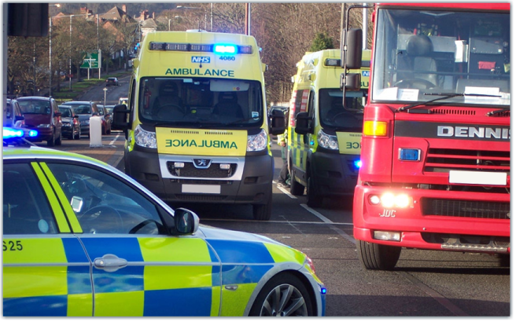
Introducing JESIP
JESIP began with a focus on the blue light emergency services. It developed to include all emergency responders. Today these principles apply to all agencies involved in some way in responding to incidents in the UK.
Notes:
Lesson Management:
There is a long, and continuing history of emergency management in major incidents in the UK. Ask your group to name some examples (Hillsbo rough is one obvious example).
There is always learning for responder agencies in managing incidents more effectively. JESIP continues to develop new systems and processes and encourage best practice amongst emergency responders.
You can ask your group why it is important to continue refining the way we work together. Consider what happens when things go wrong and the potential implications for your organisation. You can refer to Health & Safety At Work Act 1974, Working Time Regulations 1998, Human Rights Act 1998, Corporate Manslaughter and Corporate Homicide Act 2007, any criminal or civil investigation/prosecution and public enquiries.

Slide 4
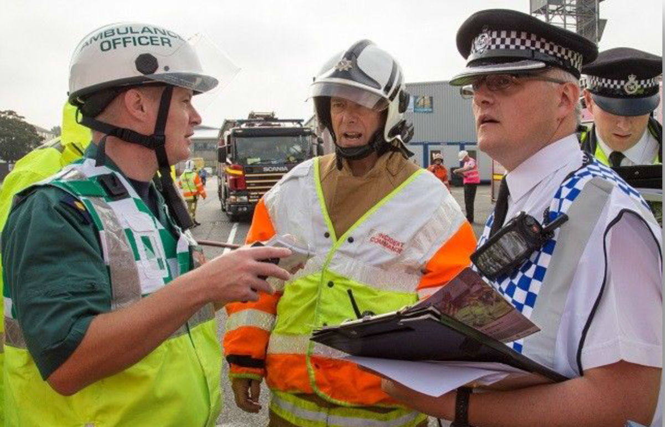
What is Interoperability?
It means working together smoothly and effectively. The formal definition is ‘the extent to which organisations can work together coherently as a matter of routine’.
Notes:
Lesson Management:
This is the true strength of integrated emergency management in the UK. Highlight how the risk landscape is constantly changing (nationally & globally) and integrated emergency management evolves with it. Looking backwards, moving forwards ensures that we will continue to evolve in our capability to respond to a wide range of emergency scenarios.
Ask the group for recent examples of this, it doesn’t have to be a major incident.
You can ask group members to highlight some of the new and/or evolving risks that emergency responders are having to address in the UK. Some of these challenges will be very complex. (You can consider terrorist scenarios in Paris, Brussels, Nice & Berlin and their potential to occur in the UK. You can also consider the on-going challenges around flooding and other forms of severe weather. Transport related incidents may also feature)

Slide 5
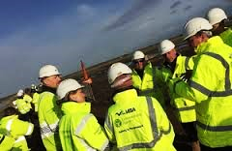
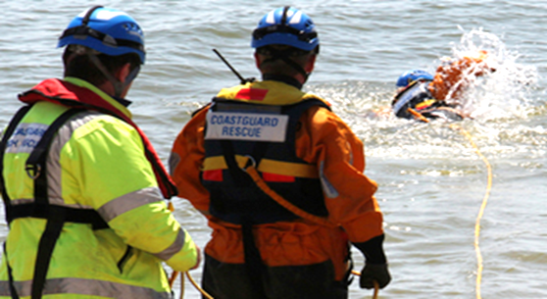
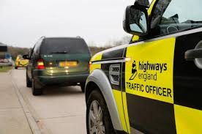
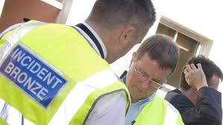
What is JESIP All About?
Its about improving the way we all work together when responding to incidents so we can get better at saving lives and reducing harm.
Notes:
Lesson Management:
It is important for all responder agencies to work well together at incidents: the public will expect no less.
JESIP is also about improving joint and well co-ordinated working between all responder agencies at all levels.
This awareness package explains in practical terms where you can find guidance to help you work effectively at incidents.

Slide 6
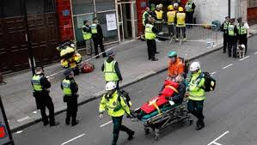
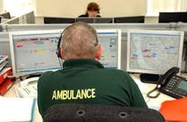
Major Incidents
A major incident is an event or situation with a range of serious consequences which requires special arrangements to be implemented by one or more emergency responder agency.
JESIP is about good practice at all incidents - not just major ones.
Notes:
Lesson Management:
JESIP is about good practice at all incidents – not just major ones.
For simplicity we will focus on major incidents, but it is important that responders work well together at all incidents, large or small.
The ‘one or more emergency responder agency’ part of this definition is interesting, ask the group why. People sometimes only consider the Response phase when attending major incidents however there is always a Recovery phase regardless of the type of incident.
Should those responder agencies who play a lead co-ordinating role in the response phase of a major incident automatically play a lead co-ordinating role in the recovery phase? How does the response phase differ from the recovery phase? It could be that the police take a lead role in the response stage of an incident and the local authority take a lead role in the recovery phase. An example of this could be flash flooding.
The key point here is that a wide range of agencies will be involved in the management of a major incident from response through to recovery, examples include local authorities, environment agency, utility companies and so on.

Slide 7

Who can declare a Major Incident?
It could be you!
Know what the policy is in your agency for declaring a major incident
Notes:
Lesson Management:
In general, even if there is some doubt, it is better to declare a major incident, and then scale down if it turns out we didn’t need to declare one.
That will make it easier to work together, save lives and reduce harm
Group members need to know what their agency’s guidelines are and how they would declare a major incident. They should ask their manager if they don’t know.
All responder agencies have different guidelines on major incidents.

Slide 8

Why do we need to declare a Major Incident?
Agencies will respond to major incidents differently depending on their responsibilities and resources.
If a major incident is not declared quickly enough it can lead to problems co-ordinating a joint response.
Notes:
Lesson Management:
Declaring a major incident triggers a response from each emergency service and other responders.
At a major incident it can take time to get resources in place and operational structures working, this also includes the tactical and strategic leadership support which is often out of sight but extremely important in managing the response effort by many different agencies.
Agencies will respond to major incidents differently depending on their responsibilities and resources. What may be a major incident for one may not be for others. One of the reasons that it is important that you declare a major incident is to let other agencies know what is happening and consider their own response.
So, the earlier a major incident is declared, the sooner joint working arrangements can be put in place. If a major incident declaration is needed but doesn’t happen quickly enough – this can lead to problems in co-ordinating a joint response.

Slide 9
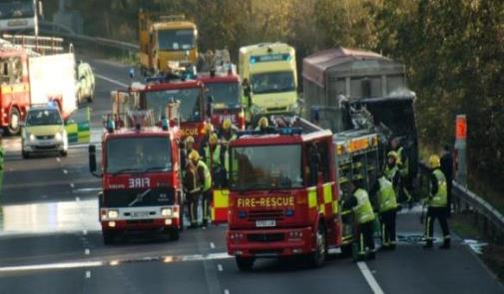

Working at the Scene
You are at this incident. In this situation you will need to work together with other responders to save lives and reduce harm.
How?
Notes:
Lesson Management:
Ask the group what they would do at this scene. Group members may describe what they would do rather than describing how they would do it… Jointly. This is a key point.
It’s not simply a case of what we do as a responder agency, it’s also about the way that we do it.
There are five key principles to follow (go to the next slide).

Slide 10
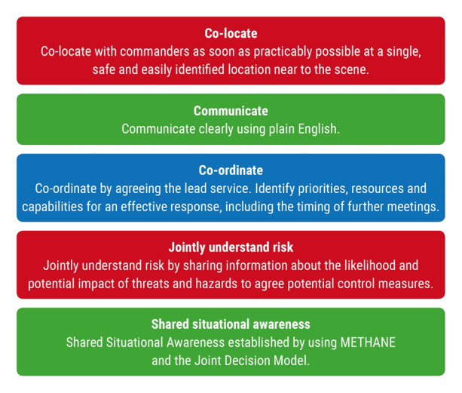
Key Principles
Notes:
Lesson Management:
This slide will focus on the first three principles (co-locate, communicate, co-ordinate) The last two principles (shared understanding of risk and shared situational awareness) will be covered in the next slide.
Co-locate so that those leading the response for each responder agency are able to get together as soon as possible at a single, safe and easily identified location near the scene.
Communicate using plain, simple English at all times.
Co-ordinate by agreeing which agency will lead in the early stages of the incident and then jointly agree on priorities, resources, actions and when to meet next.
Co-locate
On arrival at the scene, those leading the response for their agency need to get together face to face. If there is any delay in being able to do that, they should try to use radios (if issued) to talk to each other.
This will help them to agree on objectives and the joint plan – which will make the response more effective and the situation easier to resolve.
Make sure they are known to others. Those in charge at the scene should wear their agency’s Incident Commander tabard. They should make sure everyone knows where the Forward Command Post is – this is where the Incident Commanders and Managers meet.
Communicate
Without good communication, you will find it difficult to work together. If you don’t communicate with other agencies it will be harder to understand the risks in a situation and work out what is actually going on.
It means:
Sharing information and judgements about hazards, risk and threats – making sure that it is accurate and reliable. Sometimes other people cannot see things in the same way as you.
Keeping it clear and simple – no acronyms, jargon or technical language.
Making sure everyone understands who is doing what – knowing the role, responsibilities and activities of each agency involved.
Making sure that everyone understands the information that is being shared.
Co-ordinate
This means that those leading the response on behalf of their agency:
Agree which is the co-ordinating agency, this will depend on the type of incident.
Discuss resources.
Agree the activities of each responding agency.
Make joint decisions. This is a multi-agency response.
Why do we do it? So that we avoid potential conflicts, understand the importance of risks, prevent wasted or duplicated effort and make sure that resources are used effectively.
Final points :
The co-ordinating agency is the one most suited to lead that particular incident – at that particular time.
Co-ordination status may be passed to another if changing circumstances make this appropriate.

Slide 11

Key Principles
Through good co-location, communication and
co-ordination you are more likely to achieve the remaining two principles:
Joint Understanding of Risk
and
Shared Situational Awareness
Notes:
Lesson Management:
Jointly understand the risks by all responder agencies sharing information about threats and hazards and agreeing on ways to reduce them.
Establish shared situational awareness so that all responder agencies have a common understanding of what is going on.
Joint Understanding of Risk and Shared Situational Awareness will be covered in more detail in Module 3 .

Slide 12

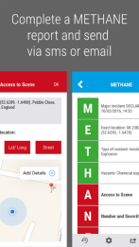
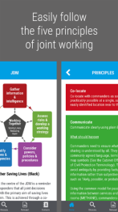
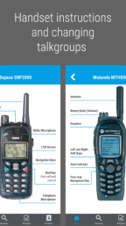
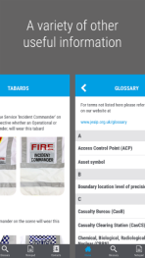

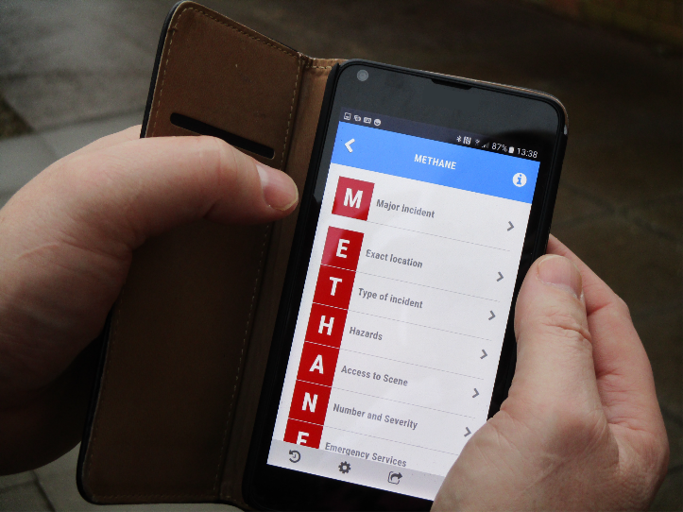
JESIP App
Prevention
Notes:
Lesson Management:
The JESIP app has several useful features:
A reminder about the principles for joint working and the tools that support them.
An incident checklist – for commanders and managers as they arrive at an incident.
A M/ETHANE report template that can be completed using the app and sent via text or e-mail.
Advice on how to develop joint understanding of risk for those at the scene.
Instructions for Airwave radio handsets, including how to change talk groups.
Examples of Incident Commander tabards worn at the scene of an incident.
A glossary of agreed map symbols.
A tool for generating a brief when handing over command.
Reminders of things to think about in de-briefs.

Slide 13
JESIP Awareness
2. M/ETHANE

Slide 14
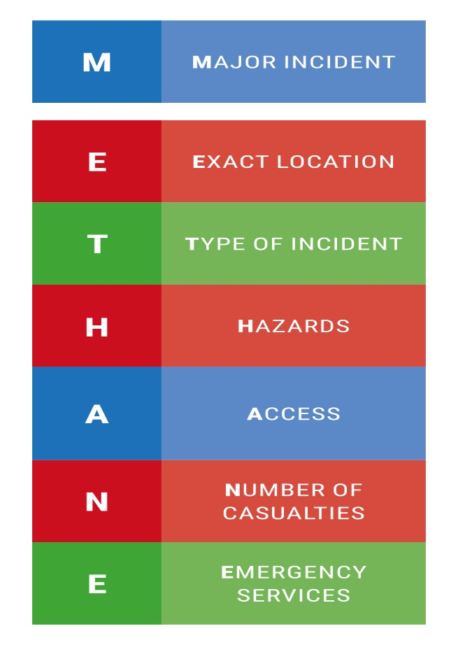
What is it?
A standard way to share important information about an incident in a clear and consistent way
Notes:
Lesson Management:
Ask the group why emergency responders need to adopt a standard reporting procedure. What could happen without this?
There is always pressure in the very early stages of an incident for accurate information. This responsibility often falls to emergency responders arriving first at the scene. M/ETHANE is now a standard reporting process that is used by all responder agencies working in a multi-agency environment.
It is good practice to send M/ETHANE reports when attending all incidents, including those that fall below the definition of a ‘Major Incident’. In circumstances such as these then the M (major incident declared) is dropped and you deliver an ETHANE report.
The M/ETHANE report should not be used just once. It is the standard format for passing information about an incident. This will make sure that all agencies get the information they need. It will also act as a trigger if an incident that is not declared as major at the beginning then escalates.

Slide 15
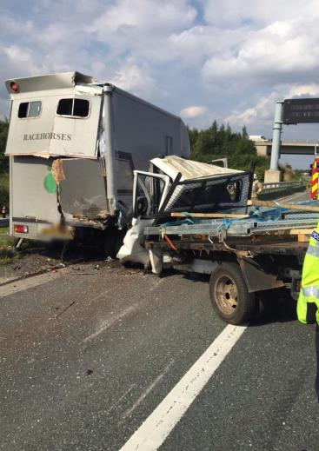
Why do I need it?
Put yourself at the scene of this incident, you are one of the first emergency responders to arrive. What might you be thinking or feeling?
…..what are you seeing?
Notes:
Lesson Management:
This slide asks group members to place themselves at the scene of the incident as one of the first responders to arrive. Ask the group what sort of thoughts and actions will be going through their heads. There may be serious injuries to people and animals. What sort of tasks do you need other agencies to undertake either at the scene or elsewhere? (You can consider Highways England, local authority, media, air ambulance and so on)
Ask the group to identify what sort of risks they can see at this scene. Why is it important not to immediately jump in and give assistance?
You are under pressure because people need your help. You know you need to save lives and reduce harm but also realise that you can’t do it on your own and will need lots of resources. Your supervisor and other responders may still be travelling to the scene.
Your control room, managers and other responders need to know what you are seeing at the incident so they can deploy appropriate resources and develop a working plan to help manage the incident. This is why sending a M/ETHANE report is a priority.
There are often lots of dangers at an incident such as this. Some are more obvious than others. An early assessment of risk is very important.
M/ETHANE reporting is not just for ‘blue light’ emergency responders, ask the group members to think how their own agency can use it at incidents.

Slide 16


Think M/ETHANE
Notes:
Lesson Management:
This slide contains an audio recording of a M/ETHANE report relating to the incident shown in the photo. Click on the audio icon in order to play the M/ETHANE report. The report reflects reality in that it is not perfect. However, it does contain all the relevant information. The emphasis here is on a structured reporting process when working under pressure.
A key point is that responders should pass this information to their control rooms at the earliest opportunity, check that the group understand why this needs to happen.

Slide 17
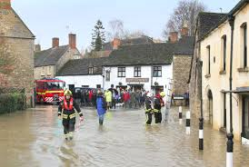
Building a bigger picture
M/ETHANE is a reporting model which supports the development of Shared Situational Awareness
Your own and other responder agencies need your M/ETHANE report at the earliest opportunity for communication, co-ordination, co-location and the joint understanding of risk
Your M/ETHANE report is important in the early development of shared situational awareness amongst all responders
Notes:
Lesson Management:
This slide highlights the relevance of M/ETHANE and how it contributes to the 5 key principles mentioned in Module 1.
You can remind the group of the main components of Communicate and Co-ordinate (set out below), without these it can be difficult for responder agencies to establish joint understanding of risk and shared situational awareness.
Communicate
Share information and thoughts about all types of risk – make sure that it is accurate and reliable
Keep it clear and simple
Make sure everyone understands who is doing what
Make sure that everyone understands the information that is being shared
Co-ordinate
Discuss resources
Talk about who does what
Agree who is the lead co-ordinating agency
Make joint decisions
Your M/ETHANE report is vital in developing a bigger picture in terms of scene management, this is called shared situational awareness and will be covered in greater detail in Module 3.

Slide 18
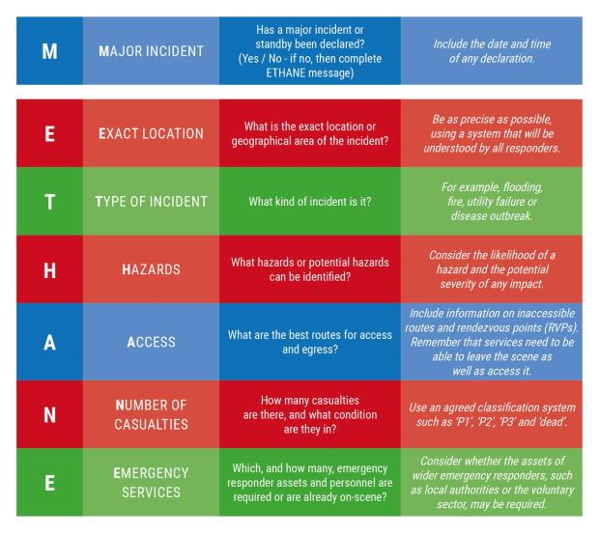
Shared Situational Awareness – M/ETHANE
You should not hesitate to send a M/ETHANE report if you are unsure that the incident in front of you is ‘major’ by definition
Notes:
Lesson Management:
This slide shows all of the components of the M/ETHANE model.
It is better to scale up the initial response and then scale it down accordingly.
Each responder agency should send an initial M/ETHANE report to their respective control or operations room on arrival at the scene. This will contribute to shared situational awareness across all responder agencies.
The ‘major incident’ definition was given in Module 1.

Slide 19
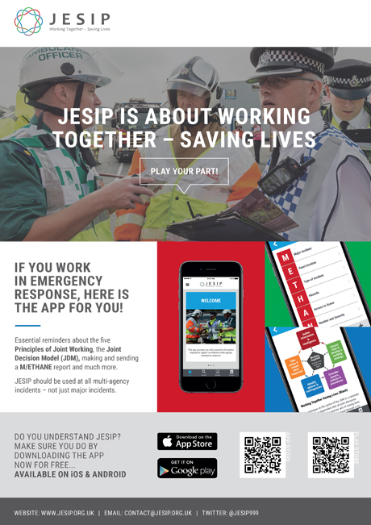

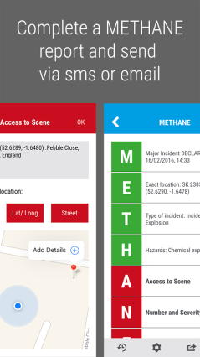
Notes:
Lesson Management:
This final slide highlights the JESIP app as an aide memoire.
To summarise, responders are under a great deal of pressure when they first arrive at the scene of a major incident and so M/ETHANE was created to assist responders in remembering the key information they need to give to their control rooms.
You can refer to the M/ETHANE section of the JESIP app on your phone to assist you as an aide memoire whilst at the scene. You can even send M/ETHANE reports by text or e-mail if your agency can receive it.
You can ask group members to locate the JESIP app on their phones and download it now.

Slide 20
JESIP Awareness
3. Seeing The Same Picture

Slide 21
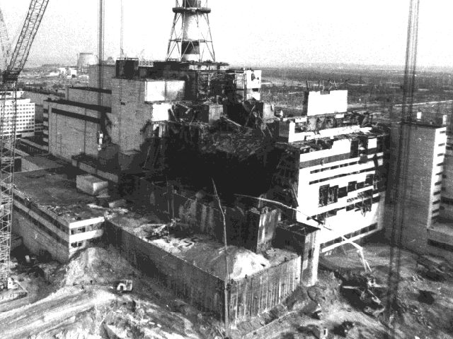
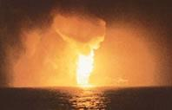
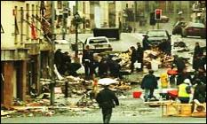

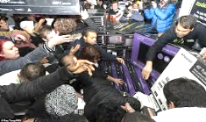
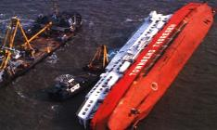
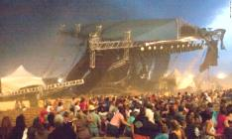
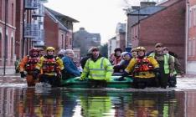
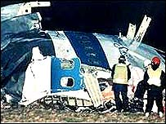
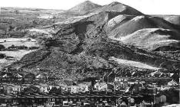
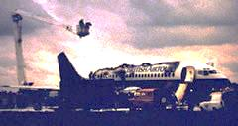
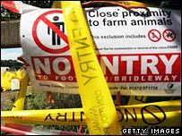
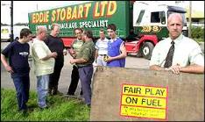

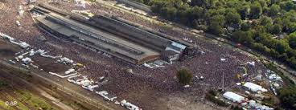
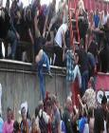
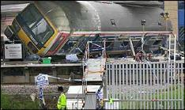
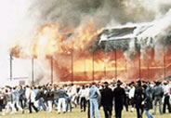
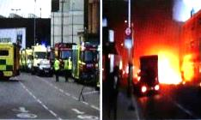
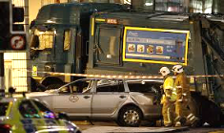
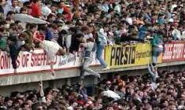
Notes:
Lesson Management:
The group will recognise many of these major incidents, each one is unique in their characteristics and presented emergency responders with huge challenges.
This slide is for illustration purposes only. Don’t make the group try and identify what these incidents were. Instead, get them to reflect on what sort of challenges these incidents might have presented.
Ask the group to identify recent major incidents in either the UK or across the world which significantly challenged emergency responders.
Ask the group what they understand shared situational awareness to be and why it needs to be created.
JESIP principles apply to all these major incidents, whatever their nature or cause. Remember that these principles also apply to minor incidents.

Slide 22

Shared Situational Awareness
What is it?
It is a common understanding of the circumstances, immediate consequences and implications of the emergency, along with an appreciation of the available capabilities and the priorities of all responder agencies
Notes:
Lesson Management:
Note that this includes understanding the resources, capabilities and priorities of the responding agencies involved in the incident or emergency.
This information helps to ensure that everyone involved knows what the problem is and understands how they are going to deal with it.
It is absolutely essential to establish shared situational awareness. Ask the group why?
Without it:
Decisions made at any level may be flawed.
The risks created by an incident may not be commonly understood.
Each agencies priorities may not be fully understood by others.
The quality of the response could be seriously compromised, because we might miss a vital factor in our understanding of the situation.

Slide 23
Creating Shared Situational Awareness
Three Key Questions
What?
So what?
What if..?
What is happening?
What does it mean?
Now think ahead
Notes:
Lesson Management:
The basic approach to establishing your own situational awareness is to work through a series of questions in your mind. These are:
What. What has happened? What is happening at the moment? What is being done about it?
So What. What does all that mean and what effects will it have?
What if. What might happen next? Or in the future?
It is really important to share these thoughts with other responders agencies. They are integral to good communication, co-ordination and joint understanding of risk.

Slide 24
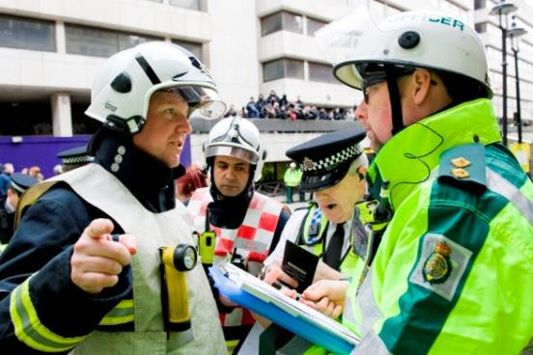
Establishing Shared Situational Awareness
What does all that mean and what effects will it have?
What might happen next? Or in the future?
What is happening at the moment and what is being done about it?
I need to get everybody’s understanding of this situation so nothing is missed moving forward
Notes:
Lesson Management:
The key point here is to achieve the ‘big picture’… collectively. This is shared situational awareness.
Two further tools can help you achieve shared situational awareness. Ask the group what these might be.
M/ETHANE. Aim to get your first M/ETHANE report out quickly. After that, subsequent reports will be more useful once you have talked to members of the other agencies at the scene. We covered that in Module 2. Remember to submit your report on behalf of your own agency, don’t wait for others to do it.
Once you have submitted your M/ETHANE report, it will be reviewed at higher levels to build a common operating picture. So, you must ensure that it is accurate and where possible reflects the activities, requirements and risk assessments of all agencies. You can send new M/ETHANE reports to keep people updated.
Joint Decision Model (JDM). This will feature on the next slide

Slide 25
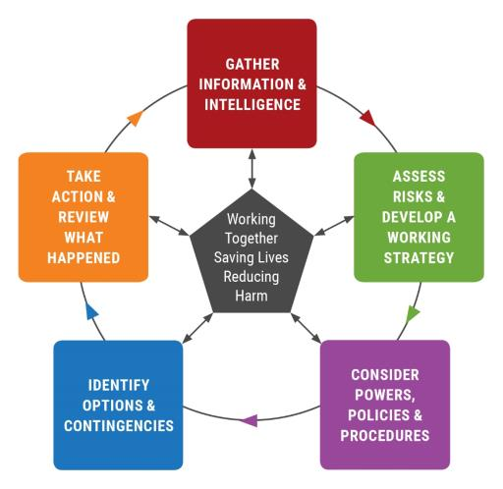
Joint Decision Model
Notes:
Lesson Management:
This is the decision model for responders who will be managing the incident.
These levels are often referred to as strategic and tactical. It should also be used by Incident Commanders or managers who are working at the scene, they are often referred to as operational.
The purpose of the Joint Decision Model is to help manage incidents through structured decision making. It is important to have a model that everybody understands and can work with so that joint decisions are made.
Your agency may have given you training in its use.
The next slide illustrates the levels of command that are adopted when managing a major incident.

Slide 26
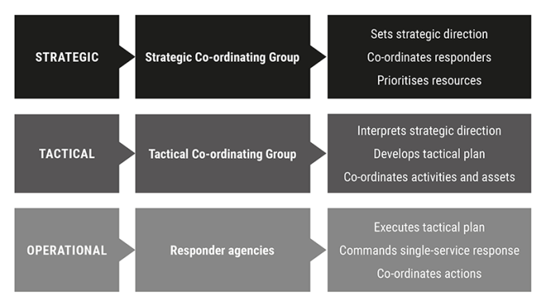
Levels of Command
The
Big Picture
Making it happen
Doing it
Notes:
Lesson Management:
Responder agencies may adopt levels of command when responding to incidents. The level may not convey the actual seniority or rank a person has within their responder agency but rather the level of command an individual has at the incident.

Slide 27
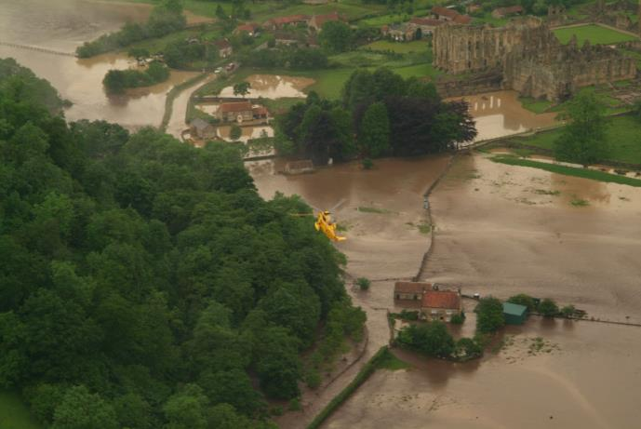
Why is joint understanding of risk essential?
This flooding scenario is a Major Incident.
Notes:
Lesson Management:
Ask the group why the joint understanding of risk is important in this scenario.
Key Points:
Each agency will carry out its own dynamic risk assessment according to its own working practices.
People from different agencies may see and understand risks at an incident differently because of their training and expertise.
These must be shared with responder agencies to achieve a common understanding of all the risks and hazards.
This will help to ensure that responders stay safe and will reduce the potential for harm to the public and the environment around the scene.
The Flooding Scenario:
In understanding what this might mean for the response as a whole and for the safety of the public and the responders, many agencies will have important information about this major incident and it is vital that this is shared.
If those in command do not communicate with each other and do not co-ordinate the resources they have, the response may be disjointed and confused – with different responders doing their own thing separately rather than working together, saving lives and reducing harm
Specific areas of this major incident may present different risks and hazards and so the need to share this information is even more important.
Establishing Joint understanding of risk applies to all incidents.

Slide 28
Multi-Agency Resilience
Ambulance
Police
Fire &
Rescue
Coast-
guard
Local
Authority
Voluntary
Sector
Public Health
England
Ports
Environment Agency
Military
Media
Central
Government
Transport
Highways England
Airports
Health &
Safety
Executive
Water
Power
Notes:
Lesson Management:
Different agencies respond to an incident because they have specific functions, capabilities and expertise. Ideally, all responders should have a basic understanding of each other’s roles so that they can work together effectively.
It is important to remember that this list is intentionally not complete, nor does it cover every agency that might be involved in an incident.
A single incident can have a knock-on effect in different ways that requires additional planning and the involvement of many different organisations.
We often tend to think about incidents in terms of the immediate scene, saving lives and reducing harm, this is the response phase.
In truth, the recovery phase can be equally as challenging and take longer than the response phase.
Recovery is about returning things to normal following an incident and can involve many different agencies and organisations.
Final Points:
If you aren’t sure of the purpose or capabilities of an individual or agency – ask them. They may have exactly the capability you need to help achieve your aim, or know how to get it.
Multi-agency working is all about what each agency brings in the way of capability, expertise and resource.
Interoperability is how you make it all work together.

Slide 29
JESIP Awareness
4. Looking Back, Moving Forward

Slide 30
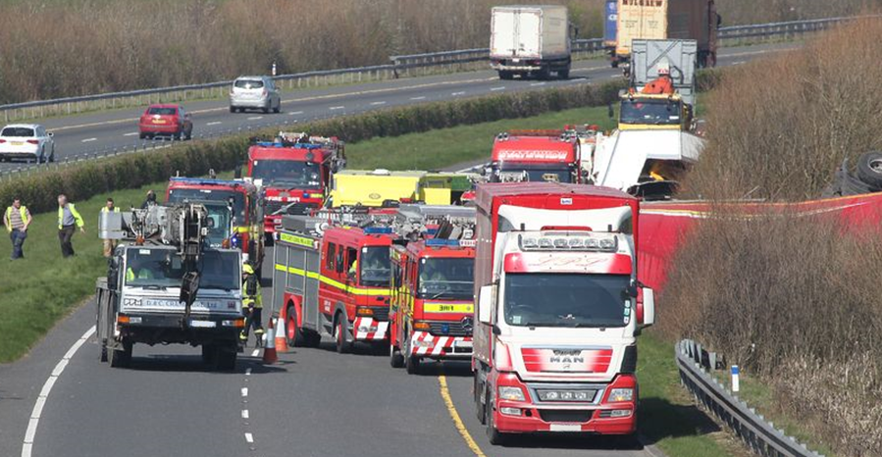
Looking Back, Moving Forward
It is several hours on from the time you attended this incident. You have been stood down from the scene and are back at the office. The incident is now entering the recovery phase which may take a long time. You are thinking about your own role during the response to this incident, people from other responder agencies will be doing the same.
Notes:
Lesson Management:
This slide is an introduction to de-briefing and joint organizational learning.
Go to the next slide for some of the questions that a responder may be reflecting on.

Slide 31

Looking Back, Moving Forward
Did everybody know what they were doing?
Did we do a good job?
Did I do everything?
What made things challenging?
Did we have a near miss?
Could we have done something better?
Notes:
Lesson Management:
It is important to establish learning points at the earliest opportunity whilst things are still fresh in people’s minds. It is recommended that managers hold an initial debrief with their staff as soon as practicable after an incident so that as much information as possible is collected.
Bigger debriefs involving responder agencies can take place at a later date in the knowledge that information has already been captured by individual agencies.

Slide 32


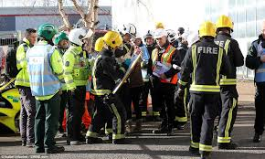
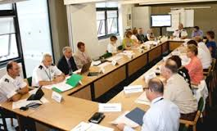
Joint Organisational Learning
Notes:
Lesson Management:
Learning from experience is important to ensure that things do not go wrong in the future when managing incidents. Holding joint debriefs with responder agencies is a great way to share problems people may have had and then identify solutions which can be used to update emergency plans or procedures. It lets us capture lessons and share better ways of doing things with colleagues across all responder agencies. We call this Joint Organisational Learning
We know from past experience that areas for improvement relating to multi-agency working at incidents have been identified, however they have not always been acted on in a way that actually makes joint working more effective.
Incidents are not the only source of lessons, exercises or training can also identify areas for improvement. It is important to record and share these lessons as well.
Joint Organisational Learning is accepted as the standard for all responder agencies, it helps to build further understanding and improve joint working at future incidents. Lessons are identified and acted on to make things work better.
‘Resilience Direct’ hosts a joint organisational learning application. This is a way of capturing, analysing, implementing and sharing learning not just from incidents, but from joint training and exercising.
It is vital that responder agencies have good debrief procedures that identifies better ways of joined up working.
By learning from each other we will keep getting better at Working Together, Saving Lives and Reducing Harm.

Slide 33

You have now reached the end of the JESIP Awareness package
Further information can be found on the JESIP website at www.jesip.org.uk

