Slide 1


Joint Organisational Learning
Charis Taylor
JOL Coordinator

Slide 2
Why Share Lessons?
The Civil Contingencies Act 2004
Category 1 responders must collectively:
Learn and implement lessons from exercises
Share lessons learned from emergencies and exercises in other parts of the UK
Make sure that those lessons are acted on to improve local arrangements
Notes:
Why Joint Organisational Learning
This slide provides a useful over view of the obligations under the Civil Contingencies Act (2004) for responder agencies to not only learn and implement their own lessons but to share these lessons appropriately in order for others to learn.
Emphasis is made on lessons shared that they should focus on the “what” and the “why” rather than “who”. All lessons submitted on JOL Online should focus on the route cause of the lesson rather than who was potentially at fault.
Local resilience forums ( LRFs ) are multi-agency partnerships made up of representatives from local public services, including the emergency services, local authorities, the NHS, the Environment Agency and others. These agencies are known as Category 1 Responders, as defined by the Civil Contingencies Act 2004

Slide 3
Why Share Lessons?
We also need to share lessons so that we can:
  Protect our colleagues
  Protect the public
  Learn from training, exercises and incidents
  Ultimately save more lives and reduce harm

Slide 4
The key message to responder agencies is that JOL is not about who but about what and why
All lessons submitted on JOL Online should focus on the root cause of the lesson rather than who was potentially at fault.

Slide 5

The multi-agency structure
JESIP Interoperability Board
JOL
Coordinator
Single Sector
JOL Working Group
ODU
CT Business Partners Forum
LID
NPoCC
JOL Users and JOL SPoCs
NOL
Notes:
JOL Users and SPOCS
Anyone with an RD account can create a JOL Online account.
Each Police, Fire and Ambulance Service have around 3 JOL Single Points of Contact (SPOCs).
For all other responding agencies there is a SPOC within every Local Resilience Forum (LRF).
Any user can submit a Lesson Identified or Notable Practice.
JOL SPoCS are responsible for ensuring their organisation or LRF are submitting lessons to JOL Online and sharing lessons with relevant staff from JOL Online.
JOL Working Group
The JOL Working Group sits monthly to discuss every lesson identified submitted to JOL Online.
The standing members are the National Organisational Points of Contact (OPOCs) – from NFCC, NPoCC, NARU and Cabinet Office CCS.
Some additional stakeholders will be invited to certain JOL Working Groups as and when required.
Single Sector
LID (Lessons Identified Database) is the ambulance single sector learning system
NOL (National Organisational Learning) is the FRS single sector learning system
NPoCC all single sector police lessons will be sent to NPoCC to be distributed to the correct department as they do not have one single sector learning system
CTODU (Counter Terrorism Operational Development Unit) – any CT related lessons will be shared and discussed with all CT partners at the CT Business Partners Forum, chaired by ODU to ensure nothing is shared on JOL Online without authorisation.
JESIP Interoperability Board
The Board oversee everything JESIP and JOL.
It is a Strategic Level Board of multi-agency partners from across the UK.
The Board meets quarterly to discuss interoperability between partner agencies and oversee the workstreams of the JESIP Team.
Any JOL Action Notes are sent by the JESIP team on behalf of the Interoperability Board.

Slide 6
Membership
JESIP Team
Emergency Services
(Chief Officer level)
Her Majesty’s Coast guard (HMCG)
Devolved Administrations
Government Departments (Director or Deputy Director)
Home Office
Cabinet Office
Ministry of Housing & Local Government
Department of Health & Social Care
Ministry of Defence
Civil Contingencies Secretariat
Office for Security & Counter Terrorism (OSCT)
Crime, Policing and Fire Group (CPFG)
Emergency Services Collaboration (ESC)
Resilience & Emergencies Division (RED)
National Fire Chiefs Council
National Police Chiefs Council
Association of Ambulance Chief Executives
National Counter Terrorism Police Headquarters (NCTPHQ)
National Ambulance Resilience Unit
Local Government Association (LGA)
Inspectorates
Wales
Northern Ireland
Scotland
Joint Emergency Services group (JESG)
Welsh Government
Police Service Northern Ireland (PSNI)
Emergency Services Network (ESN)
Department of Justice Northern Ireland
Scottish Multi Agency Training & Exercise Unit (SMARTEU)
Her Majesty’s Inspectorate of Constabularies and Fire & Rescue Services (HMICFRS)
Care Quality Commission (CQC)
Association of Police & Crime Commissioners (APCC)
College of Policing
Notes:
The JESIP Interoperability Board

Slide 7
The JOL Process
Identify and submit to JOL Online
Organisation
Impact assessment and liaison with stakeholders
JOL Coordinator
Decisions on recommendations and publishing
JOLWG
Escalation to the Board for JOL Action Notes
JESIP Interoperability Board
Notes:
A lesson is identified by a responding agency following an incident, exercise of training and submitted to JOL Online.
At this stage, the lesson can only been seen by the submitter and the JOL Coordinator.
If necessary, the JOL Coordinator may need to gather information around the lesson, by contacting the agencies involved.
The JOL Coordinator will then liaise with stakeholders to get advice on the lesson and what should be done with the submission. This will include contacting national bodies or subject matter experts.
An impact assessment will be completed on the lesson and will result in a rating of tolerable/low, medium, high or very high.
If a lesson is related to Counter Terrorism, it will go to the JOPWG, chaired by OSCT and the CT business partners forum. This is to ensure the lesson is appropriate to be shared and decisions made on this will be decided amongst all CT partners. Wording will be authorised by these two groups.
The lesson will then be taken to the JOL Working Group for final decision and agreement on the rating, recommendations and publishing decisions.
The lesson will then either be closed, published to all, or published to SPOCs only.
When published to SPoCs only, it is the responsibility of the SPOC to share the lesson with the relevant staff within their organisation or LRF.
Any lessons that may require an action from services will be escalated to the JESIP Interoperability Board who may decide a JOL Action Note is required.
Stakeholder liaison throughout the process is key
National Guidance reviews are informed by lessons submitted to JOL Online

Slide 8
Key Points
Once submitted, ONLY the JOL Coordinator and the submitter can view the lesson until it is published.
Every Lesson Identified is redacted where necessary to ensure anonymity unless authorised by ALL the agencies involved.
Nothing is published until authorisation is given by ALL relevant stakeholders and the JOL Working Group.

Slide 9
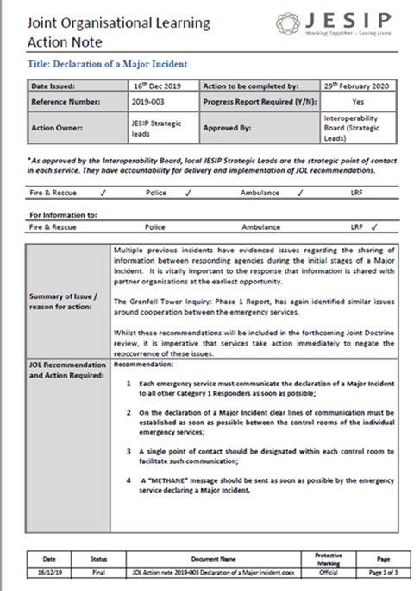
Closing the loop
Lesson Identified
Lesson Submitted to JOL Online
Lesson assessed and rated and shared
Implementation of change (locally or via JOL Action Note)
Lesson Learned
Notes:
When a lesson identified is reoccurring on JOL, or has a high rating from an impact assessment, an action may be required from services to reduce the risk of the issue happening again.
The information is presented to the JESIP Interoperability Board who may decide that a JOL Action Note is required.
The JESIP Team liaise with stakeholders to create the recommendations and produce the Action Note, it then gets sent to the Strategic Lead and JOL SPoC for the relevant service(s).
The receiving service is then asked to respond to the Action Note (normally to their National OPOC) and the responses are coordinated and presented back to the Board – and in this case – reported back into the Grenfell Inquiry Team.
This provides an audit trail that information has been received and understood and that change has been implemented in order to learn the lesson and improve the way organisations respond to incidents.
Unless we implement change following the identification of lessons, the lesson will reoccur.
We need to close the loop and not just identify issues – we must learn from them by changing the way we work, to reduce the risk of the lessons reoccurring.

