Slide 1
JESIP Training Workshop
Julian Frost

Slide 2
Workshop Objectives
Development Path
Training Framework
Access to Resources
Learning Outcomes
All Staff Awareness
Command Training
Control Rooms

Slide 3
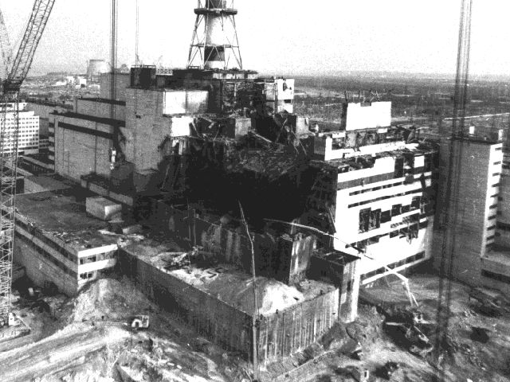
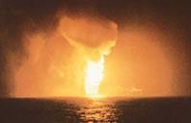
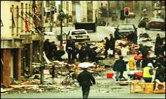
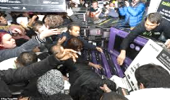
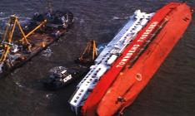
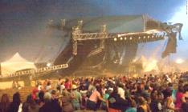
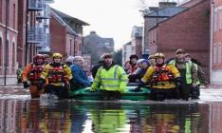
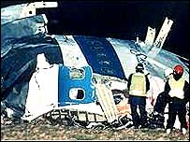
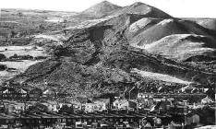
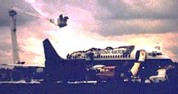
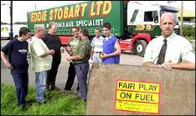
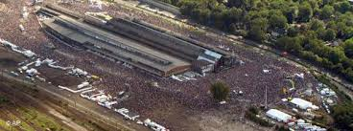
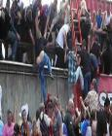
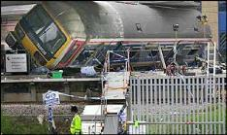
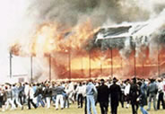
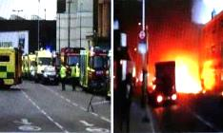
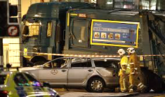
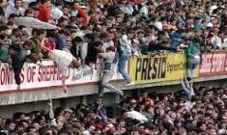
Notes:
Lesson Management:
The group will recognise many of these major incidents, each one is unique in their characteristics and presented emergency responders with huge challenges.
This slide is for illustration purposes only. Don’t make the group try and identify what these incidents were. Instead, get them to reflect on what sort of challenges these incidents might have presented.
Ask the group to identify recent major incidents in either the UK or across the world which significantly challenged emergency responders.
Ask the group what they understand shared situational awareness to be and why it needs to be created.
JESIP principles apply to all these major incidents, whatever their nature or cause. Remember that these principles also apply to minor incidents.

Slide 4
Development Path
National Products
Review
Consultation
Engagement Events in 2016
Changes at College of Policing
Working Groups

Slide 5
Training Framework
Localism
Learning Outcomes Framework supports locally produced products
New all staff awareness products
Refreshed national command products
Sustainable train the trainer
Control room awareness and training

Slide 6
JESIP Training Products
Strategic Commanders
Tactical Commanders
Operational Commanders
Multi Agency Gold Incident Commander (MAGIC) Training
Control Room
Tactical Commanders Course
Operational Commanders Course
Operational Staff
Control Room Supervisors Course
Commander
E-Learning Package
Commander
E-Learning Package
Welsh GOLD
All Staff
Awareness
New
Entrants
All Staff
Awareness
All Staff
Awareness
All Staff Awareness
All Staff
Awareness
All Staff
Awareness
Introduction
to JESIP Presentation
Introduction
to JESIP Presentation
Introduction
to JESIP Presentation
Introduction
to JESIP Presentation
Introduction
to JESIP Presentation
Introduction
to JESIP Presentation
Other Cat 1 & 2 responders can attend the command courses and access the all staff awareness package
Notes:
This diagram explains the range of JESIP products against the people they are designed for.
Whilst JESIP has services training their priority commanders, operational staff from joining through their promotional journey to commander need to understand the importance of and principles of interoperability.
The future challenge for services will be to look again at how operational staff are trained and consider new joint training opportunities with other emergency services so that joint working becomes second nature - business as usual. Could new recruit training have combined modules?

Slide 7
The 2017 model
Chief Officer Responsibility
How Many People Trained
How they are Trained
National Products
Learning Outcomes
Trainer/Deliverer Specification

Slide 8
Products available on website

Slide 9
Learning Outcomes
Hosted on JESIP Website
Owned by JESIP
Currently Version 1
Granular and not a Curriculum
Underpin extended training. i.e. command

Slide 10
Learning Outcomes Audiences
Audience | Definition
All Responder Staff | All staff who may be first on scene, deployed to the scene as the incident develops or working remotely from the scene
Control Room Staff | All staff who work in a responder organisation control room, emergency rooms, operations room, or equivalent
Control Room Command/ Manager/Supervisor | All staff who carry out a command / manging role in a responder organisational control room, emergency room or equivalent
Operational Command | All those who perform an operational command role in relation to incident response
Tactical Command | All those who perform an tactical command role in relation to incident response and may be required to attend a Tactical Co-ordinating Group if one is established
Strategic Command | All those who perform an strategic command role in relation to incident response and may be required to attend a Strategic Co-ordinating Group if one is established

Slide 11
Example - Interoperability
Audiences
All Responder Staff | Control Room Staff |  | Control Room Command/ Manager/Supervisor | Operational Command | Tactical Command | Strategic Command
Define interoperability |  | Define interoperability | Define interoperability | Define interoperability | Define interoperability | Define interoperability
Explain why it is important organisations work together at incidents |  | Explain why it is important organisations work together at incidents | Explain why it is important organisations work together at incidents | Explain why it is important organisations work together at incidents | Explain why it is important organisations work together at incidents | Explain why it is important organisations work together at incidents
 |  |  | Describe the JESIP Joint Doctrine guidance and how to access it | Describe the JESIP Joint Doctrine guidance and how to access it | Describe the JESIP Joint Doctrine guidance and how to access it. | Describe the JESIP Joint Doctrine guidance and how to access it
Demonstrate an awareness of the JESIP mobile application |  | Demonstrate an awareness of the JESIP mobile application | Demonstrate an awareness of the JESIP mobile application | Demonstrate an awareness of the JESIP mobile application | Demonstrate an awareness of the JESIP mobile application | Demonstrate an awareness of the JESIP mobile application
List the five principles for joint working |  | List the five principles for joint working | Describe the five principles for joint working and why they are important | Describe the five principles for joint working and why they are important | Describe the five principles for joint working and why they are important | Describe the five principles for joint working and why they are important

Slide 12
All Staff Awareness
Support learning outcomes
Awareness not training
Two delivery methods, One set of outcomes
E-learning
Classroom
Owned by JE
Available from our website

Slide 13
All Staff Awareness On-Line
Approximately 40 to 60 minutes
SCORM 1.2 and 2004 Versions
HTML version
Hosted HTML version
Quiz (not exam) in SCORM, HTML and on Paper
Free to use
ADD HYPERLINK

Slide 14
Online Learning

Slide 15
All Staff Awareness Classroom
Delivers the same Learning Outcomes as the on line product
PowerPoint with notes
Recommended deliverer specification
Paper quiz for knowledge check
Designed to take less than an hour
ADD HYPERLINK

Slide 16
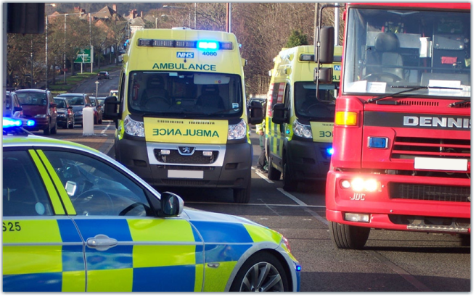
Introducing JESIP
JESIP began with a focus on the blue light emergency services. It developed to include all emergency responders. Today these principles apply to all agencies involved in some way in responding to incidents in the UK.
Notes:
Lesson Management:
There is a long, and continuing history of emergency management in major incidents in the UK. Ask your group to name some examples (Hillsbrough is one obvious example).
There is always learning for responder agencies in managing incidents more effectively. JESIP continues to develop new systems and processes and encourage best practice amongst emergency responders.
You can ask your group why it is important to continue refining the way we work together. Consider what happens when things go wrong and the potential implications for your organisation. You can refer to Health & Safety At Work Act 1974, Working Time Regulations 1998, Human Rights Act 1998, Corporate Manslaughter and Corporate Homicide Act 2007, any criminal or civil investigation/prosecution and public enquiries.

Slide 17
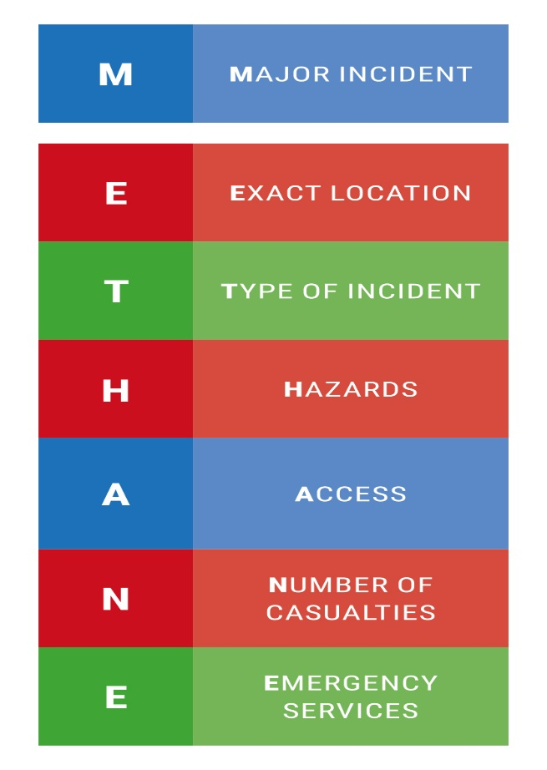
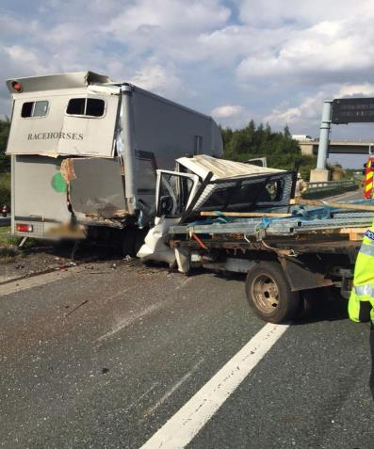
Think M/ETHANE
Notes:
Lesson Management:
This slide contains an audio recording of a M/ETHANE report relating to the incident shown in the photo. Click on the audio icon in order to play the M/ETHANE report. The report reflects reality in that it is not perfect. However, it does contain all the relevant information. The emphasis here is on a structured reporting process when working under pressure.
A key point is that responders should pass this information to their control rooms at the earliest opportunity, check that the group understand why this needs to happen.

Slide 19
Command Training
National Product Simplification
Localisation
Local train the trainer
One Product for initial and refresher training
Tactical and Operational Commanders
One handbook
Simplified pre-course work
Owned by College of Policing
NCALT for definitive version (mirror on our website)

Slide 20
Multi-Agency Resilience
Ambulance
Police
Fire & Rescue
Coast- guard
Local Authority
Voluntary Sector
Public Health
England
Ports
Environment Agency
Military
Media
Central Government
Transport
Highways England
Airports
Health & Safety Executive
Water
Power
Notes:
Lesson Management:
Different agencies respond to an incident because they have specific functions, capabilities and expertise. Ideally, all responders should have a basic understanding of each other’s roles so that they can work together effectively.
It is important to remember that this list is intentionally not complete, nor does it cover every agency that might be involved in an incident.
A single incident can have a knock-on effect in different ways that requires additional planning and the involvement of many different organisations.
We often tend to think about incidents in terms of the immediate scene, saving lives and reducing harm, this is the response phase.
In truth, the recovery phase can be equally as challenging and take longer than the response phase.
Recovery is about returning things to normal following an incident and can involve many different agencies and organisations.
Final Points:
If you aren’t sure of the purpose or capabilities of an individual or agency – ask them. They may have exactly the capability you need to help achieve your aim, or know how to get it.
Multi-agency working is all about what each agency brings in the way of capability, expertise and resource.
Interoperability is how you make it all work together.

Slide 21
Command Training
One day classroom delivery
Operational and Tactical now Consolidated
Multi-agency training team
HYPERLINK or EMBED TRAINER Specification
Multi-agency students
Local Scenarios
Although RTC and Festival scenarios are still available

Slide 22
Multi-Agency Interoperability Training Operational and Tactical Command
Module: The Role of Commanders

Slide 23
Command Training Changes
Trainers trained locally
Reflects Second Edition Doctrine
Operational and tactical merged
Local Scenarios
Airwave Section
Pre-course learning Awareness and Legislation
Delivers refresher training

Slide 24
Consolidated Command Trainer Guide

Slide 25
Command Training Similarities
Multi-agency groups
Multi-agency trainers
Based on the Joint Decision Model
Each element explored and discussed
Takes a day

Slide 26
Control Room
Work started in March
Control room awareness (early summer)
Classroom standalone
On line top up product
Managers and Supervisors
Classroom product (summer)

Slide 27
Products available on website

Slide 28
Thank You & Any Questions?
www.jesip.org.uk
contact@jesip.org.uk
Twitter @jesip999

