Slide 1
Training & Delivery Workshop
JESIP Team

Slide 2
Housekeeping
Fire Alarms
Toilets
Phones, Pagers and other comms devices
Breaks

Slide 3
Agenda
09.30 - 09.45 – Welcome
09.45 - 10.30 – JESIP update
10.30 - 11.00 – Joint Doctrine edition 2
11.00 - 11.30 – Coffee & Networking
11.30 - 12.00 – General training update
12.00 - 12.30 – Assurance visits update
12.30 - 13.30 – Lunch
13.30 – 14.30 – Workshops
14.30 – 15.00 – Coffee & Networking
15.00 – 16.00 – Workshops
16.00 – 16.30 –Q&A and closing remarks
16.30 - Departure

Slide 4
JESIP Vision
“Working Together – Saving Lives”
Aim
“To ensure that the blue light services are trained and exercised to work together as effectively as possible at all levels of command in response to major or complex incidents so that as many lives as possible can be saved”

Slide 5
What is interoperability?
Interoperability is defined as the extent to which organisations can work together coherently as a matter of routine

Slide 6
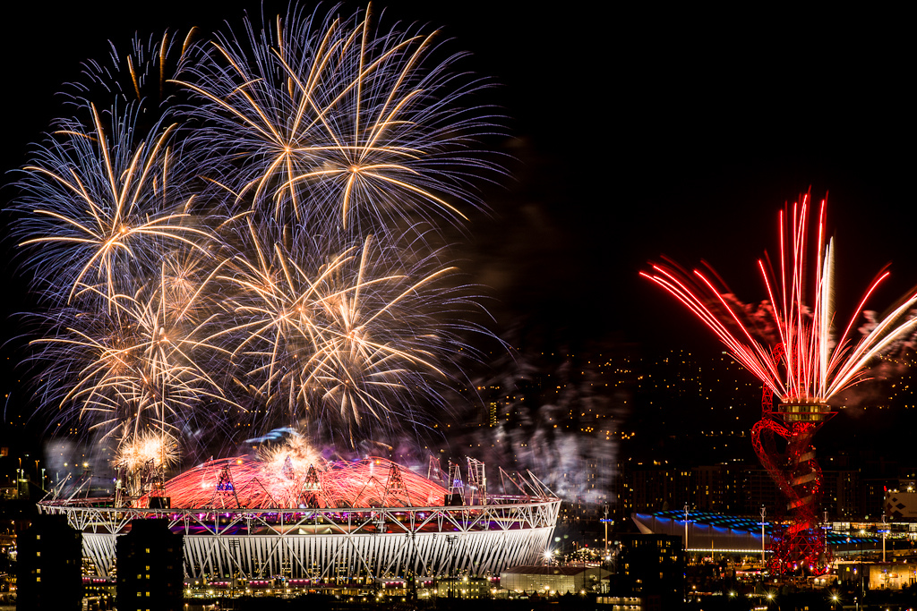

Slide 7
…..Since Sept 2012

Slide 8
…..Since Sept 2012
Collaboration
Fire reform
Hillsborough

Slide 9
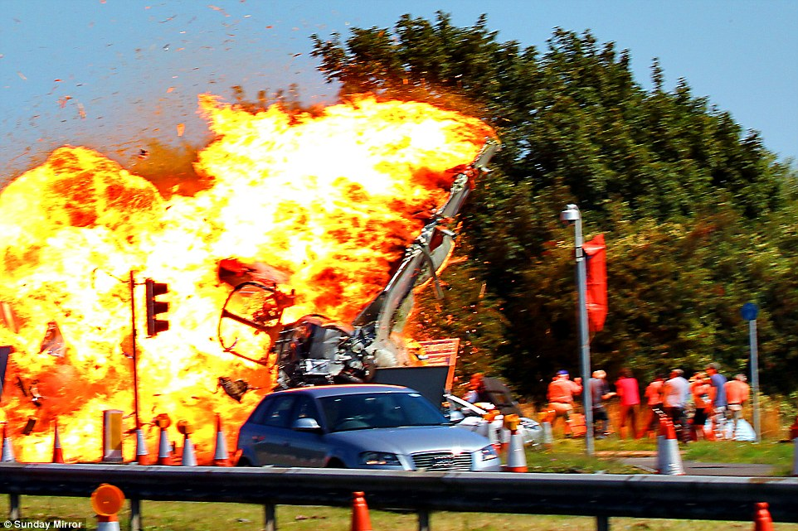
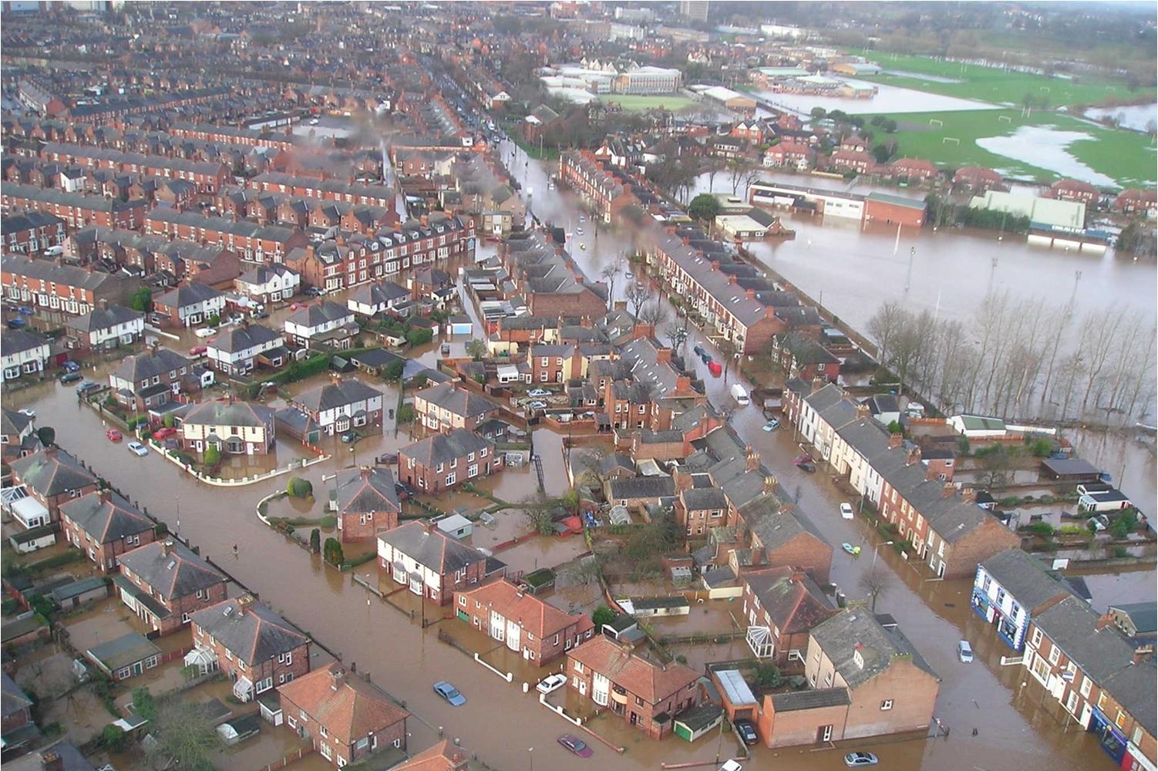
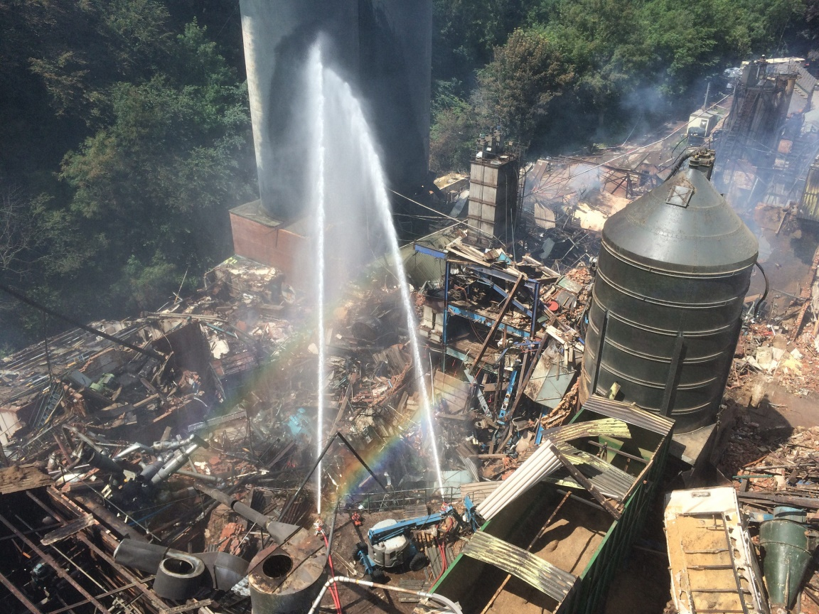
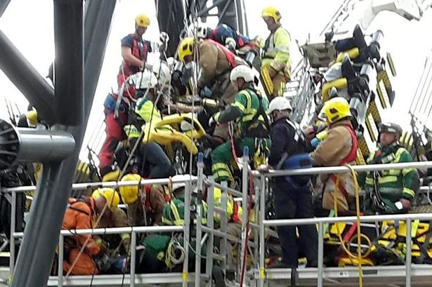
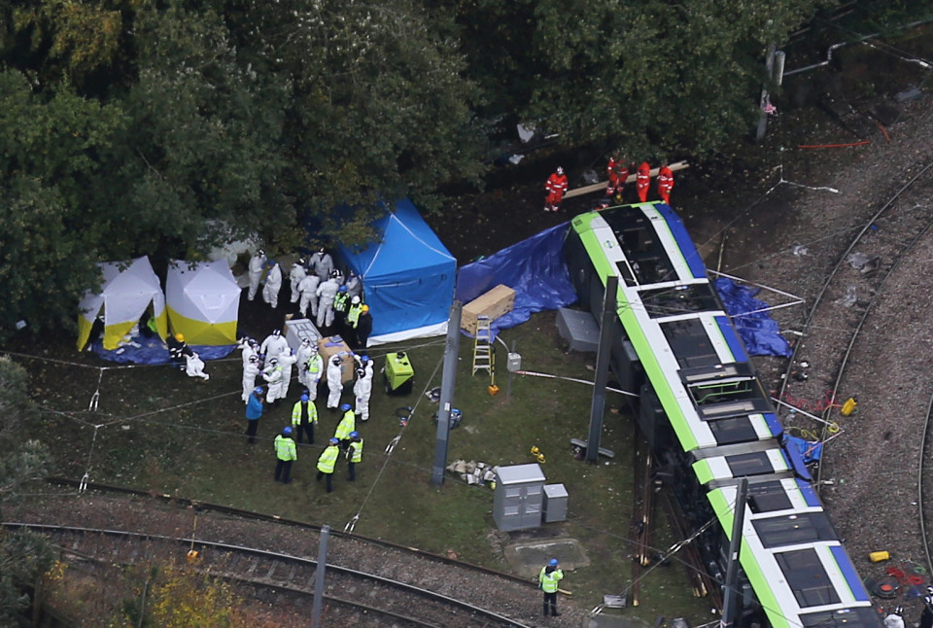
The only constant….
The incidents keep on coming….
Shoreham
Flooding
Bosley Mill
Alton Towers
Croydon tram crash

Slide 10
…..not just for Christmas
JESIP isn’t done
Joint working, not JESIP?
Single service/sector models still prevalent
OTHERS
SHATTERS
HAULEM
SMEAC
CETHANE
PICTURE
SBAR
UHALET
M
Notes:
We have come a long way, but we are at a potentially dangerous junction and need to ensure complacency doesn't creep in!
The effort put into the training was immense and it has helped better position the services to respond to incidents, however without refresher training people will forget it!

Slide 11
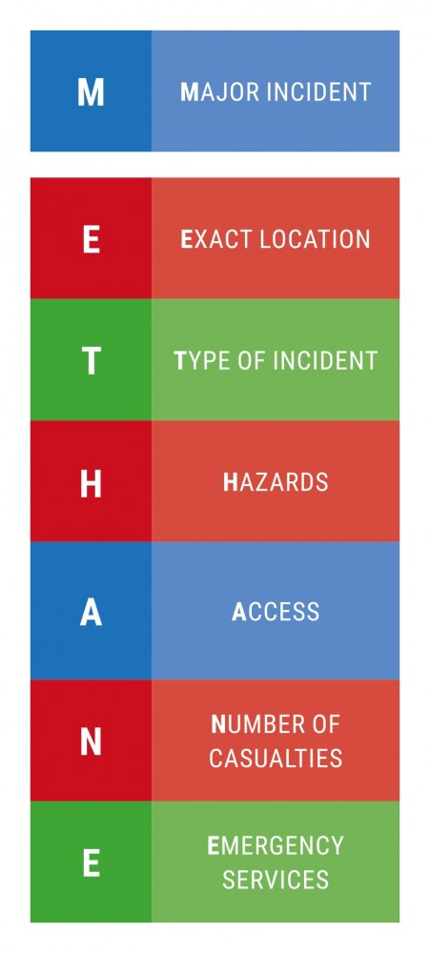
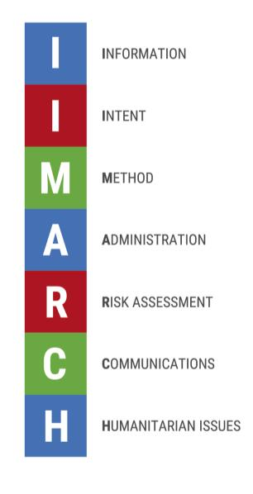
All are covered by…..

Slide 12
Challenges
Emergency Services are not funded or governed by any one Government department
Training regimes, requirements and focuses are different
Then add in the wider responders…..

Slide 13
It has to be a team effort..
“Coming together is the beginning, keeping together is progress, working together......is success.”

Slide 14
Enjoy the day
www.jesip.org.uk
contact@jesip.org.uk
@jesip999

Slide 15
JESIP Update & Embedding Reminder
Joy Flanagan
Communications & Engagement Manager

Slide 16
By the end of the day…..
JESIP update & embedding activities
Discussed the revised Joint Doctrine
Understood Training – the new world
Heard about Assurance visits
Attended both Workshops 1 & 2
1) Training – new products and approach
2) Joint Organisational Learning – why its important and what we need you to do
Had access to the JESIP team & your partners and peers

Slide 17
Let me take you back….
Interoperability
Working Together – Saving Lives
Joint approach to situational awareness, decision making and risk awareness
Improved use of mobile communications with common strategy for use
More effective and coordinated deployment of resources at major incidents
Shared understanding of roles, responsibilities and capabilities
Joined up and common application of doctrine to supporting joint working
On-going effective governance structure for interoperability
Notes:
JESIP not about interchangeable services
Recognise differences and be aware of them to work better together.
Interoperability needs to become business as usual and principles could be applied locally as well as nationally.

Slide 18
Why?
Poor working practices and organisational planning
Inadequate training
Failure to learn lessons
No monitoring/audit mechanism
Previous lessons/reports not acted upon
Opinions
Emergency Services
JESIP team
Academic research
32 Major incidents from
1986 to 2010
“The consistency with which the same or similar issues have been raised by each of the inquiries is a cause for concern.”

Slide 19
2015 - HMIC Led Tri-Service Review
All operational staff to have awareness of JESIP
Training and / or awareness extended to Cat 1 & 2 partners
Ensure exercises are multi-agency and based on scenarios beyond local risk registers including issues raised via JOL
Services need to build JESIP into CPD programmes , refresh and test knowledge regularly
Increase knowledge of Airwave and talk groups (until new ESN live)
More effective organisational learning processes required including links from local learning to national learning - JOL
Continual focus on improving joint working with robust assurance methods overseen by Ministers

Slide 20
JESIP 2016 Objectives
Joint Doctrine fully embedded
Specialist capabilities based on JESIP doctrine
JESIP models used routinely
Effective JESIP training
JOL - the standard for multi-agency learning
Supported by local multi agency debriefing processes
Appropriate assurance processes
Align JESIP strategy to collaboration and new emergency services technology changes

Slide 21
The findings..…….
Poor working practices and organisational planning
Inadequate training
Failure to learn lessons
No monitoring/audit mechanism
Previous lessons/reports not acted upon
The solutions…….
Easy to understand guidance and framework for joint working
Joint training, testing & exercising
National Joint Organisational Learning arrangements

Slide 22
A year in the life of JESIP

Slide 23
Doctrine
Revised, consulted and published Version 2
Aligned other products to new version
Aide Memoires
JESIP App (available for Windows phones now!)
downloaded over 20,000 times in 12 months
Increasing level of alignment of national doctrine / policy / guidance to JESIP
Published an embedding checklist to clarify expectations on services

Slide 24
Training, Testing & Exercising
Learning outcomes framework
JESIP exercise objectives & other templates to support de-briefing & capturing learning
New JESIP All Staff Awareness in three formats
Revised command training products
Tri-service communications tactical advisor course

Slide 25
JOL
Delivered additional JOL workshops
Three JOL action notices issued and acted upon
Learning through JOL led to:
change in national doctrine and guidance for CT events
Adoption of JESIP by MOD
Working with Cabinet Office to replace JOL App and LessonDirect with a single learning database

Slide 26
MTFA
Joint Operating Principles for MTFA
Standardised set of MTFA exercise objectives to support exercise planning, debriefing and the capture of joint organisational learning
Designed and distributed an MTFA aide memoire
Developed a table top exercise assurance programme for MTFA and supported the delivery of seven exercises to date
Three MTFA awareness DVD’s on the way

Slide 27
Transition & Assurance
Transition of essential JESIP central team functions to business-as-usual activities
Support and engagement with a number of other Category 1 & 2 organisations
Planned and executed a programme of assurance visits across 104 emergency services

Slide 28
Communications & Engagement
JESIP awareness presentations delivered or planned to over 50% of LRFs
Delivered 12 regional engagement events across the UK
Delivered training and support to both Northern Ireland and Scotland as they adopt JESIP
JESIP newsletters, editorial articles, correspondence
Over 5,500 followers on Twitter
Open channel for feedback / support (JESIP email)

Slide 29
And a few other things….
Joint Operating Principles for CBRN
Other responder agencies generic tabard “officers in charge” on-scene (sample available)
Facilitating Combined Tactical Air Cell guidance
National Police Air Service (NPAS) and HM Coastguard
Contribution at various MOD events
the intermediate land course (Army Majors)
Defence Contribution to Resilience Course (JRLOs and brigade HQ commanders)

Slide 30
Others who are adopting and embedding JESIP
Her Majesty’s Coastguard
Environment Agency
Highways England
National Grid
St Johns Ambulance
Red Cross
Port Authorities

Slide 31
Its over to you….

Slide 32
Embedding JESIP Your Responsibilities
Identify all polices & procedures affected
Integrate JESIP content into them
Incorporate JESIP into relevant on-going training courses / learning programmes and train staff (learning outcomes)
Test understanding via multi-agency testing & exercising (JESIP tools & templates)
De-brief and discuss issues with those involved to mutually agree any JOL
Agree who will submit lessons onto JOL

Slide 33
We know its difficult…
Requires culture change
Requires support & leadership from the top
Requires local process to support national process
Requires trust, discussion and collaboration

Slide 34
JESIP needs you!

Slide 35
To help?
JESIP website stacked full of support
Principles, JDM & METHANE explained
Easily accessible products
Embedding Checklist
Assurance visits
Learning Outcomes Framework
Free JESIP App
Twitter @jesip999

Slide 36
Why should we?
Public
Public visibility and scrutiny of emergency services & other responder agencies
Legal
Obligation to act on lessons identified
Challenge on agencies - public enquiries
Professional
Mistakes from the past NOT repeated
Providing the service the public expects

Slide 37
Thank You & Any Questions?
www.jesip.org.uk
contact@jesip.org.uk
Twitter @jesip999

Slide 38
Joint Doctrine - ‘the Interoperability framework’ Edition 2
Carl Daniels
JESIP Deputy Senior Responsible Officer

Slide 39
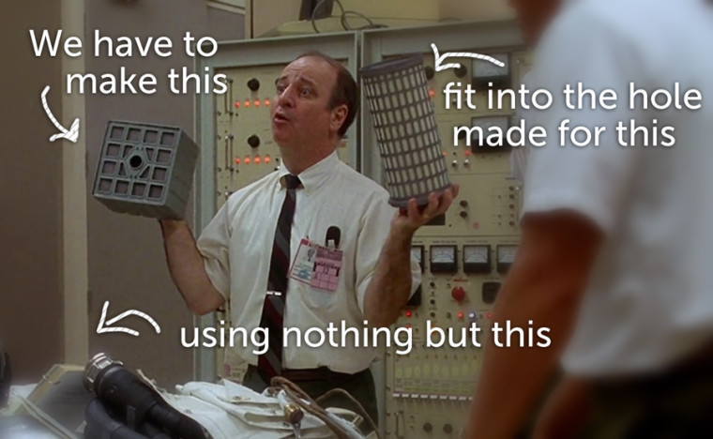
Challenges

Slide 40
Doctrine Review Outline
What we set out to do!
Build on the success and direction of edition 1
Bring additional clarity around the models and their use
Provide guidance for control rooms
Extend the reach of JESIP

Slide 41
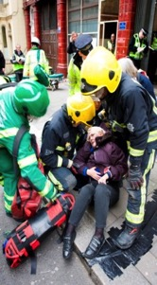
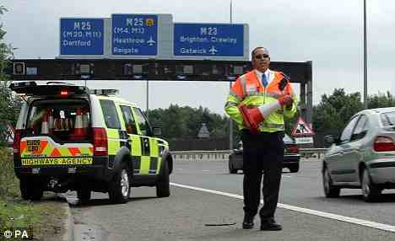
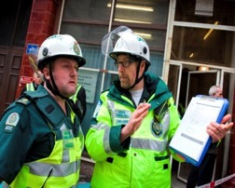
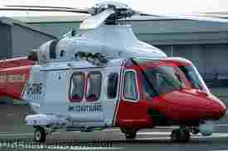
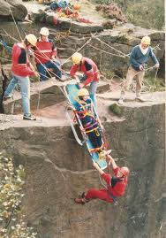
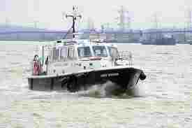
Joint Doctrine Edition 2
Edition 2 released in July 2016
Key changes:
Language more inclusive
Online resource
Extended use of METHANE
Inclusion of a standard briefing tool (IIMARCH)
Specific information for Military responders
New Major incident definition

Slide 42
Major Incident Definition
An event or situation with a range of serious consequences which requires special arrangements to be implemented by one or more emergency responder agency.

Slide 43
Not Just for Major Incidents
Joint Doctrine is scalable – not just for major incidents
JESIP principles and models can be used by ALL responder agencies

Slide 44
Single model for sharing incident information

Slide 45
Joint Doctrine…..the basics

Slide 46
This is not a hierarchy….

Slide 47
Joint Doctrine…..the basics

Slide 48
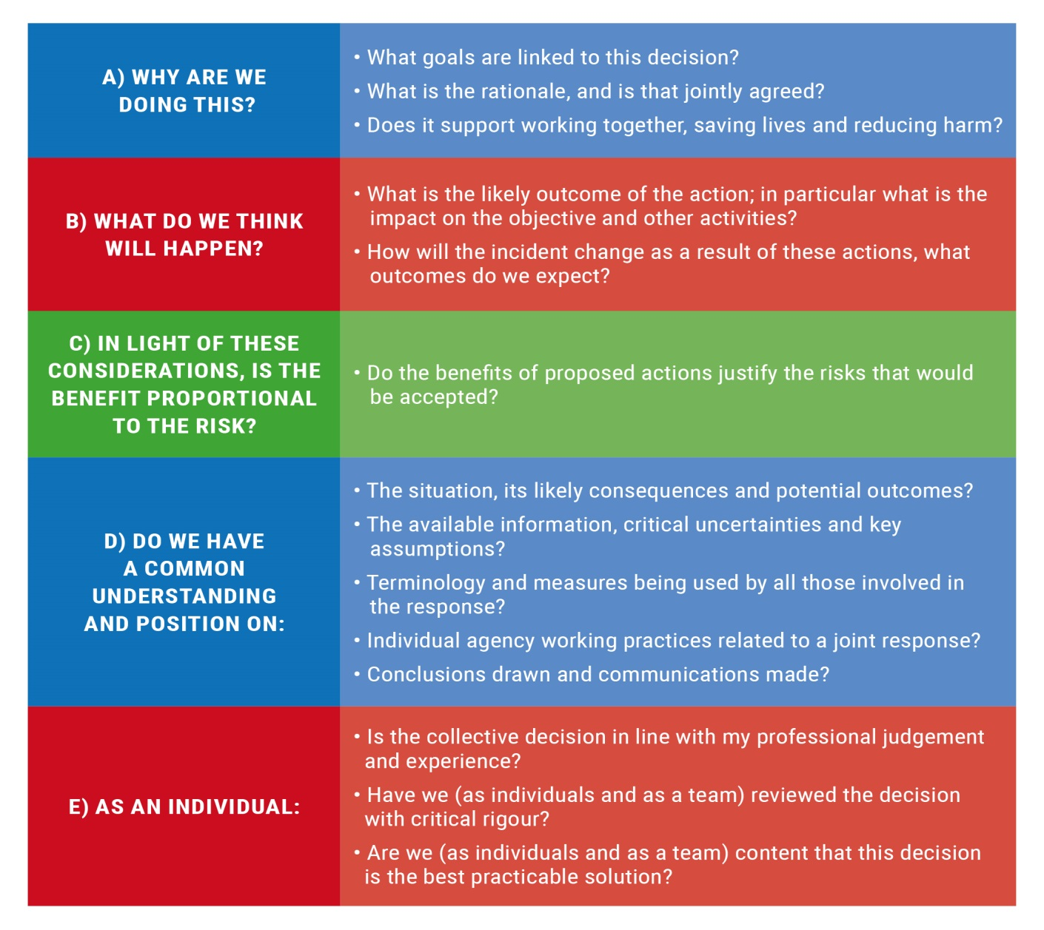
Joint Doctrine…..the basics

Slide 49
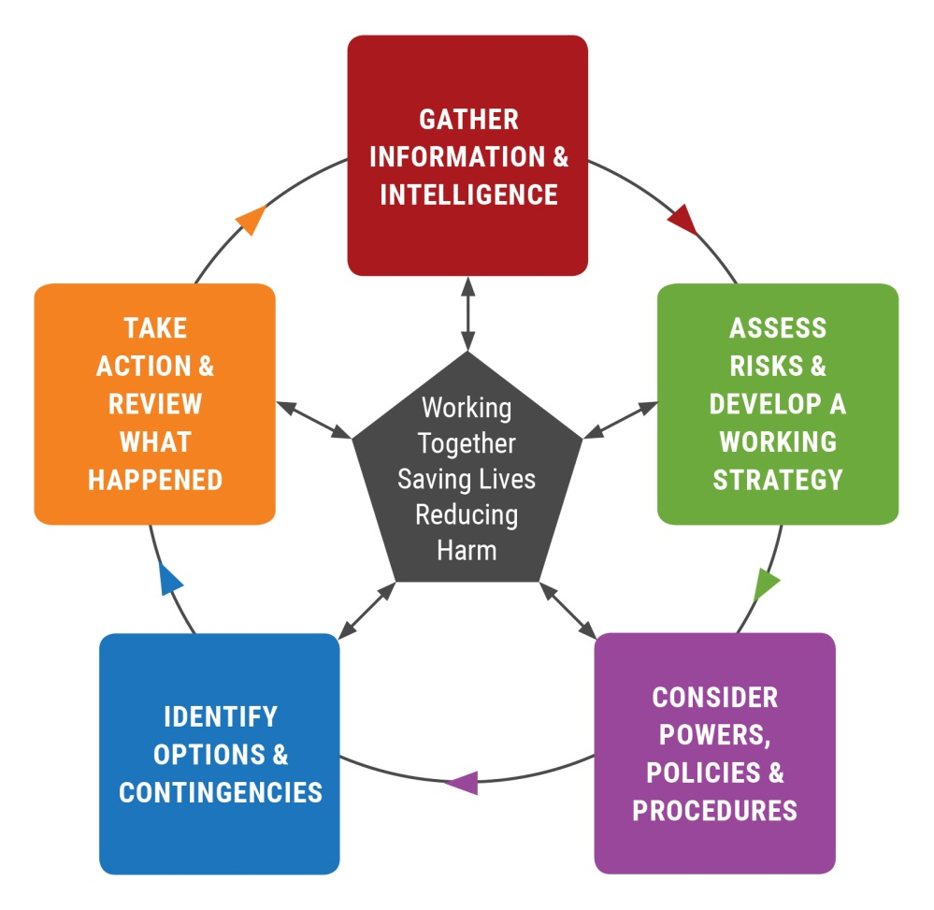
Joint Doctrine…..the basics
Briefing
For quick time briefing the JDM may be used
Protracted incidents may
require a more detailed
briefing….
Information
Intent
Method
Administration
Risk Assessment
Communication
Humanitarian Issues

Slide 50
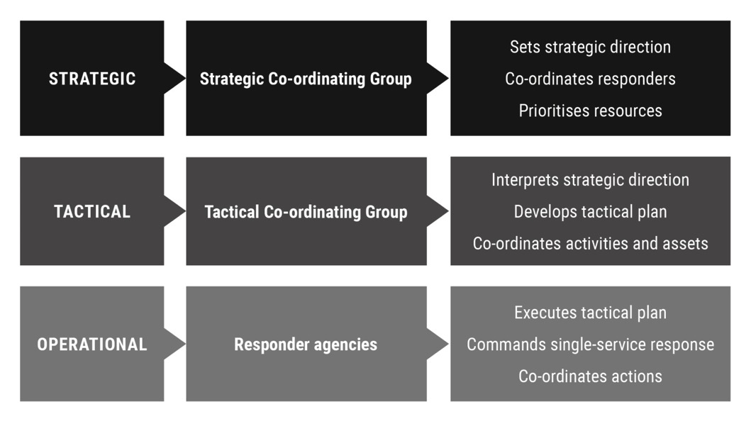
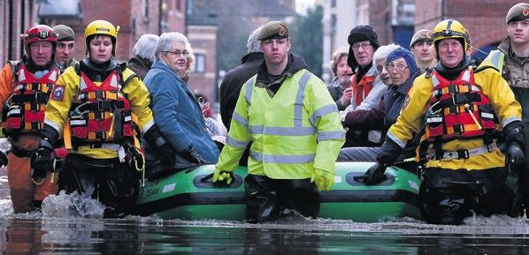
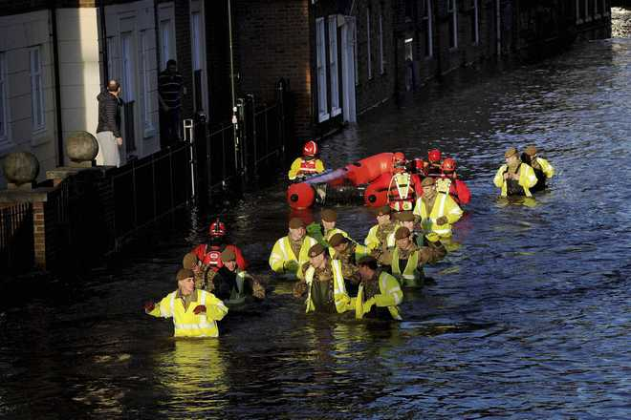
Military
Does not cover in detail requesting assistance
Command Levels
Command Authority
OPERATIONAL
TACTICAL

Slide 51
Thank You & Any Questions?
www.jesip.org.uk
contact@jesip.org.uk
@jesip999

Slide 52
Training Update
Julian Frost
Senior User

Slide 53
Training Model
Initial approach
Lessons learnt
New model 2017 onwards

Slide 54
Initial Approach
Centrally Produced Products
E-learning (all staff and commanders)
Tactical & Operational Command course
Control Room Managers & Supervisors Course
Supported by Train the Trainer delivered nationally and central reporting system
Refresher schedule – those in command roles – joint training every three years

Slide 55
JESIP Training Products
Strategic Commanders
Tactical Commanders
Operational Commanders
Multi Agency Gold Incident Commander (MAGIC) Training
Control Room
Tactical Commanders Course
Operational Commanders Course
Operational Staff
Control Room Supervisors Course
Commander
E-Learning Package
Commander
E-Learning Package
Welsh GOLD
Being aligned to JESIP
All Staff
E-Learning Package
New
Entrants
All Staff
E-Learning Package
All Staff
E-Learning Package
All Staff
E-Learning Package
All Staff
E-Learning Package
All Staff
E-Learning Package
Introduction
to JESIP Presentation
Introduction
to JESIP Presentation
Introduction
to JESIP Presentation
Introduction
to JESIP Presentation
Introduction
to JESIP Presentation
Introduction
to JESIP Presentation
Other Cat 1 & 2 responders can attend the command courses and access the all staff awareness package
Notes:
This diagram explains the range of JESIP products against the people they are designed for.
Whilst JESIP has services training their priority commanders, operational staff from joining through their promotional journey to commander need to understand the importance of and principles of interoperability.
The future challenge for services will be to look again at how operational staff are trained and consider new joint training opportunities with other emergency services so that joint working becomes second nature - business as usual. Could new recruit training have combined modules?

Slide 56
JESIP Training Achievements
Commanders trained
11,147
Jan 2014 to Jan 2015
Control room staff trained
1642
Since Oct 2014
Responders e-learning
100,000+
Since April 2014
Multi-agency observers
283+
Attended commanders courses (from 78 different agencies)
Interoperability trainers
540
Licensed and trained to deliver JESIP courses
Validation live-exercises
24
Incl. final programme validation exercise – Joint Endeavour (850 participants)
Notes:
Latest JESIP training figures update.
Most significant development since last conference is control room staff (78% of total training requirement due by end March).

Slide 57
Successes
Most ambitious and extensive joint training programme ever undertaken
Joint training delivered results
JESIP brought structure to existing joint working
Built trust between organisations
Enabling successful collaborations

Slide 58
Lessons Learnt
We acted on your feedback
More flexibility in local training approaches needed
Opportunities to embed JESIP content into other training
Need to integrate JESIP locally in Continuous Professional Development (CPD)
Extend reach beyond blue lights
Ease of access to national products

Slide 59
Its over to you….

Slide 60
The 2017 model
Localism
Learning Outcomes Framework supports locally produced products
Refreshed national command products
New All staff awareness products
Sustainable Train the Trainer
Control Room Training

Slide 61
Train the Trainer
No further train-the-trainer workshops
Licence arrangements re-negotiated
Cascade training
Specification (handout)
Command
All Staff Awareness

Slide 62
Workshop
Learning Outcomes Framework
Centrally produced products
All staff awareness e-learning
All staff awareness classroom
Consolidated Tactical & Operational Command
Train the Trainer

Slide 63
Control Room Training
Refresh of Control Room Managers / Supervisors Course
New all control room staff package
E-learning
Classroom
Initial workshop held March 2017
Products due summer 2017

Slide 64
Notable Practice
Broadening “command” training underpinned by JESIP
Public Order training involving fire & ambulance
Wider Responders involved
Increasing understanding of others capability

Slide 65
Thank You & Any Questions?
www.jesip.org.uk
contact@jesip.org.uk
Twitter @jesip999

Slide 66
Assurance Visits
Progress and observations

Slide 67
Progress so far
Services visited so far = 38
20 FRS
12 Police
6 Ambulance
Three services – dates outstanding
Region by region but none complete yet
Remaining visits from now to July 2017
Executive reports to each service following visits (outstanding)
Complete report to Interoperability Board
September 2017

Slide 68
Here’s where we’ve been
South Central
Thames Valley Police
West Midlands
W. Mercia & Warwickshire Police
East Midlands
Derbyshire FRS
South East Coast
South West
Hampshire and IOW FRS
Royal Berkshire FRS
Hampshire Constabulary
South Central Ambulance Service
Oxfordshire FRS
Staffs FRS
Shropshire FRS
West Mids FRS
Hereford & Worcs FRS
Warwickshire FRS
West Mids Ambulance
West Mids Police
East Mids Ambulance
Derbyshire Police
Nottinghamshire FRS
Northants Police & Fire
Leicestershire FRS
East of England
Beds, Cambs, Herts Police
Essex FRS
Herts FRS
Norfolk FRS
East of England Ambulance
Norfolk Police
Suffolk Police
Lincolnshire FRS
South East Ambulance
Kent Police
East Sussex FRS
Surrey FRS
Avon FRS
Avon & Somerset Police
Dorset & Wiltshire FRS
South Western Ambulance Service

Slide 69
Aims
To gain a national picture of how well JESIP has been embedded
Provide support & guidance to services
To provide assurance to Government
Likely to form basis of future HMIC led tri-service review

Slide 70
Assurance Visits – Observations
Embedding checklist, self-assessment survey and visits appear to have brought focus to embedding requirements
Some really good examples of embedding JESIP locally (primarily single service)
Biggest concern - CPD - future joint training plans for commanders
Three year refresh cycle been known since initial training
Some services waiting for JESIP products but still no plans in place

Slide 71
Notable Practice
METHANE used for all informative messages to embed use (FRS)
NARU developed specific national command training for the ambulance service
mandatory from 2018/19
Regional meeting of JESIP lead officers with a standard agenda
JESIP compliant pre-exercise presentation developed & delivered resulting in more successful multi-agency exercising
JOL – service have developed a local process and reporting mechanism to help staff capture information post incident and provided training

Slide 72
Airwave Test
Designed to improve use of interoperability talkgroups
Control rooms and commanders
Monthly / weekly
Full details available on website
Downloads / Toolkits
http://jesip.org.uk/airwave-test
Airwave hailing channel used by control rooms to share “Stay Safe” messages increasing confidence on Airwave use

Slide 73
Operational Communications Advisor Training (Airwave Tac Ad)
For those new to role or those requiring re-qualification
Multi-agency course replaces 3 x single service courses
Existing Tac Ads – update days now available
Course Future proofed ready for ESN
College of Policing coordinating courses (website)
Variable venues and course dates

Slide 74
Thank You & Any Questions?
www.jesip.org.uk
contact@jesip.org.uk
Twitter @jesip999

