Slide 1
Debriefing & Joint Organisational Learning (JOL)
Brian Welsh
JESIP Senior User - FRS

Slide 2
Joint Organisational Learning (JOL)
Final but fundamental piece of the JESIP puzzle
To become the standard for multi-agency learning

Slide 3
Areas for discussion today?
Debriefing
Transition from central JESIP team to Emergency Services and Civil Contingencies Secretariat -2017
How current systems will integrate with JOL
New JOL database –bringing together JOL and lessons direct (JOL ONLINE)

Slide 4
The learning cycle
Planning
Objective setting
Umpire/Assurance
Debrief
Capture of lessons
Implementing Lessons
Review learning

Slide 5
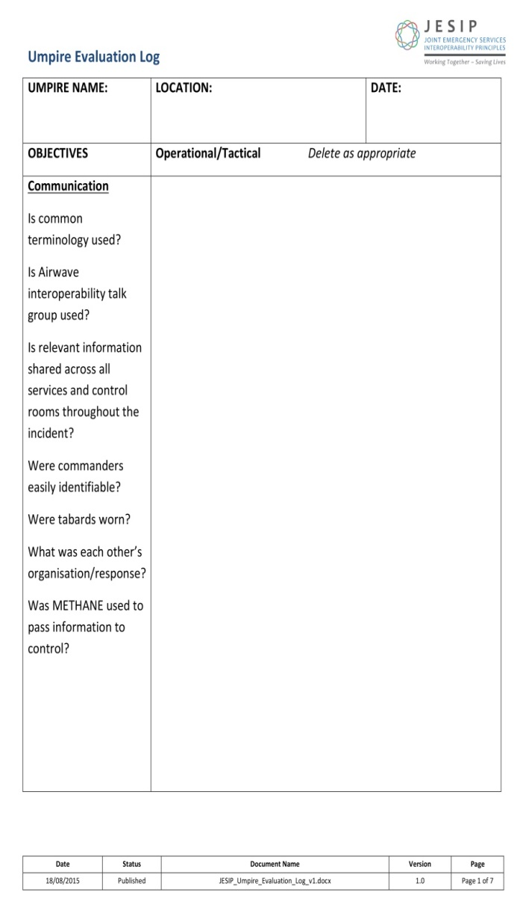
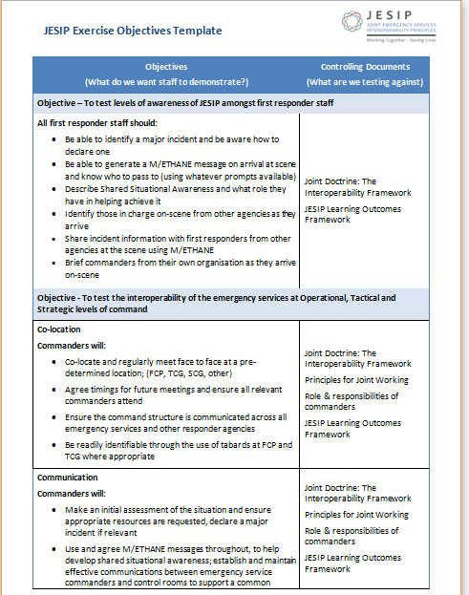
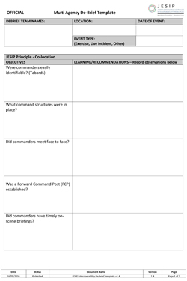
Tools to support capture of lessons
JESIP objectives should be at the core of EVERY multi-agency exercise
Objectives should be set against previous lessons identified
JOL templates aid capturing interoperability lessons

Slide 6
How do you capture interoperability lessons
Hot debrief
Single service formal debrief
Multi agency debrief
equipment
briefing
mobilising
Triage
Interoperability?
Scene preservation
Command and control
resources
communications

Slide 7
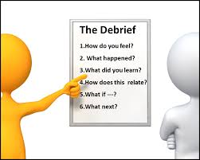
Local process for JOL
Interoperability lessons are captured from debriefs
How do we debrief?
e.g
What went well?
What didn’t go well?
How can we do better?
Share & agree interoperability lessons with partners – in what forum?
LRF sub group?
Blue light group?
Other?
Input

Slide 8
JOL transition- working group
JESIP team
Carl Daniels
Brian Welsh
Chief Fire Officers Association (CFOA/NFCC)
DCFO Martin Blunden
AM Stewart Nicholson
National Police Chiefs Council (NPCC)
ACC Chris Shead
DI Frankie Westoby
Association of Ambulance Chief Executives (AACE)
Director/Ass Chief Keith Prior
National Coordinator Mark Norbury
Cabinet Office - Civil Contingencies Secretariat (CCS)
Ben Platt

Slide 9
JOL – transition working group
Continue to embed JOL into the emergency services and wider responder organisations through local structures for capturing lessons including Local Resilience Forums.
Provide a governance structure including responsibility and accountability for JOL across the emergency services and wider responders.
Oversee the transition and handover of JOL from the central JESIP team to an emergency service led JOL structure by the end of 2017.
Provide a solution for the seamless capture of interoperability lessons and wider lessons identified through closer joint working between JOL and Lessons Direct.
Continue to promote a local culture that encourages the reporting and capture of lessons identified and notable practice.
Provide explicit links between JOL and other sector organisational learning processes removing any duplication so that learning can easily be shared and acted upon where appropriate.

Slide 10
How do we capture and input lessons?
Interoperability Board
Emergency Service and Wider Responder Lessons
JOL
decisions
decisions
Single sector lessons
JOL
secretariat
secretariat
JOL input
Single sector lessons input

Slide 11
How JOL ONLINE will work
JOL
JOL Subject Matter Advisors
Emergency Service and Wider Responder Lessons
Interoperability Board
FRS
NOLUG
JOL Subject Matter Advisors
decisions
JOL
Police
NPoCC
JOL
Secretariat (NARU)
JOL
Ambulance
LID
JOL
JOL input
LRF
JOL

Slide 12
JOL ONLINE review 2017
Engagement events asked you what “you” wanted
Analysed single service lessons processes (handout)
Working with services and LRFs to ensure duplication is reduced
Working with services to ensure interoperability lessons are captured within current and new single sector processes
Provide functionality for JOL SPoCs to request reports
User friendly search function
A traffic light system so you can follow your inputs
Ability to update and modify inputs
Secure to official sensitive (Resilience Direct)
More control over sharing your data
JOL mailbox for each service/LRF
JOL@merseyfire.gov.uk
JOL@wmas.nhs.uk
JOL@met.pnn.police.uk
JOL@LRF.org.uk

Slide 13
Thank You & Any Questions?
www.jesip.org.uk
brianw@merseyfire.gov.uk
contact@jesip.org.uk
@jesip999

