Slide 1
Embedding JESIP
Workshops August and September 2018

Slide 2





Welcome
Fire Alarms
Toilets
Mobile/Pager
Lunch/Refreshments
Timings

Slide 3
Request from the Ministers
Deliver a JESIP structure locally which includes a strategic lead, a training or delivery lead, and JOL lead, ensuring that a process is in place to maintain these positions as normal practice;
Establish a formal process locally with all Local Resilience Forum partners to share multi-agency lessons and notable practice as standard onto JOL Online;
Subscribe to JESIP peer review arrangements outside of statutory inspections; and
Continue to deliver multi-agency training and awareness packages, and have a written commitment to do so. Training should be received at all levels – up to and including chief officer level – and continue throughout careers.

Slide 4

This is about you

Slide 5

Enjoy the day
www.jesip.org.uk
contact@jesip.org.uk
@jesip999

Slide 6
Overview of JESIP Work to Date and Ongoing Challenges
Paul Owen
Senior Police User
0753 360 9737
paul.owen@hampshire.pnn.police.uk
Notes:
Official / 15 minutes / question policy

Slide 7
Introduction
The assurance program
7 x recommendations
Summary of key findings
Our favourite Notable Practice
Notes:
Doctrine Training (including awareness for frontline) Exercising JOL. Black Box culture

Slide 8

The Assurance Programme
Visits took place between January and August 2017
Based on services self-assessment questionnaire return
Included interviews with Strategic leads and multi disciplinary focus groups
Conducted 101 visits and interviewed over 700 people
Notes:
Couldn’t arrange interviews with 3 Police forces, 1 FRS and 1 Ambulance service Interviews included the Strategic leads through to frontline staff. Multi level = tac / operational / strat

Slide 9
Assurance Report Recommendation 1
Services prioritise a review of local policies, plans and procedures based on risk. It should ensure JESIP models and principles are included in all relevant documents and materials.
Are the principles included?
Is the JDM used?
M/ETHANE?
Notes:
Do local Policies and Procedures reflect JESIP

Slide 10

Assurance Report Recommendation 2
Eradication of single sector models in local policies, plans and procedures which duplicate JESIP.
Notes:
The scale of the challenge

Slide 11
Assurance Report Recommendation 3
Commanders, control room managers and supervisors to attend a multi-agency training course, every three years.
All frontline responders and control room staff to receive JESIP awareness annually.
Training
Awareness
Notes:
Local learning and development strategies should include the requirement for

Slide 12
Training and Awareness
‘Over 12,000 commanders trained’
Training Plans
Has any training taken place since the initial rollout?
Who are services training (new/refresher)?
What provision is there for frontline and control room staff?
Notes:
Are agreed plans in place

Slide 13
Assurance Report Recommendation 4
A robust training calendar with multi-agency and refresher courses.
The provision of awareness products, for frontline and control room staff.
Notes:
Evidence via training statistics -quarterly

Slide 14
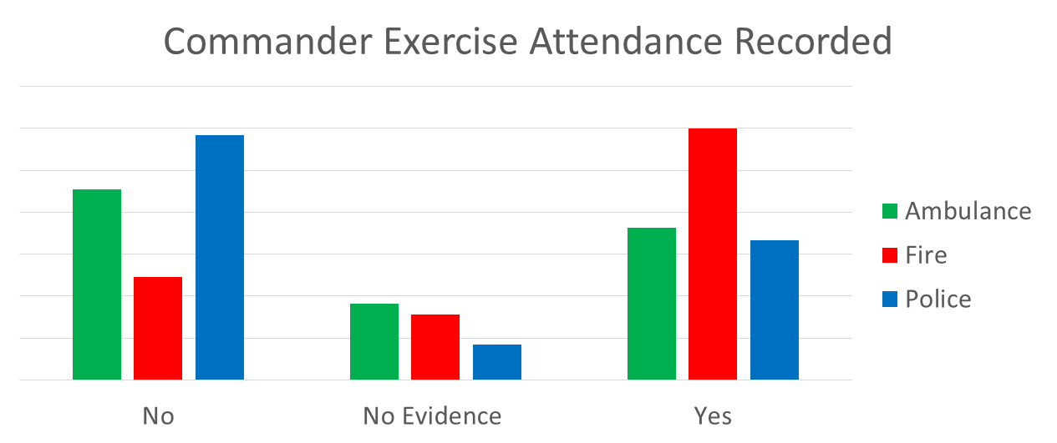
Assurance Report Recommendation 5
Exercises in place which include the JESIP exercise objectives.
All commanders recorded as attending an exercise every 3 years to apply JESIP.
The JESIP exercise assurance framework should be considered by services as a partnership model for delivery.

Slide 15
Exercising
Is there a published multi-agency exercise calendar in place
Is a commanders attendance at an exercise recorded?
Are commanders mandated to attend an exercise?
‘Multi-agency testing and exercising programmes need to be better coordinated and risk-based beyond Local Resilience Forum Community Risk Registers/National Risk Assessments’.
HMIC Tri-Service Review - 2015
Notes:
Published to who?

Slide 16
JOL Usage
‘The emergency services need to have more effective processes in place for learning and embedding lessons locally and, for cascading the learning to staff. The knowledge and understanding of the Joint Organisational Learning process needs to be greatly improved’.
HMIC Tri-Service Review - 2015

Slide 17
Assurance Report Recommendations 6
Local policies support the identification of lessons through a multi-agency debrief processes. Then
Lessons identification and sharing arrangements should be formalised.
shared via JOL Online.
This must include who will be responsible for uploading these and when

Slide 18
M/ETHANE
&
JDM TEST MESSAGE

Slide 19
Recommendation 7 –Use the Notable Practice
Inclusion of M/ETHANE in routine mandatory police officer safety training Cheshire and South Wales Police
A 3 way conference call between control rooms at the start of each shift. Issues discussed among others include - Service capacity and significant challenges, ongoing operations and any exercises that may be taking place. SWAS
Command hand over sheet – II MARCH from Staffs Fire
LRF multi-agency Handbooks incorporated JESIP Notts & Derbishire LRF LRF

Slide 20
Summary
New video, visits, new app, continuing JESIP, app
Services have undertaken a lot of work and there has been some good progress
Abstractions remain a challenge (Training and Exercise)
Lack of multi-agency exercises (need to be innovative)
Local delivery not as robust as could be
JOL is still significantly underused!!

Slide 21

Thank You
www.jesip.org.uk
contact@jesip.org.uk
@jesip999
Notes:
Full report on the website

Slide 22

over to you

Slide 23

over to you
Q1. What are the obstacles to embedding in your local area?
5 mins to answer each
15 mins to feedback

Slide 24
Dashboard Reporting
Carl Daniels
JESIP Deputy Senior Responsible Officer

Slide 25

First off…
STUFF

Slide 26
Interoperability Board
Chair of National Fire Chiefs Council – NFCC (Chair)
Deputy Director for Office of Security & Counter Terrorism - OSCT (Co-Chair)
Operations Lead – National Police Chiefs Council – NPCC (JESIP SRO)
Chair of Association of Ambulance Chief Executives - AACE
Director of Civil Contingencies Secretariat (CCS)
Chair of the Local Government Association
Chief Coastguard
Ministry of Defence
Deputy Director for Ministry of Housing, Communities & Local Government
Deputy Director for Department of Health and Social Care
Deputy Director for Home Office Fire
National Coordinator - National Counter Terrorism Police Headquarters (NCTPHQ)
JESIP Deputy Senior Responsible Officer

Slide 27
Purpose
PROVIDE ASSURANCE
To
That
Ministers
Government Departments
Interoperability Board
Emergency Services
The public
Services are continuing to embed JESIP into business as usual arrangements
‘JESIP to be fully embedded by 2020’

Slide 28
Objectives
Doctrine
To provide a consultation function for all appropriate services to ensure that; 1. JESIP is written into all relevant local doctrine, and 2. unnecessary single service models are removed.
Training
Ensure that specific JESIP training courses are always written into services’ locally mandated L&D strategy and training delivery plans.
The Interoperability Board to commission quarterly reports from each service detailing JESIP multi-agency training completed in the last quarter and scheduled for the next two quarters, including figures to demonstrate attendance at training courses.
Exercising
Work with local services to improve the organisation and implementation of local multi-agency exercises, including the insertion of the JESIP exercise objectives and debrief template in all local exercise planning toolkits.
All services to introduce an auditable exercising database to clearly record when responders – particularly commanders – take part in multi-agency exercises and when they are due a refresh.

Slide 29
Objectives
Joint Organisational Learning (JOL)
Ensure that all services develop a formal, written multi-agency agreement (e.g. a Memorandum of Understanding) agreed locally and signed off by the LRF. This agreement should sit within the ‘LRF handbook’, terms of reference or policy document covering debriefing and formalise the local process for ensuring multi-agency lessons are shared on JOL, including the requirement for every service to have a JOL single point of contact.
The JESIP team to work with single sector services to ensure that multi-agency lessons inputted onto single sector learning systems are transferred onto JOL as a matter of routine.
Local Structure
The JESIP team to ensure that local services employ a structure which includes; a local strategic lead, a training lead, and JOL SPOC. This should include a process whereby local roles are maintained without requirement of assurance by the JESIP team.

Slide 30
Objectives
Assurance
The JESIP team should work closely with HMICFRS and CQC to ensure that JESIP is included, where appropriate, in any ongoing inspection regimes (e.g. Peel) as a matter of routine.
The JESIP team to introduce a peer review process of JESIP to be conducted in non-inspectorate review years.

Slide 31
Metrics
Doctrine
80%-100% of services have fully embedded JESIP into local doctrine. JESIP fully embedded into over 90% of relevant national guidance.
80%-100% of services have removed all single service models which perform same function as JESIP models.
Training
80%-100% of services have formally written JESIP commitment into L&D strategy.
>80% of services to have formally written JESIP into training delivery plans.
Every service to have been represented on at least two returns to the Interoperability Board by March 2019.
Exercising
80%-100% of services have embedded JESIP exercise objectives and debrief template locally.
80%-100% of services have established and evidenced a mechanism in place to record attendance at exercises.
Joint Organisational Learning (JOL)
>90% of services have formal agreement in place for multi-agency debrief process and identification and sharing of lessons on JOL.

Slide 32
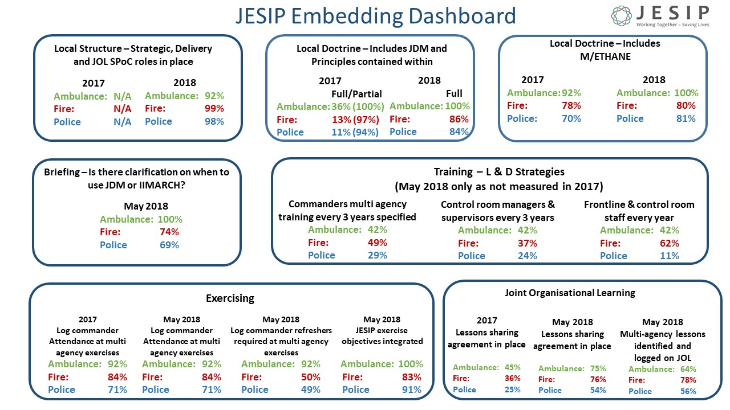

Slide 33
Questions
www.jesip.org.uk
contact@jesip.org.uk
@jesip999

Slide 34
Break!

Slide 35
over to you
Q2. What are the challenges that prevent multi-agency debriefs being shared on JOL Online as a matter of routine?
5 mins to answer
15 mins to feedback

Slide 36
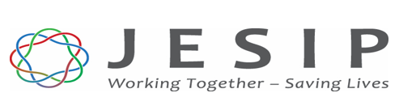
Joint Organisational Learning JOL Online
Brian Welsh – JESIP Senior User
Charis Taylor – JOL Coordinator

Slide 37



Joint Organisational Learning (JOL)
Final but fundamental piece of the JESIP puzzle

Slide 38
Why Joint Organisational Learning
The Civil Contingencies Act 2004 and supporting statutory and non statutory guidance places requirements, through Local Resilience Forums that Category 1 responders must collectively:
Learn and implement lessons from exercises
Share lessons learned from emergencies and exercises in other parts of the UK
Make sure that those lessons are acted on to improve local arrangements
The key message to responder agencies is that JOL is not about “who” but about “what” and “why”…
Notes:
Why Joint Organisational Learning
This slide provides a useful over view of the obligations under the Civil Contingencies Act (2004) for responder agencies to not only learn and implement their own lessons but to share these lessons appropriately in order for others to learn.
Emphasis is made on lessons shared that they should focus on the “what” and the “why” rather than “who”. All lessons submitted on JOL Online should focus on the route cause of the lesson rather than who was potentially at fault.
Local resilience forums ( LRFs ) are multi-agency partnerships made up of representatives from local public services, including the emergency services, local authorities, the NHS, the Environment Agency and others. These agencies are known as Category 1 Responders, as defined by the Civil Contingencies Act 2004

Slide 39
Ministerial Appetite – Scrutiny and Interest
Cross Government Ministers increased interest learning
How do we learn lessons
Are we actually learning Lessons
2015 Floods
2017 Terrorist attacks
Grenfell and the public inquiry
Manchester Arena and independent inquiry
Assurance…
Notes:
The UK Government is committed to improving our resilience and response arrangements and learning lessons form past events. JESIP and JOL Online has provided a response to the first question “How do we learn lessons” in providing a national process for how we identify lessons, capture, record and share with partner agencies across the UK.
Are we actually learning lessons is a challenging question, as this question tends to appear post event where through any debrief or inquiry, the question is asked “has this happened before, if so what did we do about it”
On this note JOL has impacted on many national response arrangements

Slide 40
Government commitment to JOL
Government Procurement Process
Open and transparent
Value for money
Security
Pen Testing – GCHQ approval
Senior Information Officer
ResilienceDirect conditions and user acceptance process
Freedom of Information
Same FOI laws apply to your systems as the Cabinet Office
Public Interest
Data Protection Act – JOL Online has been reviewed by Cabinet Office to ensure GDPR compliant…
Notes:
JOL – Joint Organisational Learning
GCHQ -Government Communications Headquarters
FOI – Freedom of Information
GDPR - General Data Protection Regulation
ResilienceDirect is a web-based service built on a proven resilient and secure platform.
ResilienceDirect is a service built for the Resilience Community, by the Resilience Community. Providing a secure platform for sharing information that supports effective multi-agency working and offers a greater sense of shared situational awareness

Slide 41
Information Flow Generic (all) RD users JOL SPOCS
Lead Government departments
Closed Group
JOL Coordinator
&
JOL Working Group
Other organisations
JOL SPOC
RD Generic User
RD Generic User
RD Generic User
Publish to all
Publish to Closed Group
Notes:
Information flow, Generic (all) RD users and JOL Spocs
This slide shows the information flow from both JOL Single Points of Contact as well as all other RD users.
Point of note. This system allows all RD account holders share lessons and notable practice. All Category 1 and 2 responders, the military and the voluntary sector. This message should be pushed out through LRF’s
The flow of information from users goes to the moderation secretariat. All lessons are moderated and impact assessed. If a lesson is deemed, through cross sector discussion, to be of a high impact or experienced frequently it will be escalated to the Interoperability board. (for further information on the interoperability board and its representatives visit the JESIP website)
Other lessons, not escalated and is of value to other organisations will be moderated to ensure that the lesson or notable practice is clear and then published on to Resilience Direct.

Slide 42


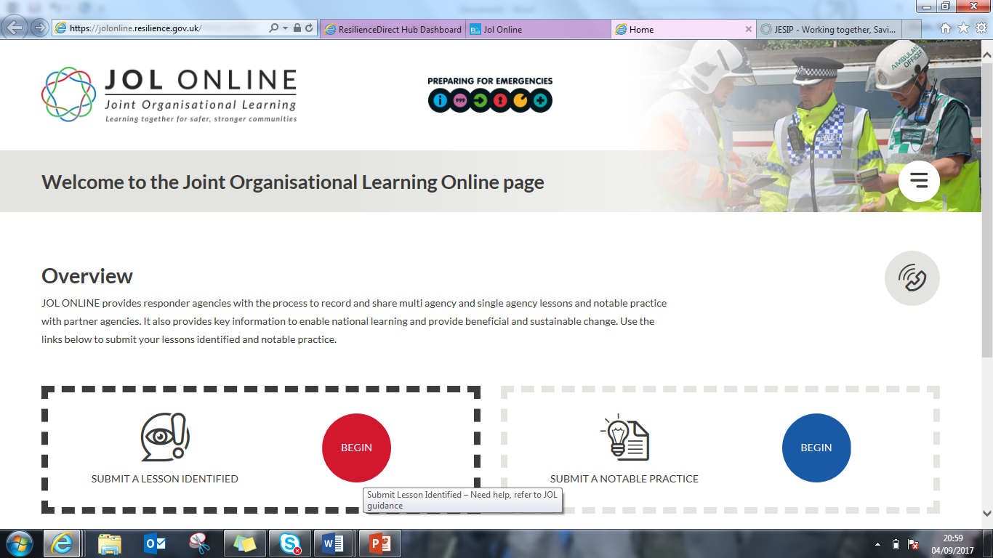


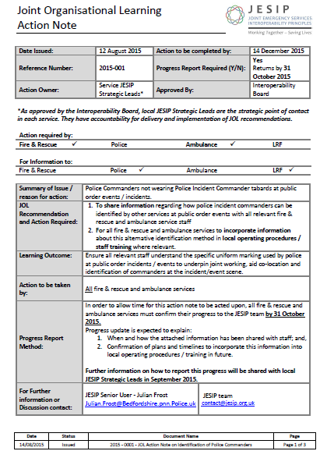
Areas of Learning
Interoperability Board
Interoperability Board
Incidents
Testing and Exercising
Training
Included in local policies & Procedures
Included in local training & exercises
Provided briefings for staff
Doctrine
Recorded who has been briefed & when
Notes:
(Lead Government Department for National risks as well as local Polices, Plans and Procedures)

Slide 43
So what do we put onto JOL Online?
JOL guidance -scope
Nationally recognised Risks
Nationally Recognised Risk Categories
Influence Government and Specialist thinking (numbers, capability for responders etc)
National Planning Assumptions – linking in with local planning assumptions
BREXIT…

Slide 44
How successful had JOL been?
First national system for capturing and sharing multi agency lessons – JOL Online (government sponsored web based service)
National cadre of Strategic, Training and JOL SPoCs across emergency services and Local Resilience Forums
Interoperability Board released six JOL Action Notes….
Notes:
ResilienceDirect is a web-based service built on a proven resilient and secure platform.
ResilienceDirect is a service built for the Resilience Community, by the Resilience Community. Providing a secure platform for sharing information that supports effective multi-agency working and offers a greater sense of shared situational awareness
JESIP Roles and Responsibilities
To assist with the embedding of JESIP by services locally, it is imperative that services have and maintain the key roles that have direct responsibility for the oversight, delivery and embedding of all JESIP activities locally. The JESIP roles are:
Strategic Lead
Training Lead
JOL SPoC(s)
Whilst these roles have been in place since the early part of the programme, their existence has been ad hoc and services sometimes do not fill all roles or failure to inform the JESIP team when one becomes vacant.
Roles & Responsibilities of JESIP Strategic Leads
JESIP strategic leads form a consistent national network across all emergency services and a link from the local level to the national JESIP governance arrangements. For their service, strategic leads must:
Have an appropriate level of delegated authority to make strategic level decisions with regards interoperability on behalf of their organisation.
Have responsibility for implementation and embedding JESIP within their service ensuring JESIP principles are taught on initial training, promotion and via a robust Continuous Professional Development pathway for all staff;
Have responsibility for providing clear lines of evidence supporting compliance with JESIP, where requested, during any JESIP review or assurance process;
Have responsibility for ensuring the recording and reporting of interoperability lessons identified through doctrinal reviews, training, testing & exercising and incidents (via JOL Online); and,
Be a strategic point of contact with accountability for delivery and implementation of recommendations from Joint Organisational Learning.
Roles & Responsibilities of JESIP Training Leads
JESIP training leads should have responsibility for leading on the delivery of training throughout the organisation and in partnership with other emergency responders. The JESIP training lead must:
Have an appropriate level of delegated authority to ensure that specific JESIP training courses are annually written into services’ locally mandated L&D strategy and training delivery plans
Maintain records of commander attendance at multi-agency training courses that deliver JESIP learning outcomes
Provide records of commander attendance at multi-agency training courses and present them to the Interoperability Board quarterly (replace quarterly with when requested)
Maintain and provide records of commanders attending multi-agency exercises and present them to the Interoperability Board quarterly
Have a formal agreement in place for their multi-agency debriefing process and identification and sharing of lessons onto JOL Online
Work with internal departments and partner agencies to ensure that all services develop a formal, written multi-agency agreement for Joint Organisational Learning (e.g. a Memorandum of Understanding) agreed locally and signed off by their respective Local Resilience Forum
Be responsible for the implementation of recommendations from Joint Organisational learning in a training and exercise environment
Roles & Responsibilities of JESIP JOL SPoC
JESIP JOL SPoC(s) should be in a role within their organisation or LRF that has responsibility for capturing lessons from single service or multi-agency debriefs from incidents, exercises and training. The JESIP JOL SPoC(s) should:
Have responsibility for managing their organisations generic JOL mailbox.
Have an awareness and understanding of the Joint Doctrine: The Interoperability Framework and be able to identify relevant lessons or notable practice from debriefs that fall within the scope of JOL
Have appropriate delegated authority and influence to ensure that where JOL Action Notes and other JOL information is communicated to organisations or LRFs then it can be effectively implemented
Have basic IT ability and confidence in using web based applications
Input Lessons Identified and Notable Practice on behalf of their organisation
Have access to Resilience Direct
Where any responder agency changes their JOL SPoC, they must inform the JOL coordinator with their contact details. This will ensure the contact database remains current.

Slide 45
Changing how we debrief and capture interoperability lessons
Introduction of Resilience Standards in partnership with Cabinet Office (CCS)
12 Resilience Standards No 7 – Interoperability
Tranche 2, August 2018 – Joint Organisational Learning
Supported multi agency response to terrorist incidents through doctrine reviews.
Command and Control at Major CT Incidents
Command and Control at CT Siege
CBRNe (JOPS)
Responding to a MTFA and terrorist siege (JOPS)…
Notes:
JOPS – Joint Operating Principles

Slide 46
National Incident Management for HMPPS
Alignment of incident command with JESIP joint doctrine
Combined Tactical Air Cell (CTAC) guidance
Alignment of guidance with JESIP joint doctrine
CONTEST June 2018
Prepare
Fully embed the Joint Emergency Service Interoperability Principles across the emergency services by 2020, to ensure that they can work together effectively in response to a terrorist attack”…
Notes:
HMPPS – Her Majesty's Prison and Probation Service
CONTEST – The Governments Counter-terrorism strategy (CONTEST) 2018. The aim of CONTEST is to reduce the risk to the UK and its citizens and interests overseas from terrorism, so that people can go about their lives freely and with confidence. The strategy runs across 4 key areas –
Prevent
Pursue
Protect
Prepare

Slide 47


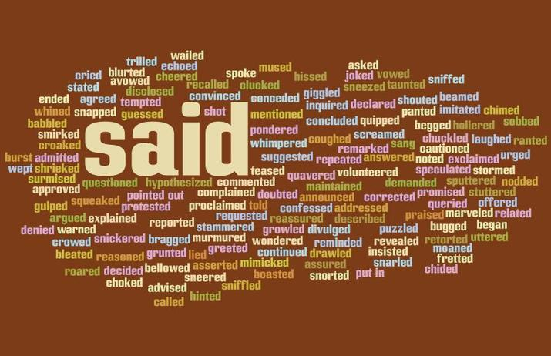
We asked, you said, we did
Notes:
Provide some examples of what we have done
Collaborated JOL and LD
Added calendar
Track lessons
Search easier
Add my likes
etc

Slide 48
JOL Online - changes
Q - Why did you submit this LI/NP?
Grey text in ALL free text boxes to assist end users
Inclusion of LI and NP numbers in search facility
New questions based on use of briefing models
Request of location linked to google maps
Inclusion of reviewers comments (JOL Coordinator) to update LI or NP
Re formatting of NP to align to JOL guidance…

Slide 49
Next steps
Continue to distribute JOL Monthly newsletter
1st edition released June 2018
Production of a quarterly learning and development digest
Ability to pull of reports based on your filter/search criteria (September 2018)
Input of 58 Kerslake recommendations onto JOL Online
Action owners of 17 multi agency lessons to be confirmed by JESIP team and activity to be overseen by Interoperability Board (complete)
Ministerial letter to support use of JOL Online (complete)...

Slide 50



www.jesip.org.uk
contact@jesip.org.uk
@jesip999

Slide 51
over to you
Q3. What systems and processes could you put in place to assist with the challenges?
5 mins to answer
15 mins to feedback

Slide 52
over to you
Q4. What will you do differently following this Workshop?
Q5. What is a good piece of advice you would give to partners about embedding JESIP and JOL?
5 mins to answer both questions
5 mins to feedback both questions

