Slide 1

CONTROL ROOM STAFF
JESIP AWARENESS DISTANCE LEARNING SUPPLEMENTARY MATERIAL
Notes:
Lesson Management;
This package is designed to support the national JESIP on line all staff awareness package. It has not been possible to produce a control room specific control room package. Control room staff should be asked to complete the online package and then review these 13 slides.
Note: A sister product is available to give control room staff awareness of JESIP in a face to face environment. This delivers the same learning outcomes as the all staff awareness package and this PowerPoint presentation.

Slide 2
CONTROL ROOM STAFF
JESIP AWARENESS
Notes:
Staff should complete the national JESIP on line learning products and then review these PowerPoint slides.

Slide 3
EMERGENCY SERVICES CONTROL ROOM
JESIP AWARENESS
THIS IS DESIGNED TO BE USED IN CONJUNCTION WITH THE JESIP ALL STAFF AWARENESS PRODUCT
Notes:
Control rooms play a vital role in managing the early stages of a multi agency incident. There cannot be a coordinated multi agency response or effective communication if control rooms do not deliver a swift and joint approach to handling them.
Control rooms can play a vital role at all stages of managing an incident.
Trainers should describe how all responders configure and run their control rooms differently. This section describes these differences at a high level.

Slide 4
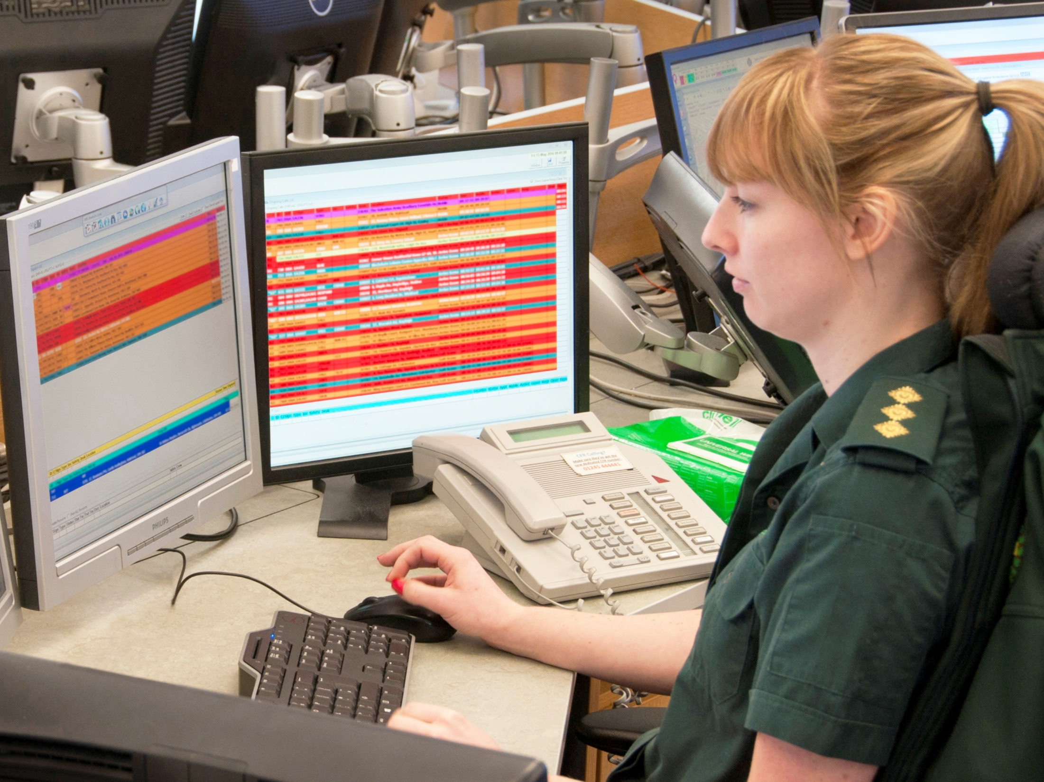

Slide 5
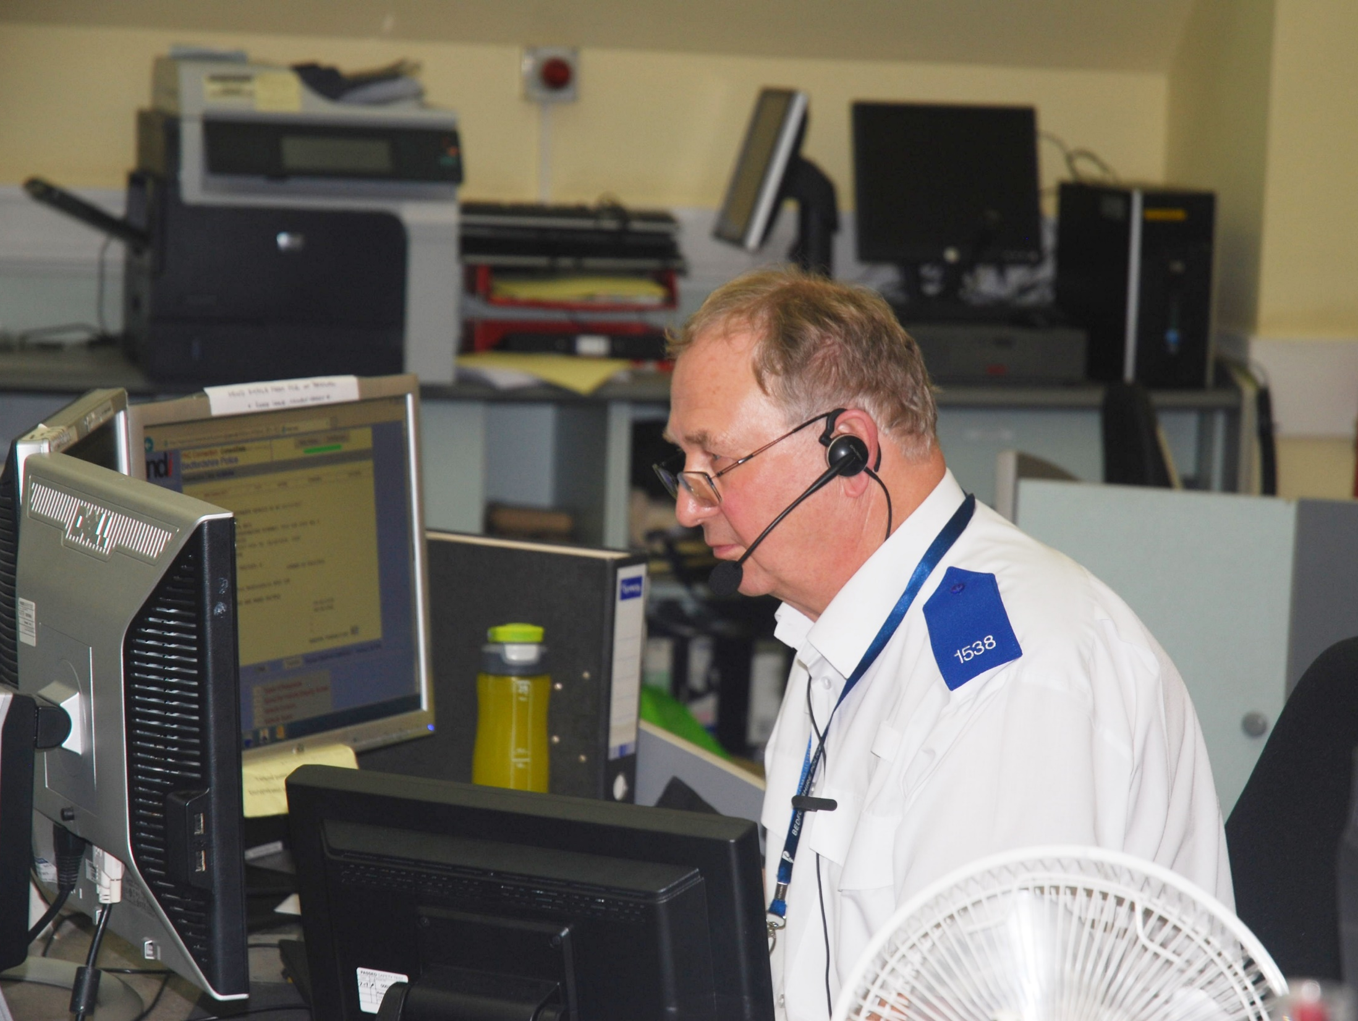

Slide 6
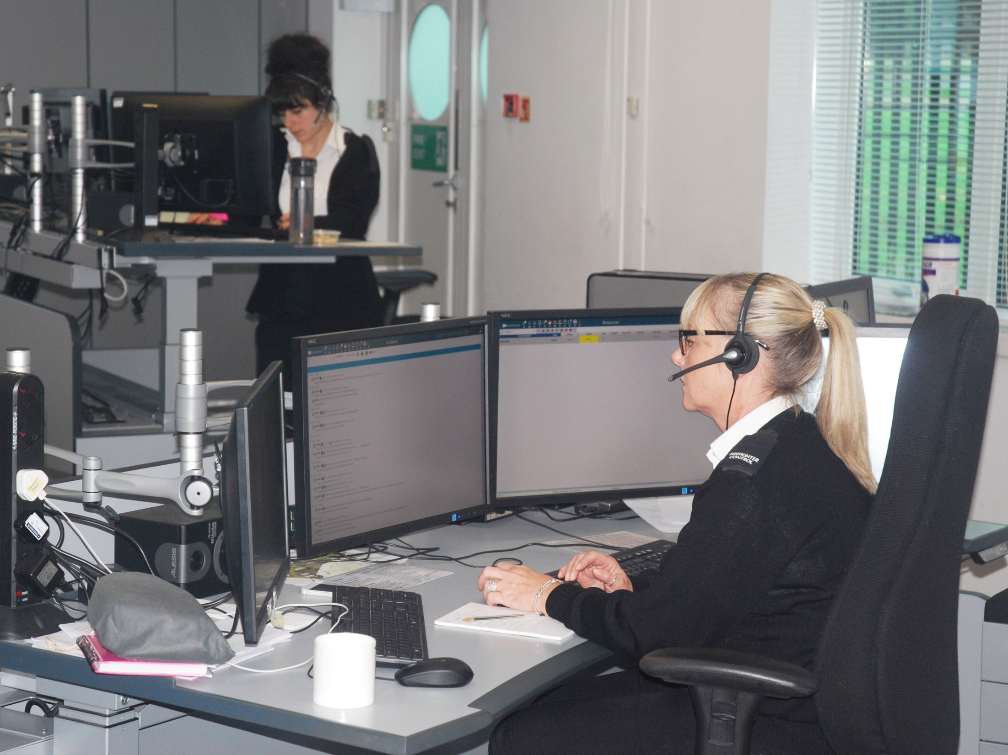

Slide 7

AMBULANCE CONTROL ROOMS
• Will cover a large area on a regional basis
• Receive 999 calls
• Often use ICT systems with clinical algorithms to provide advice and
assist in dispatch decisions
• Have a ‘desk’ system for command and specialist functions
• Normally use mobile data for dispatch
• Mostly use Airwave point to point rather than group calls
Notes:
Trainers should explain that, outside metropolitan areas, ambulance control rooms will tend to cover a wider geographic area that police and fire. Ambulance control rooms will be larger than fire control rooms and similar in size to police control rooms although they will cover a wider geographic area.
Mobile data is the primary means for dispatching ambulances and updating command and control systems. When Airwave is used, the point to point feature is the normal means of voice communication.

Slide 8
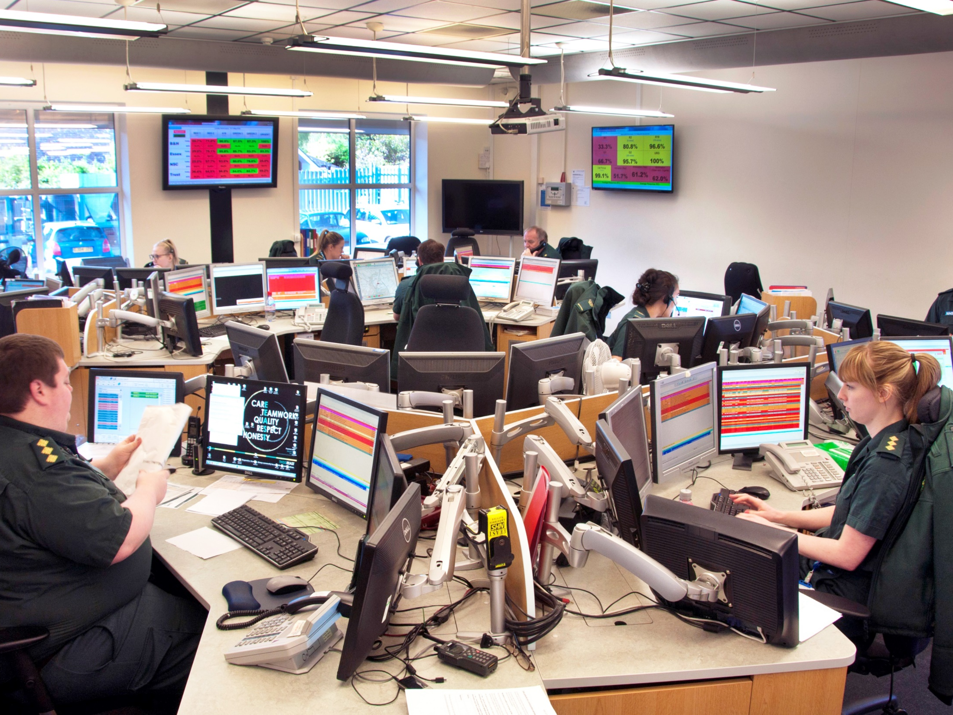

Slide 9
AMBULANCE CONTROL ROOMS
Locally services may wish to work with each other to populate this slide
• How many ambulance control rooms are there
• Where are they located and areas of responsibility
• Typical Number of calls and numbers of incidents generated
• Typical staffing levels
• Key performance indicators
• Command structure
Notes:
Locally services may wish to provide their students with information on responder agency control rooms in their area. This information should be obtained through your LRF, local JESIP training group or similar structure.

Slide 10
COAST GUARD CONTROL ROOMS
• National Structure
• 9 Regional Coast Guard Operation Centres (23 Staff in each)
• 1 National maritime Operations Centre (90 staff)
• Mobilisation and tasking of resources (coast Guard and other agency)
• Tasking of Coast Guard Aircraft
• Command and Control is embedded in control room
• Take 999 and maritime distress calls
Notes:
Each of the regional Coast Guard control rooms covers a geographic area. When a large incident occurs the operations centre covering that area will focus on that incident and another operations centre will take on business as usual for the area.
The Coast Guard is different to the other emergency services as the Operations Centres will often task non- Coast Guard assets to respond. This could include Royal National life Boat Institution assets, merchant shipping, private yachts or military vessels and aircraft,

Slide 11
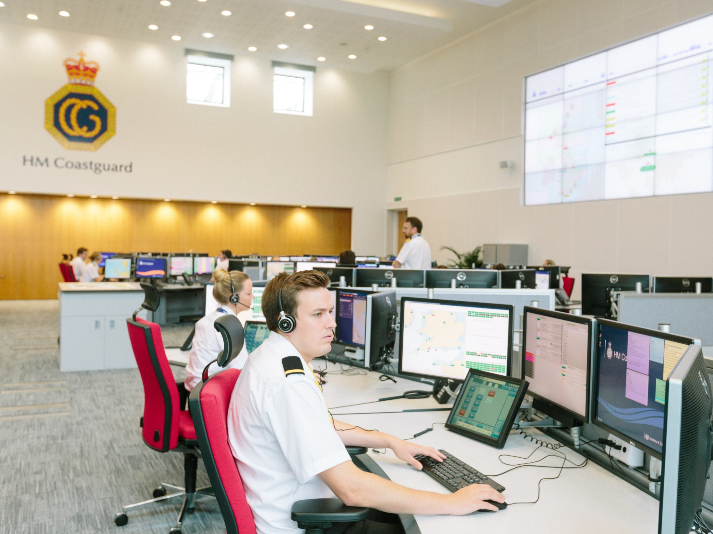

JESIP CONTROL ROOM
COMMANDERS MANAGERS AND
SUPERVISORS COURSE 2017

Slide 12
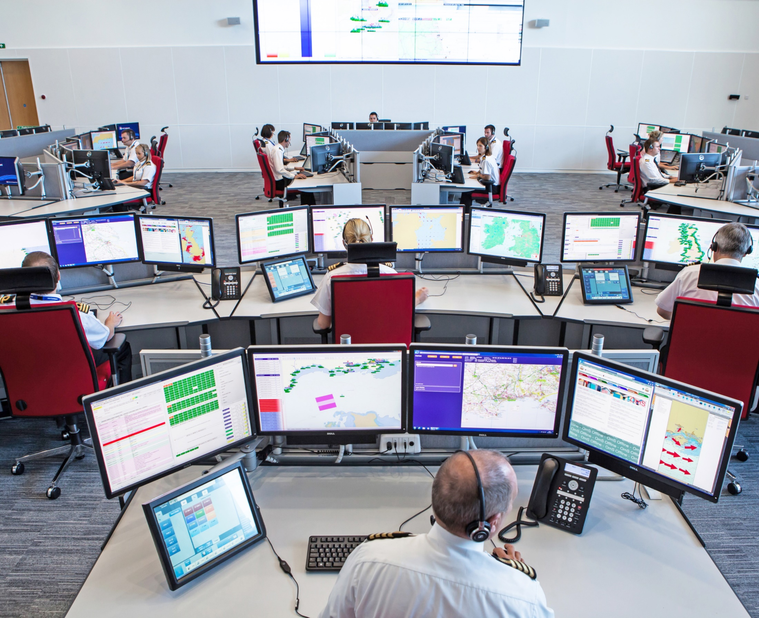
JESIP CONTROL ROOM
COMMANDERS MANAGERS AND
SUPERVISORS COURSE 2017

Slide 13
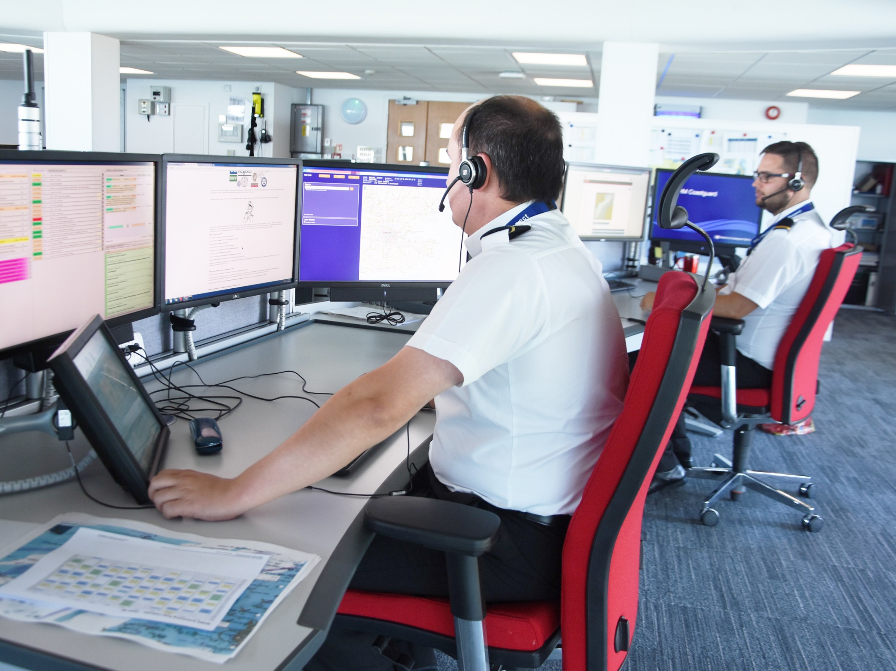
JESIP CONTROL ROOM
COMMANDERS MANAGERS AND
SUPERVISORS COURSE 2017

Slide 14
FIRE CONTROL ROOMS
• Take 999 calls from public
• Mobilise Resources
• Normally no command function
• All staff are trained to perform all roles
• Can manage an incident to initial call to conclusion
Notes:
Typically a fire control room will be significantly smaller that the police and ambulance control rooms for a similar area. This is primarily due to the lower call volumes taken by fire and rescue services than their counterparts.
In most fire control rooms all staff are trained to perform all roles. Unlike ambulance and police control rooms normally there are not different roles for call takers and radio dispatchers.
Most fire control rooms do not have a command function. There role is to allocate and dispatch resources with command always being delivered at the incident ground.

Slide 15
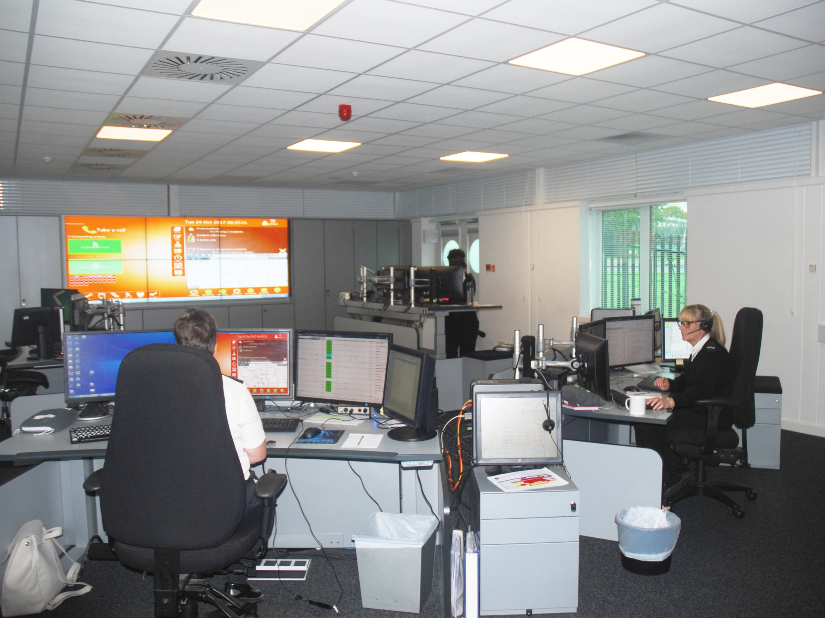

Slide 16
FIRE CONTROL ROOMS
Locally services may wish to work with each other to populate this slide
• How many fire control rooms are there
• Where are they located and areas of responsibility
• Typical Number of calls and numbers of incidents generated
• Typical staffing levels
• Key performance indicators
• Management structure
Notes:
Locally services may wish to provide their students with information on responder agency control rooms in their area. This information should be obtained through your LRF, local JESIP training group or similar structure.

Slide 17
POLICE CONTROL ROOMS
• Take 999 and 101 calls from the public
• Staff often have different levels of training
• people who take calls and create incidents,
• people who dispatch and control officers on the radio,
• Supervisors,
• Often act as a general switch board
• Will dispatch offices to incidents
• Will support officers at incidents
• May provide command for some incidents
• Will command all spontaneous firearms incidents and police pursuits
Notes:
Staff in police control rooms will be trained to different levels. Some may only answer non- emergency calls, some may take emergency calls and some will be trained to work as radio dispatchers.
In some forces the call handling centre will be remote from the radio dispatch control room and in some forces they may be co-located. Some police force control rooms also perform a crime recording and telephone investigation function
There is a significant command capability in a police control. Dispatchers will command smaller incidents whilst vehicle pursuits will be commanded by control room supervisors. The majority of police firearms deployments will be commanded from police control rooms.

Slide 18
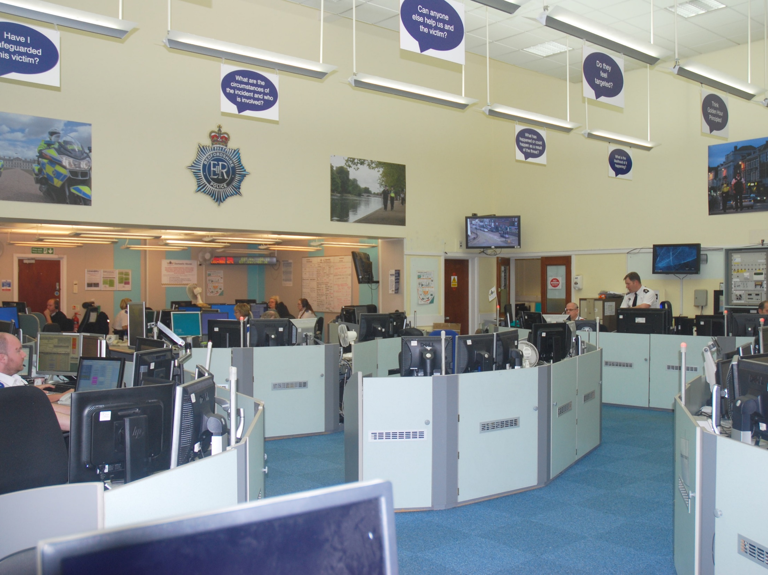

Slide 19
POLICE CONTROL ROOMS
Locally services may wish to work with each other to populate this slide
• How many police control rooms are there
• Where are they located and areas of responsibility
• Typical Number of calls and numbers of incidents generated
• Typical staffing levels
• Key performance indicators
• Management structure
Notes:
Locally services may wish to provide their students with information on responder agency control rooms in their area. This information should be obtained through your LRF, local JESIP training group or similar structure.

Slide 20
INSERT TEXT
Insert text

Slide 21
COMMUNICATION BETWEEN CONTROL ROOMS
A dialogue between control room supervisors should be establish as soon as possible in some incidents…
The best way to do this is to use the Airwave system.
In every area there will be a hailing talk group that all emergency services can use.
There are a number of national and local talk groups that can be used by responders to speak to each other
Notes:
Trainers should remind groups that hailing talkgroups should only be used for initial contact
The most likely talkgroup to be used will be one of the Emergency Services talkgroups, Normally known as ES 1 to 10 in most of Great Britain. These are normally allocated by the police but use can be requested by any service.
Plain English should be used on these talkgroups and call signs should not be used, instead staff and assets should be described by function. Agencies that use the ‘request to speak’ function for business as usual should not use it on shared talkgroups.
A similar system is in place in Northern Ireland but this is not compatible with Airwave.

Slide 22


Slide 23
STUDENTS SHOULD NOW COMPLETE THE JESIP ONLINE AWARENESS PRODUCT

